Slide 1
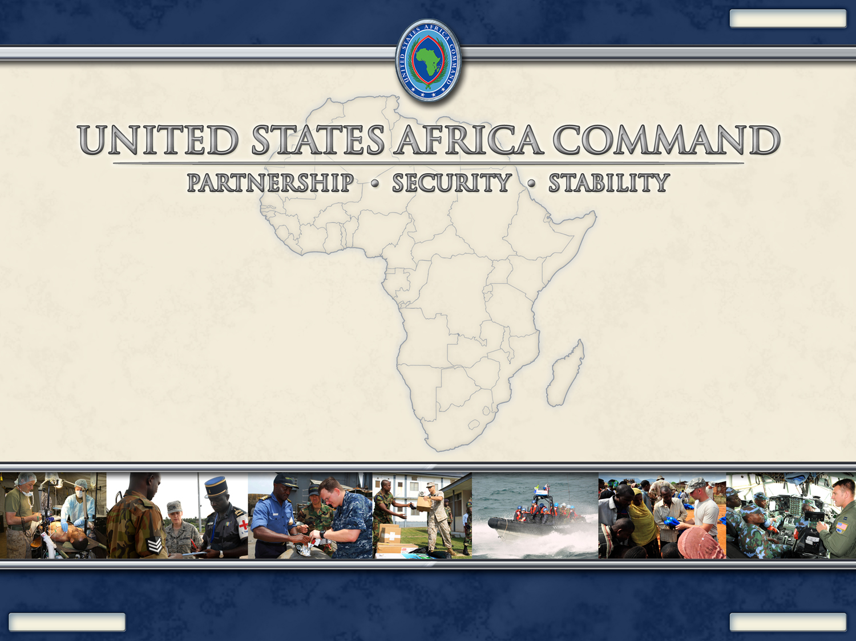
UNCLASSIFIED
An Integrated Strategic Framework for Stabilization and Reconstruction in Liberia
Ms. Ann Campbell
Vesion Apr 2011
UNCLASSIFIED
Notes:
Good Morning. For those of your I may not have met, I am Ann Campbell . I am currently assigned to the U.S. Africa Command Resource (J8) Directorate in the Strategic Capabilities and Analysis Division as an Operations Research Analyst. I am also a retired Civil Affairs Officer . My last two years on Active Duty were with the Joint Staff/J5a working on metrics for the Interagency Process for Iraq and Afghanistan. I am a graduate of the U.S. Naval War College with a Master’s Degree in National Security and Strategic Studies. Prior to my current assignment, I was also a student in Master’s Degree Program in Peace operations at George Mason University.

Slide 2
Outline
Context
Purpose
Recommendations
Discussion
Notes:
This is the outline I will follow. I would like to provide context for my presentation by briefly reviewing the U.S. Africa Command.

Slide 3
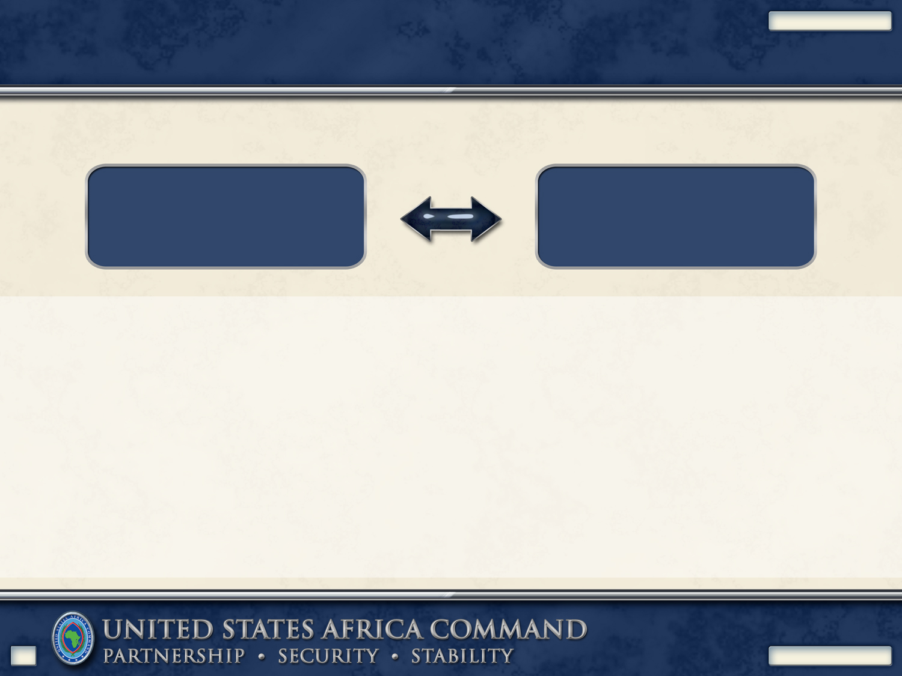
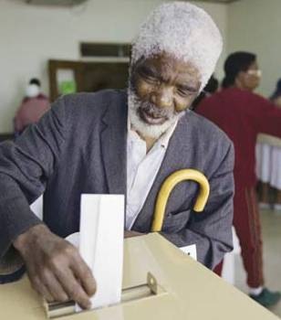
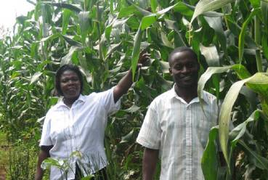
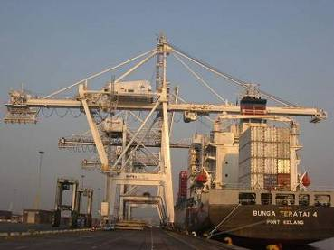
UNCLASSIFIED
Strategic Importance of Africa to U.S.
U.S. National Security Interests
Protection of U.S.
Lives and interests
In Africa
Stability that allows
Africans to leverage
opportunities
Opportunities
Will and action to build security
capacity and foster cooperation
Improving governance, building
Institutions, extending services
Greater geopolitical involvement
Economic development and
potential for U.S. investment
2
UNCLASSIFIED
Notes:
Africa is important the U.S. Because of our National Security interests, which are providing protection of U.S. lives and interests in Africa and fostering stability that allows Africans to leverage opportunities. Those opportunities include: (1) Will and action to build security capacity and foster cooperation; (2) Improving governance, building
Institutions, extending services; (3) Greater geopolitical involvem ent; and (4) Economic development and potential for U.S. investment.

Slide 4
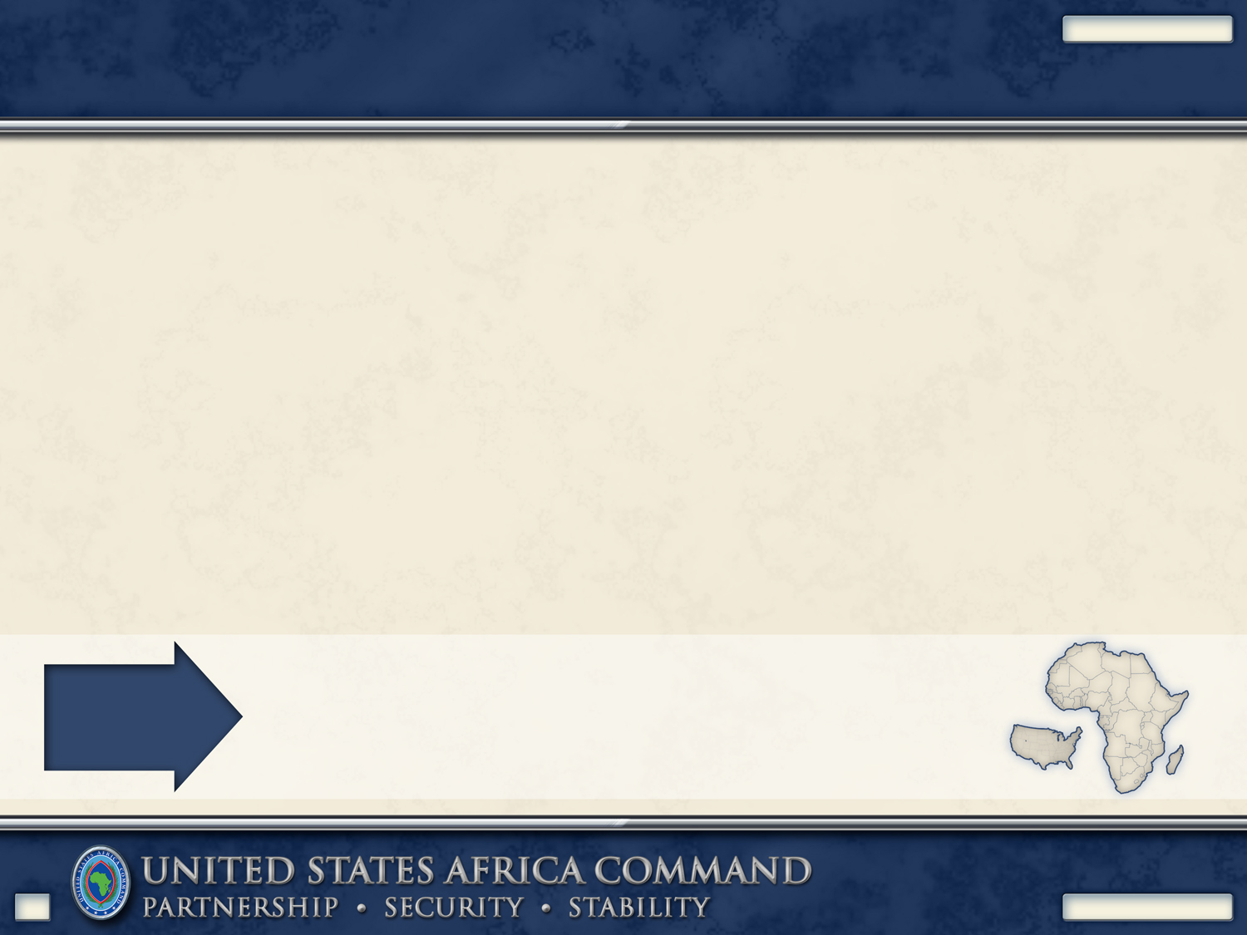
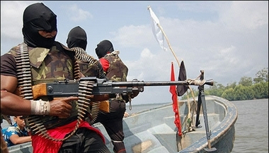
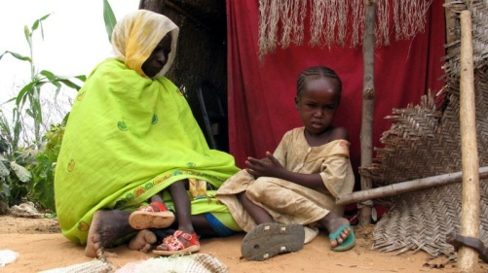
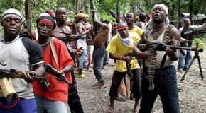
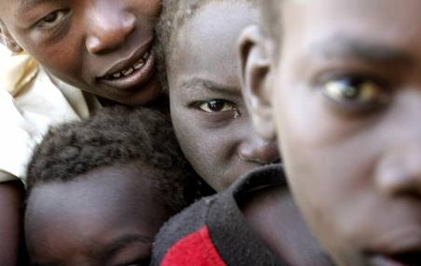
UNCLASSIFIED
African Problems are Global Security Challenges
Trafficking
Piracy
Irregular Militaries
Growing Transnational Extremism
Ethnic Strife and Instability
Poor Governance and Corruption
Pandemic Disease – HIV/AIDS, Malaria
Insufficient Means to Confront Challenges
Dependence on Foreign Assistance
11.7 million square miles
3-1/2 times the Continental United States
53 Nations, 1 Billion people
Expected to double by 2050
Over 800 ethnic groups and 1000 languages
Large Diverse
Complex
3
UNCLASSIFIED
Notes:
African Problems are Global Security Challenges. Some of the challenges include: (1) Trafficking, (2) Piracy, (3) Irregular Militaries,
(4) Growing Transnational Extremism, (5) Ethnic Strife and Instability, (6) Poor Governance and Corruption, (7) Pandemic Disease – HIV/AIDS, Malaria, (8) Insufficient Means to Confront Challenges, and (9) Dependence on Foreign Assistance.
Africa is a large, diverse and complex continent. Its area is 11.7 million square miles. Africa is 3-1/2 times the area of the Continental United States. Africa includes 53 Nations, and 1 billion people. The population of Africa is expected to double by 2050. There are over 800 ethnic groups and 1000 languages spoken in Africa

Slide 5
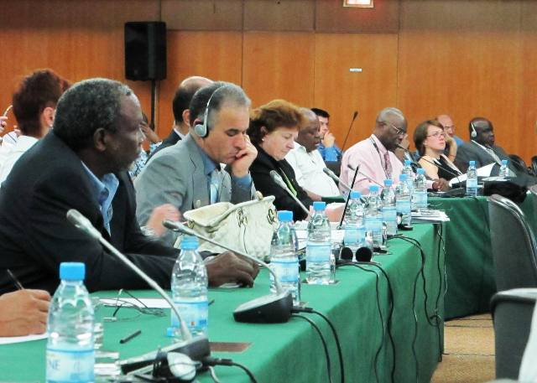
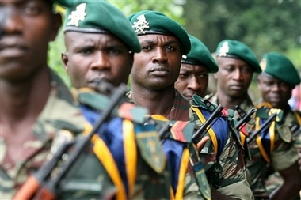
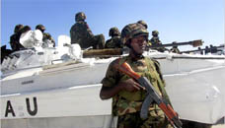
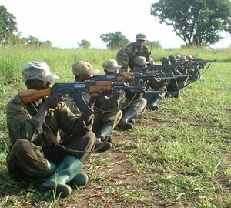
The Security-Focused Vision for Africa…
…As expressed by our African Partners
Capable, accountable, and
self-sustained security forces
Strengthened
Security Institutions
Able to support and lead
international peace efforts
Ability and will to confront
current and future threats
4
Notes:
The Security-Focused Vision for Africa, as expressed by our African Partners includes four key elements: (1) Capable, accountable, and
self-sustained security forces, (2) Strengthened Security Institutions (3) Able to support and lead international peace efforts, and (4)
Ability and will to confront current and future threats.

Slide 6
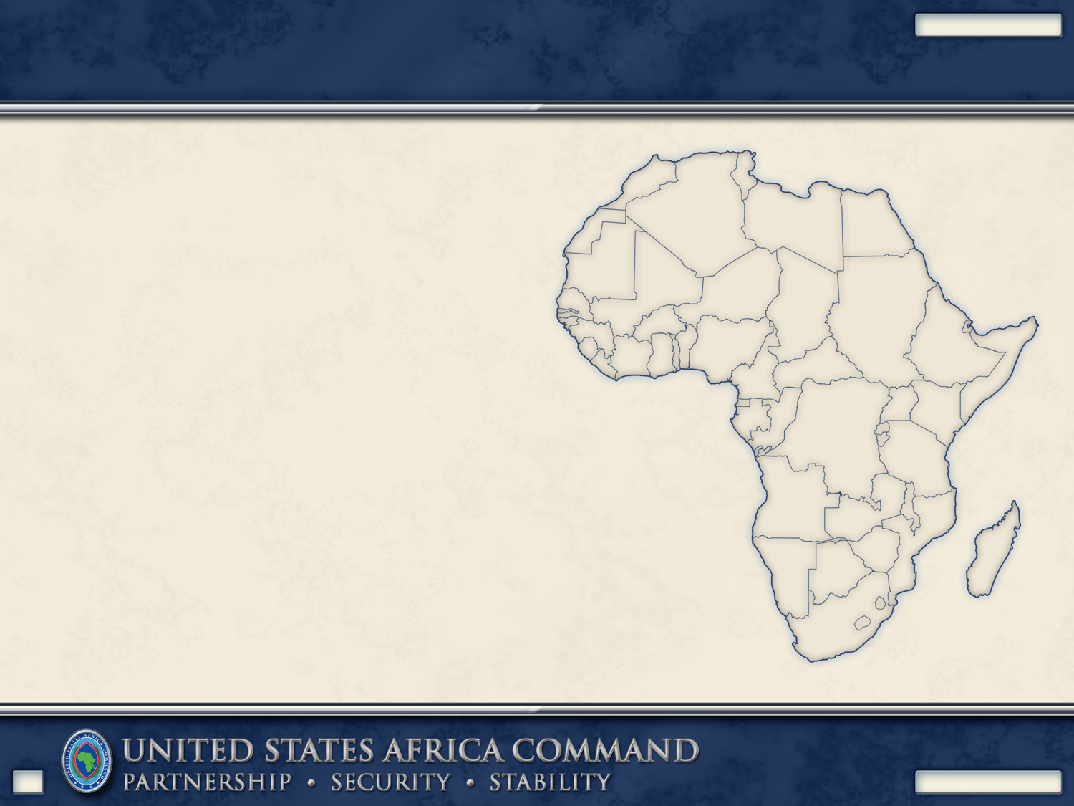
Mission
UNCLASSIFIED
United States Africa
Command,
in concert with other U.S. Government agencies and international partners,
conducts sustained security engagement
through military-to-military programs, military-sponsored activities, and other military operations as directed
to promote a stable and
secure African environment
in support of U.S. foreign
policy.
5
UNCLASSIFIED
Notes:
The mission of the U.S. Africa Command is shown here.

Slide 7
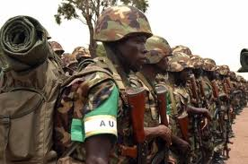
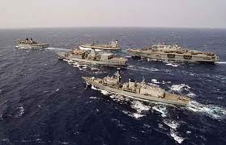
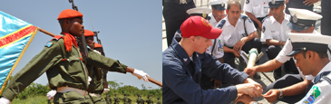
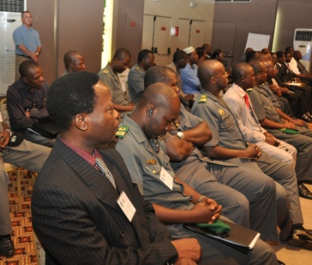
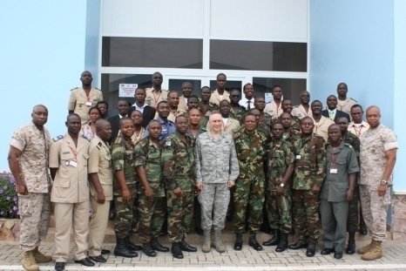
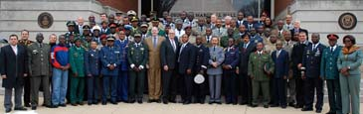
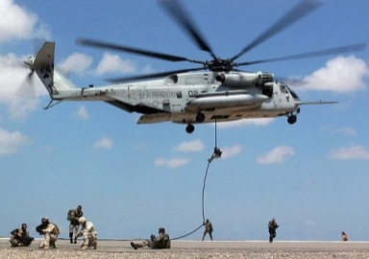
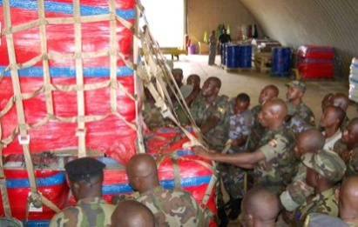
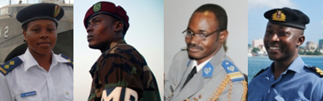
Role
Joint Military Activities
Security Force Assistance
Enable African Operations
Build Operational Capacity
Foster Strategic Relationships
Build Institutional Capacity
African Partner Requirements
U.S. Foreign Policy Objectives
Provide Crisis Response
Grow Human Capital
6
Notes:
African Partner Requirements drive U.S Foreign Policy Objectives. The U.S. Africa Command role includes: (1) Joint Military Activities, (Enable African Operations, and Provide Crisis Response) and (2) Security Force (Build Operational Capacity, Build Institutional Capacity , and Grow Human Capital).

Slide 8
Purpose
To identify an Integrated Strategic Framework for Stabilization and Reconstruction in Liberia (and other countries in the U.S. Africa Area of Responsibility)
Notes:
The purpose of this paper is to identify an Integrated Strategic Framework for Stabilization and Reconstruction in Liberia (and other countries in the U.S. Africa Area of Responsibility). The focus is on an Interagency U.S. Government framework that includes the elements of US Strategy & Policy that pertain to Liberia.

Slide 9
Limitations
US Strategy & Policy for Liberia Linkage to US Strategy & Policy for West Africa
US Strategy & Policy Linkage to International Strategy & Policy
Notes:
There are limitations to the scope of this paper. Two aspects that are important, but not within the scope of this paper are: (1) linkage to US Strategy & Policy for West Africa and (2) linkage of U.S. Strategy & Policy for Liberia to International Strategy & Policy for Liberia.

Slide 10
Recommendation #1
Adopt Guiding Principles for Stabilization and Reconstruction * as the Integrated Strategic Framework for Planning US Government Support to Liberia
*Developed by the United States Institute of Peace and the United States Army Peacekeeping and Stability Operations Institute
Notes:
This is the first recommendation.

Slide 11
Recommendation #2
Use results of Interagency Conflict Assessment Framework (ICAF) * process to assess conflict situations and identify conflict drivers in preparation for Planning US Government Support tin Liberia
*Developed by a U.S. Government Interagency Working Group co-chaired Department of State (S/CRS) and USAID (Office of Conflict Management and Mitigation) with Agriculture, Defense, State, Treasury and USAID representatives (May 2010)
Notes:
This is the second recommendation.

Slide 12
Recommendation #3
Use Liberia Poverty Reduction Strategy * to synchronize Liberian Goals and Objectives in the process of Planning US Government Support to Liberia
*Prepared by the Government of Liberia in broad consultation with stakeholders and development partners, including the staffs of the World Bank and the IMF (Jul 2008)
Notes:
This is the third recommendation.

Slide 13
Discussion
Planning Process
Strategic Assessment
Concept
Theory of Change
Notes:
Planning Process: The U.S military planning process is based on doctrine, as described in a series of Joint Publications. Assessment is part of the planning process and is used to measure progress toward mission accomplishment.
Strategic Assessment: At the strategic level, assessment focuses on tasks, effects, objectives and progress toward the end state. Strategic assessment helps the commander determine if the military force is “doing the right things.” T
Concept:T he concept is to provide a “logical” frame of reference for synchronizing actions or tasks. This is not to say that a cause and effect relationship exists between the tasks and effects, but rather a correlation between accomplishment of the effects and the associated effects.
Theory of Change: An alternative paradigm within which to consider stability is that of decreasing conflict while increasing Partner capability 9as described in “The Quest for Viable Peace”.

Slide 14
Conclusions
End State and Mission
Objectives
Effects
Tasks
Notes:
The End State is Stability.
The USG Mission is in concert with international partners to reduce conflict and increase capability of partner nations to promote a stable and secure African environment in support of U.S. foreign policy.
Guiding Principles for Stabilization and Reconstruction, identifies Objectives are: (1) Safe and Secure Environment, (2) Rule of Law, (3) Stable Governance, (4) Sustainable Economy, and (5) Social Well-Being. What has to be done next is to link objectives to effects and tasks. “Guiding Principles” provides a menu of conditions or effects from which to choose. Tasks can then be selected with which to achieve the effects.
Interagency Conflict Assessment Framework (ICAF) (ICAF) is a tool that provides analysis upon which to base objectives, effects and tasks to reduce conflict.
Liberia Poverty Reduction Strategy (PRS) to synchronize U.S. goals and objectives with those of the Government of Liberia in the process of planning U.S. Government support to Liberia to increase capability and decrease conflict.

Slide 15
Guiding Principles for Stabilization & Reconstruction
Objectives
Safe and Secure Environment
Rule of Law
Stable Governance
Sustainable Economy
Social Well-Being
Notes:
The End State is Stability.
The Objectives are: (1) Safe and Secure Environment, (2) Rule of Law, (3) Stable Governance, (4) Sustainable Economy, and (5) Social Well-Being.
What has to be done next is to link objectives to effects and tasks.
“Guiding Principles” provides a menu of conditions or effects from which to choose. Tasks can then be selected with which to achieve the effects.

Slide 16
Guiding Principles for Stabilization & Reconstruction
Safe and Secure Environment Conditions = Effects
Cessation of Large Scale Violence
Public Order
Legitimate State Monopoly Over Means of Violence
Physical Security
Territorial Security

Slide 17
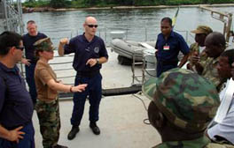
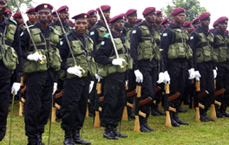
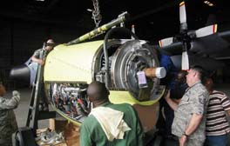
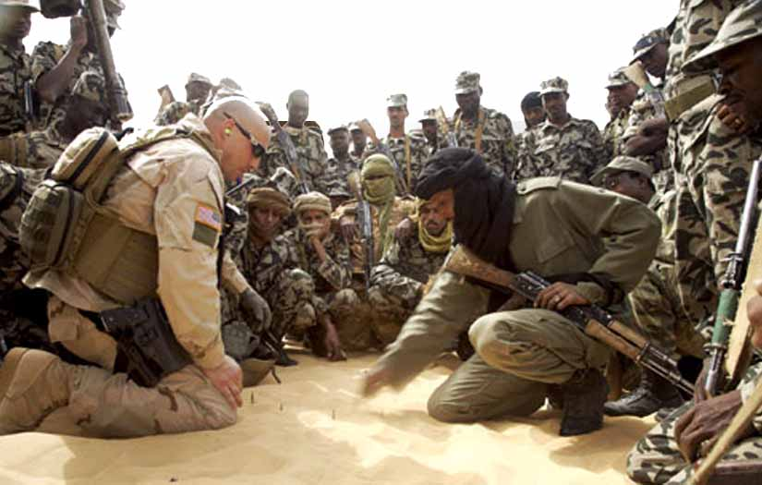
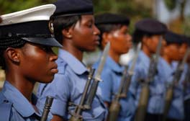
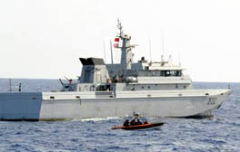
Building Capable and Accountable Forces
Adaptive Logistics Network
Africa Partnership Station (APS)
DRC Light Infantry Battalion
Balancing Ground, Maritime, and Air Capabilities
Providing Training and Equipping Programs
Growing Enabling Capacity – Logistics, Comms, Engineer, and others
OEF-TS
NCO Professional Development Programs
Africa Maritime Law Enforcement Program (AMLEP)
Supporting Partner Counterterrorism Efforts
Building Strong Non-Commissioned Officer Corps
Helping Secure Territorial Waters
7

Slide 18
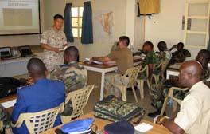
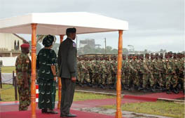
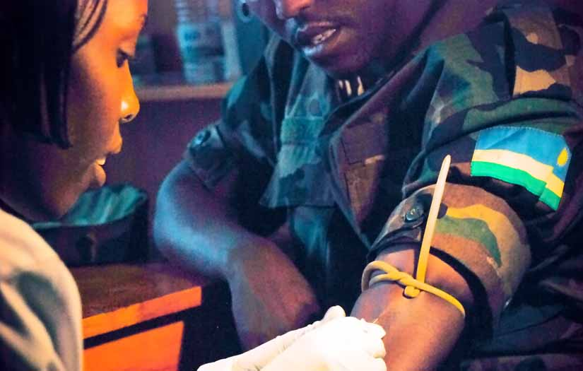
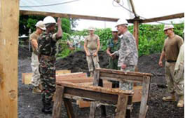
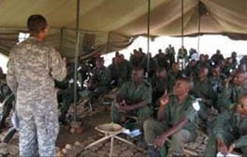
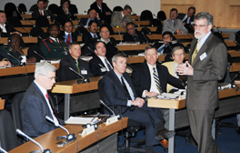
Strengthening Security Institutions
MI Basic Officer Course - Africa
Armed Forces of Liberia
Defense HIV/AIDS Prevention Program
Enhancing Professional Military Education
Contributing to Security Sector Reform (SSR)
Preserving Readiness of the Force
Chaplaincy, Legal Counsel,
Inspectors General, and others
Exercise Related Construction
USAFRICOM Academic Symposia
Building Military and Dual-Use Infrastructure
Enhancing Accountability
And Transparency
Engaging in Dialogue
8

Slide 19
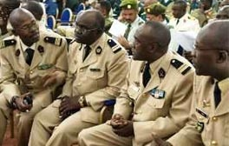
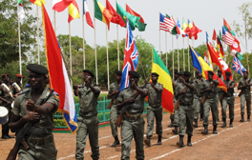
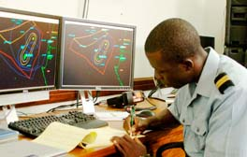
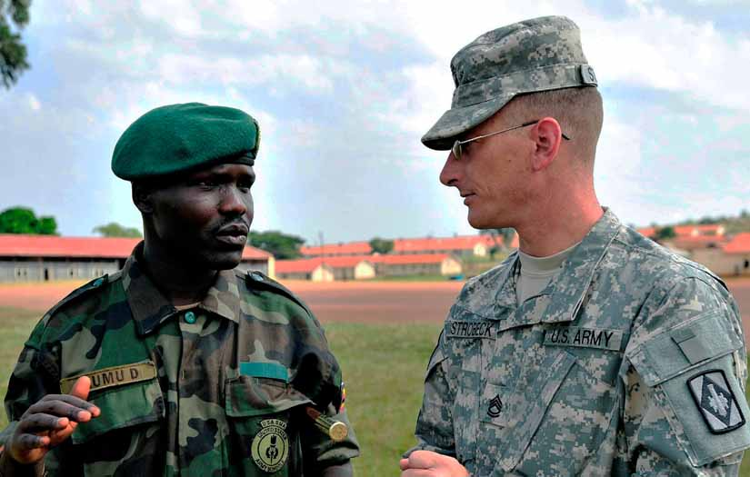
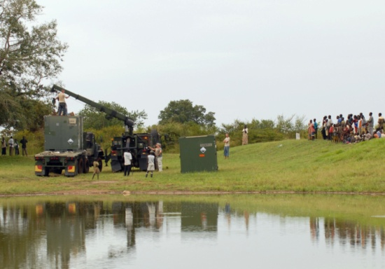
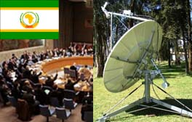
Promoting Cooperative Efforts
AFRICA ENDEAVOR
FLINTLOCK
Maritime Safety and Security Information System
Promoting Interoperability
Supporting Regional Counterterrorism Efforts
Improving Control of the Seas
State Partnership Program
NATURAL FIRE
African Union Peace Support Operations Center
Developing Lasting Relationships
Supporting Regional Crisis Response Exercises
Supporting the African Union’s African Standby Force
9

Slide 20
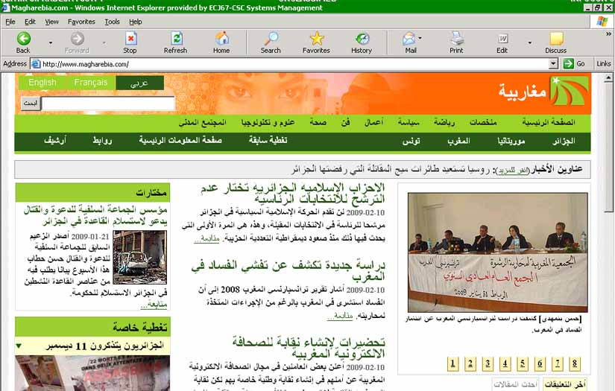
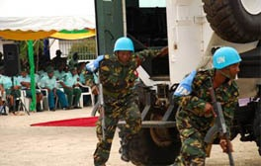
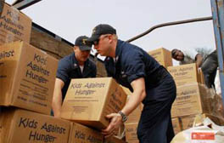
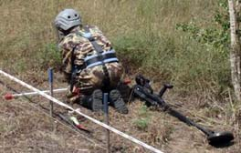
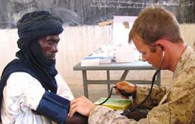
Working to Prevent / Mitigate Conflict
OBJECTIVE VOICE
Africa Contingency Operations Training and Assistance (ACOTA)
Humanitarian Civic Outreach Program
Countering Violent Extremist Ideologies
Training Peacekeepers
Supporting Improved Civil-Military Relations
Project HANDCLASP
Humanitarian Mine Action Programs
MEDCAP / VETCAP / DENTCAP
Supporting Humanitarian Assistance Efforts
Rendering Former Battlefields Safe for Use
Spreading Goodwill
10

