Slide 1
Metrics Modeling as base for Simulations of Complex Environments
Professor D.F. Davis
George Mason University – ddavis@gmu.edu
US Africa Command – david.davis@africom.mil
LMI – ddavis@lmi.org
The Institute for Defense Analyses – ddavis@ida.org
Take your pick!

Slide 2
Metrics modeling: Using the metrics framework as the base for analysis.
All assessment/metrics/evaluations normally consist of a set of measurements that are aggregated to some overall meaning. This aggregation technique is what I’m referring to as a metrics model.

Slide 3
Most Frequent
Top down decomposition aggregated by Multi-Attribute Utilities
Most Important
Next Important
Next Important
Next Important
And so on….

Slide 4
However
If and only if the decompositions are collectively exhaustive and mutually exclusive – cover every thing, doesn’t leave anything out, and are independent in definition.
Most common error is that they are nowhere near independent, and are often highly dependent. Of course, knowing that you have included all necessary elements is always risky.
But, they are easy to use and all you have to do is determine the weights.

Slide 5
Bumper Sticker
Metrics need to be organic to the plan, not appliquéd.

Slide 6
Value Focused Metrics
Use decomposition for only the highest level, fundamental or strategic elements (Fundamental Objectives Hierarchy or FOH) – be careful and don’t expect much.
Use a Means Ends Objectives Network (MEON) to represent the intermediate, dependent objectives and exploit the relationships. This is difficult because it requires that you graph your understanding of the inherent theory of change.
Identify for some or all of the objectives metrics that would indicate the level of achievement of that objective.

Slide 7
Value Focused Metrics - 2
Objectives should be written as something you wish to achieve. If they can be caused to happen directly, they are tasks or activities, not objectives.
Therefore tasks are something that you identify and execute with the hope that they will assist in the achievement of the objectives.
The MEON represents how you believe the objectives support one another and propagate the results of activities up to the achievement of the fundamental objectives.

Slide 8
The System
Outcome
Metrics
Fundamental Objective
Hierarchy
Means Ends
Objective Network
Process
Metrics
Triggers
Controls, Activities,
Programs, Projects

Slide 9
The Process
Develop the strategic and fundamental objectives
Create a Means Ends Objectives Network (MEON)
Identify candidate metrics
Identify activities that influence the MEON
Identify triggers for events
Exercise the model to validate and develop understanding

Slide 10
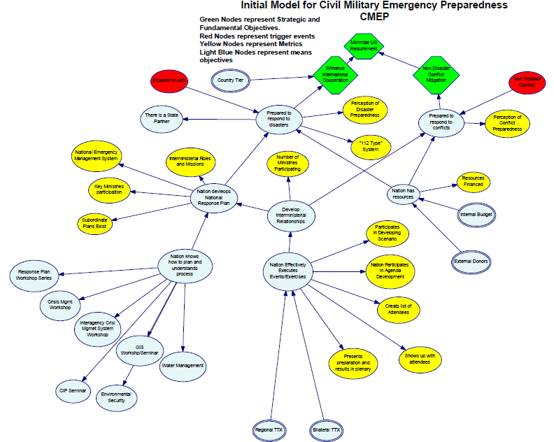
A Model

Slide 11
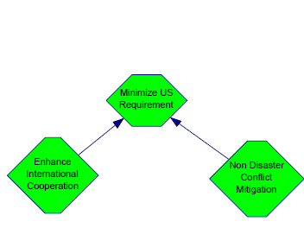
Strategic and Fundamental
Objectives

Slide 12
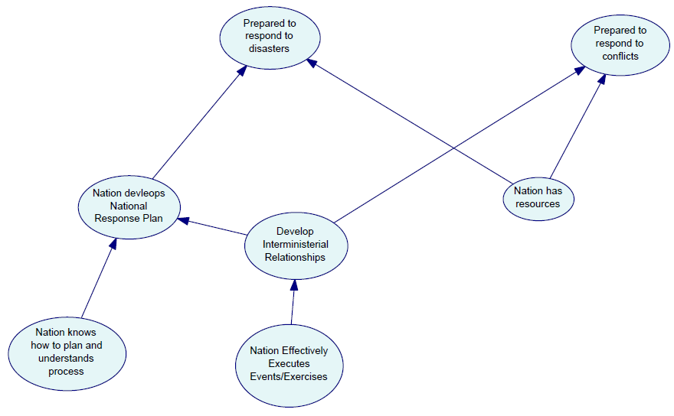

Means Ends Objectives
Network (MEON)

Slide 13
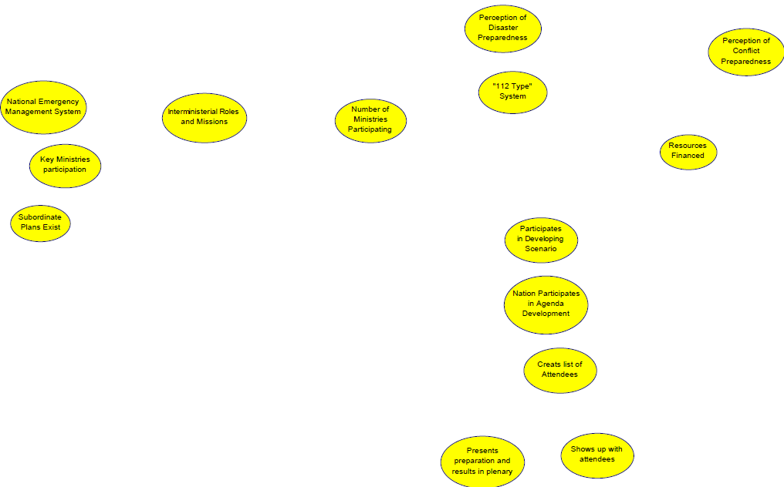
The Metrics
Perceptions
“112 Types”
Resources Financed
Interministerial Roles and Missions
Number of ministries participating
National Emergency Management System
Key Ministries Participate
Subordinate Plans Exist
Participates in Developing Scenarios
Participates in Agenda Development
Creates List of Attendees
Shows up with Attendees
Presents in plenary

Slide 14
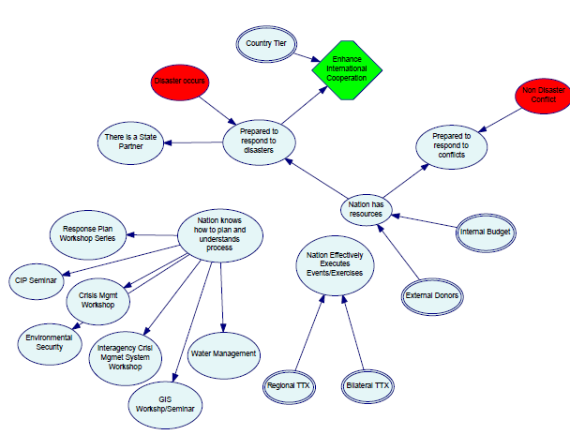
The Rest
Uncertain Events
Things that can be
controled
Things that might be influenced

Slide 15
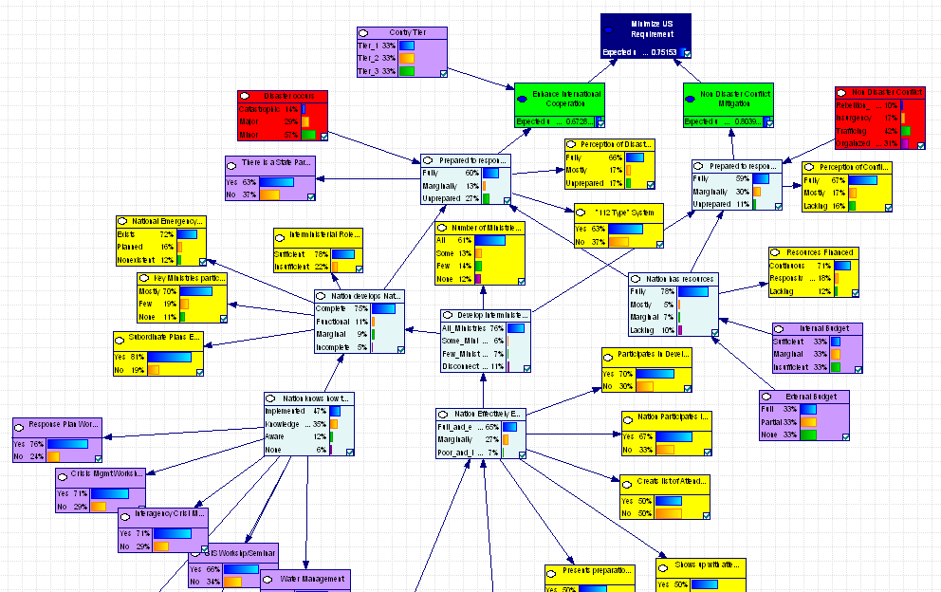
Initial State

Slide 16
Initial State
The initial state of the system depends on your prior beliefs in how the objectives relate and how the tasks impact the objectives. It also depends on what your assessment of the relationship between the actual state of the objective and the measures that may be collected.
Lots of numbers, lots of data, difficult to ‘understand.’

Slide 17
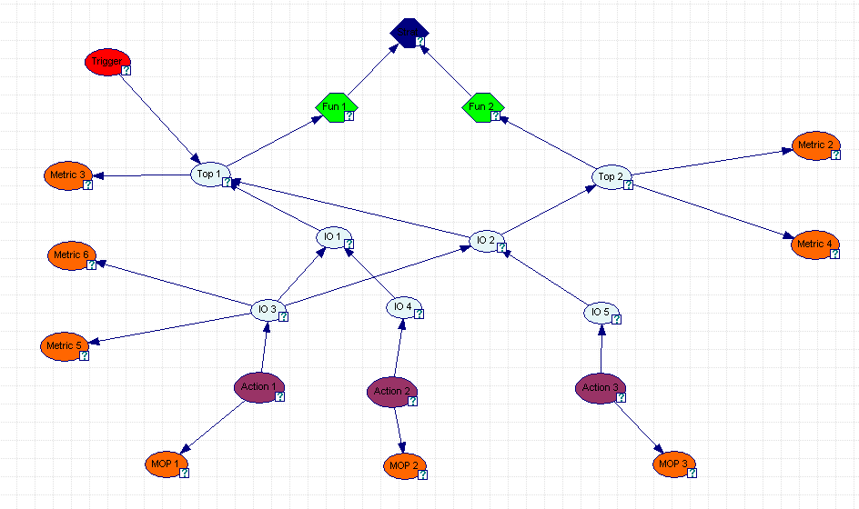
Test Model

Slide 18
Sample Results

Slide 19
Issues
VFM allows for beliefs and hard data.
Missing data valued by prior beliefs
Lots of data and elicitation
Mathematically defendable
Very hard to brief
…

Slide 20
Simulation Claim
By varying the accomplishment of tasks in a structured, but randomized way, a simulation of the system can be constructed. Haven’t done it yet, but think I know how.

Slide 21

Questions?

