Slide 1

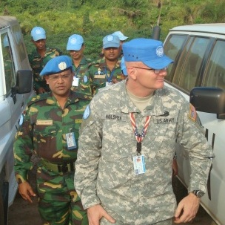
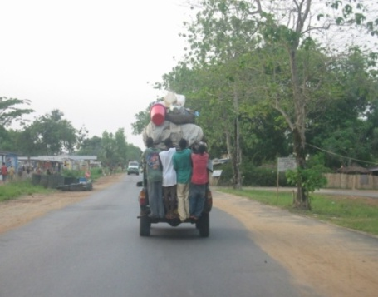
Multinational Civil-Military Approaches to Transition to Peace Management - The Liberia Experience
Cornwallis XVI:
Analysis For Future Conflict
http://www.TheCornwallisGroup.org
Col. (ret.) Christopher Holshek
20 April 2011

Slide 2
From Kabul to Monrovia…
Transferring “lessons” from Iraq-Afghanistan is problematic largely because the context for such engagements is vastly different: “Winning hearts and minds” and PRTs, for example, have more limited application in the Horn of Africa and the Congo. Among the contextual considerations:
U.S. security engagements in have been threats-based, post-conflict, counterinsurgency-centric, and within a characteristically American national security context; however, in places like Africa, which represent bulk of security and development challenges, human security and civil society challenges such as poverty and food security, rule-of-law and justice, governance, economic development and job creation, and public health are foremost, calling for more conflict prevention, peace (versus “stability”) operations, and comprehensive approaches.
In Africa, the U.S. is never the lead and hardly the dominant player.; the UN and regional organizations such as the AU and ECOWAS are, with an array of bilateral and non-state actors also shaping the outcome – the U.S. among one of many. Security engagements are more multinational then lead-nation, guided by corresponding rule-sets and models.
Resources are more limited outside the Iraq-Afghanistan box, which has received more money in security assistance and development aid from the U.S. than Africa and Latin America together has from the whole world. As the U.S. fiscal crisis grows, the more creative and collaborative approaches borne out of such a restraints, such as microfinancing, are more commonplace than the American reflex to “throw money at the problem”.

Slide 3
…or from Monrovia to Kabul?
Additionally, as the U.S transitions from a “military mission to a civilian-led effort” in Iraq and prepares to undergo a similar conversion in Afghanistan, it may be helpful to examine the transition from military-intensive post-conflict peacekeeping to civilian-led peace building with the aim of preventing a return to conflict in a major multinational intervention in Africa led by the United Nations Mission in Liberia (UNMIL), perhaps the most integrative of UN field missions. Equally important is the role of the U.S. Country Team in Liberia, which is not only working collaboratively with the Government of Liberia and UNMIL to enhance their goals common to U.S. national interests, especially security sector reform, but also with those of international partners to include China in fostering civil society and economic development.
Thus, how we understand the contextualization of security interventions in the larger world beyond Iraq and Afghanistan will not only have profound and far-reaching implications for U.S. whole-of-government engagements at the theater, operational, and tactical levels in other places abroad. It could also help us re-shape our approach to national security writ large back at home.

Slide 4
UNMIL IN TRANSITION
Source: United Nations Peacekeeping Operations Principles and Guidelines, 2008
Notes:
4
4
This is how DPKO views the essential phases and tasks of peacekeeping operations according to its newly released capstone doctrine. UNMIL is currently entering the transition/handover phase of the Mission. As it transitions from stabilization to consolidating peace, shown in the second diagram, it must concentrate its tasks around facilitating the political process, supporting the restoration and extension of state authority, and providing a framework for the international development community to consolidate the gains in stabilization and security. Note the specific post-conflict tasks listed in the diagram. This has heavy implications for CIMIC…

Slide 5
TROOP CONTRIBUTING COUNTRIES
Bangladesh
Benin
Bolivia
Brazil
China
Croatia
Czech Republic
Denmark
Ecuador
El Salvador
Egypt
Ethiopia
Finland
France
Gambia
Ghana
Guinea Bissau Indonesia
Ireland
Jordan
Kenya
Korea
Malawi
Malaysia
Mali
Moldova
Mongolia
Namibia
Nepal
Netherlands
Niger
Nigeria
Pakistan
Paraguay
Peru
Philippines
Poland
Romania
Russia
Senegal
Serbia
South Africa
Togo
Ukraine
United Kingdom
United States
Zambia
Zimbabwe

Slide 6
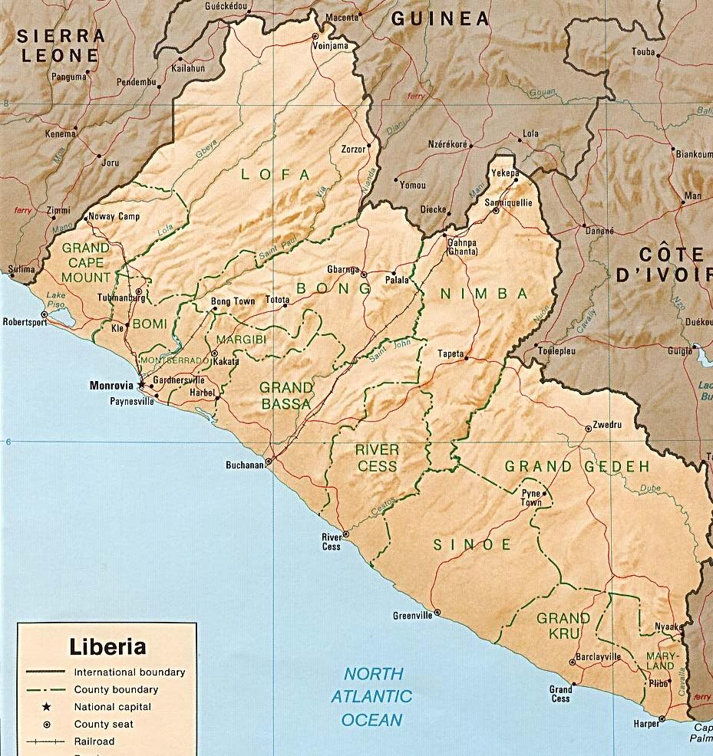
CONSOLIDATION PHASE January 2008
COY
BN(-)
Voinjama
Foya
SEC 2
Zorzor
COY
Yekepa
Sanequellie
COY(-)
COY
Bo Waterside
COY
Ganta
Laguato
Tubmanburg
Gbarnga
BN
BN(-)
COY(-)
COY
BN(-)
PL
BN(-)
Singe
BN(-)
COY
COY
COY
Klay
COY
SEC 3
Robertsport
COY
BN
SEC 1
1
Tapeta
BN
COY
Toe Town
COY
BN
Zwedru
COY
COY
BN(-)
Buchanan
BN(-)
SEC 4
Cestos City
Fish Town
COY
COY
Greenville
Webo
BN(-)
COY
Barclayville
COY
COY
BN (-)
Harper
Notes:
When I arrived in the Mission this is what the UNMIL Force profile looked like.
There was a heavy concentration of force in Sectors 1 and 2 in and around Monrovia, and on the good and easily accessible routes to Tubmanberg just to the north and Bo Waterside on the Sierra Leonean border to the northwest.
The UNMIL Force proposal to the DPKO Technical Assessment Mission (TAM) in June last year was to reduce by 3 battalions along the coastal plain and expand Sector 1 to include Grand Bassa and Rivercess Counties, whilst also reducing the size of Sector 1 battalions by 150 personnel each.
(Pause) Please turn to Slide 3

Slide 7
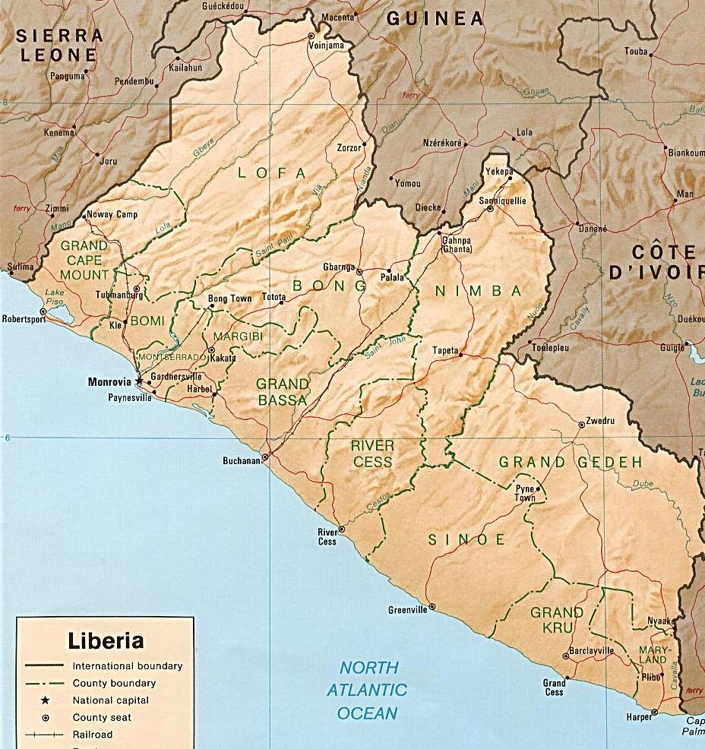
Stage 2 - Current Deployment (10,231 30 June 2009)
COY
BN(-)
COY
Pl
ENGR
COY
COY(-)
ENGR
BN(-)
COY
Pl
COY(-)
BN(-)
COY
LVL II
COY
Pl
Pl
COY
BN(-)
SEC B
Pl
COY
1
ENGR
COY
BN
COY
ENGR
COY
PRAM
SEC A
LVL II
BN(-)
BN(-)
Pl
LEGEND
Pakistani
COY
COY
COY( +)
China
COY
Bangladeshi
ENGR
Ethopian
Pl
COY(-)
LVL II
Ghanaian
COY(-)
Nigerian
BN
Notes:
The physical deployment after completion of Stage2 of Drawdown phase is as shown on the screen.

Slide 8
Civil-Military Coordination:
General Observations
Overlapping causes and effects of “human security” and increasing resource constraints mean security and development are co-dependent
Peacekeeping and peace building require the full engagement of all stakeholders; therefore, approaches must be joint and collaborative
No matter what it is called, “CIMIC” is the military’s tool to manage civil-military interaction and transition from military to civilian lead
Key to that interaction is understanding the military as “enabler” and civilians as “change agents” – the military is the multiplier
The goal of every military, police and civilian assistance organization in peace support operations should be to work yourselves out of your jobs, but in a way to prevent your return
While the ways and means between the military and civilians may differ, the ultimate overall goal is the same: self-sustained peace and civil society
Notes:
Here are some general observations about peace operations that explain the context in which UNMIL applies civil-military coordination…

Slide 9
CIVIL SITUATION IN LIBERIA
Overview: Simultaneous transition from peacekeeping to peace- building and from international to GoL lead for capacity development within PRS/CDAs leading up to 2011 general election, under intensifying de-stabilizing pressures as UNMIL draws down forces.
Facts – UNMIL Force Drawdown
Continued progression of “Overwatch” posture of indirect security and support to civil authority operations as Force draws down and realigns.
Emerging intelligence-driven operations in support of more comprehensive and collaborative Mission capacity development assistance approach under “one UN” concept.
Continued focus on CDW benchmarks and CCIRs – most with respect to developments in civil situation – thus, CIMIC is a key line of operation.
Transition to civil authority of key security and RoL tasks – incomplete.
Notes:
9
The situation in UNMIL with respect to CIMIC is based on the following facts:
Overall, although the Mission has fulfilled many of its mandated security obligations in Liberia, one last leg of the race must be run – the critical transitions mentioned here to insure the success of the Government of Liberia in assuming its civil responsibilities. In the drawdown phase, of the mission where the mandate is focusing on that development; at the same time, the mission forces are drawing down and realigning to more appropriately reflect UNMIL’s present mission, and shifting to more of a back-up security role in all the sectors. In addition to the challenges inherent to these transition processes, drawdown of the UNMIL Force, however, is taking place within the context of increasing de-stabilizing pressures.
It’s also important to note that the majority of the intelligence and measures regarding consolidation, drawdown, and withdrawal (CDW) are contingent upon developments in the Liberian civil sector, such as rule-of-law, governance, and economic and infrastructure developments. Thus, engagement of the civil sector – and therefore CIMIC – is a line of operation that is inextricably linked to the other main line of operation of the Force (security).

Slide 10
Operational Analysis – Civil Situation
Key Vulnerability: Weak governance and public administration capacity at especially: county/district level; rule-of-law; and SE
Transition Center of Gravity: Real and perceived effectiveness of GoL in delivering essential public services, among them security and rule-of-law, at county/district levels.
Decisive Points:
  Major roads open to all-season traffic-ability, especially up-country and southeast
  Police and other security forces lead independent operations
  Public confidence in GoL – greater recourse to RoL than “mob violence” and “traditional justice”; peaceful pre-election process
  Continued improvement in standard of living
Notes:
10
These is our analysis with respect to the civil situation in Liberia:
The key vulnerability to the transition process and self-sustained stability through the development of civil administration in Liberia is the lack of capacity at especially the county and municipal levels and particularly for the rule of law (police, justice system, prisons, and legal representation), and especially in the southeast. UNMIL recognizes that the real and perceived effectiveness of county-level capacity to deliver essential public services – among them security and the rule of law - is the vital center of gravity to the fulfillment of the mandate and the Mission’s exit strategy.
The decisive points to achieving this are listed here. For anyone who knows Liberia, a key tipping point is the opening of the road network, at least along the major routes, to traffic of all kinds – military, police, government, and commercial. The ability of the police and other internal security forces to take the lead and conduct relatively independent operations is another. Yet another will be whether people in Liberia begin to turn more to rule-of-law instrumentalities to resolve conflict over more volatile tradition methods – thus reflecting greater confidence in governmental processes. And last, despite the worldwide economic and financial situation, if people sense their standard of living or quality of life at their level continues to get better, it will go a long way to stabilizing society as the next general election draws near.
While UNMIL is not responsible for any of these things to happen, it must nonetheless shape conditions so that they can, because they will greatly determine the success or failure of the Mission.

Slide 11
RISKS TO CIVIL STABILITY
More Likely
  Persistent culture of dependency, corruption, and weak public service ethic
  Large-scale loss of jobs at rubber plantations and delays of job growth at major concessions up-country
  Insufficient GoL capacity/will to assume more leading roles in security
  Loss of some NGOs due to shift from humanitarian aid to development assistance and “donor fatigue”
More Dangerous
  Increasing numbers of idle and unemployed youth, especially displaced in urban areas – ideal recruits for criminal and other illicit activity
  Spillover effects from instability in contiguous states
  Acceleration of Force drawdown below levels assessed to insure stability through election – undermines transition, capacity-building, and confidence
Worst-Case Propensity and volatility for violence as a means of political and socio-economic expression becomes organized vs. spontaneous
Notes:
11
The risks and challenges to civil stability in Liberia – and thus the success of the Mission – are numerous, and include:
Among those most likely to have impact are in areas not well within the Mission’s span of control, such as a nearly overwhelming dependency of Liberians on the international presence, whether UNMIL or NGOs, resulting from a pervasive and persistent “culture of entitlement”. While UNMIL and the international presence cannot change the culture and society of Liberia, they nonetheless must now begin the process of mitigating the “gaps” that the eventual – and inevitable – drawdown will create.
Coupled with this are the job losses and delays in job growth due to economic pressures brought on by the worldwide economic crisis, the slow growth of governance, legitimacy, and sense of ownership among Liberians, and the loss of some NGOs whose donors may determine their humanitarian mandate is over or that the costs of another year of limited operations due to the poor infrastructure during the rainy season may not be worth the investment.
Increasing numbers of idle and unemployed youths, in particular young men and those displaced in urban areas, are becoming ideal recruits for criminal and other illicit activity and further feeding corruption – thus presenting the most dangerous threat to long-term civil stability in Liberia. In addition, many of the same pressures affecting Liberia are affecting neighboring states, and the effects of instability there could exacerbate civil problems in bordering areas of Liberia, presenting additional challenges to civil authority in those outlying areas which could quickly make there way to Monrovia. Then there is the tremendous international pressure to accelerate reduction of the Force below levels assumed necessary to insure stability through the next general election – feeding the visceral fear of abandonment by the international community and undermine the fragile sense of confidence of the public.
For many reasons, therefore, leading up to the next general election in 2011, the Government of Liberia must successfully espouse its public administration roles or risk becoming another “failed state”. The fates of the Mission and Government of Liberia are therefore inextricably linked – if the transition is not made to greater GoL responsibility and competence as the drawdown takes effect, while the Force capabilities still exist to facilitate it, the process may backslide into renewed instability and propensity for violence in Liberia’s volatile society could become exploited on a more organizational basis.

Slide 12
OPPORTUNITIES
Relative security/stability and international presence present “window of opportunity” to reach end state of self-sustained development
GoL Poverty Reduction Strategy and County Development Agendas frameworks reached “bottom-up” process
    Security
    Economic Revitalization
    Governance and the Rule of Law
    Infrastructure and Basic Social Services
“UN Family” Integrated Mission:
  Strong military and civil component and agency presence
  Collaborative frameworks – e.g., UN Development Assistance Framework (UNDAF) 2008-12, aligned with PRS/CDAs
  Collaborative tools – UN Country Team (UNCT) at operational level; Heads of Field Offices (HoFOs) and County Support Team (CSTs) at tactical level
  Strong bilateral support – U.S., U.K., China, Germany, et al.
  Effective strategic communications and public information
Relatively positive public attitudes toward UNMIL/Force and international presence remains for the time being
Notes:
12
At the same time, however, we see the next year of so in Liberia as a “window of opportunity. Beyond the albeit fragile stability here and the still strong international presence here, the GoL’s game plan to bridge this critical transition period is essentially a good one, derived from a participatory “bottom-up” process.
Another opportunity to exploit is the exceptionally well integrated UN presence and collaborative tools and a common framework for looking at the problem of building civil administration and transition – whether the UN Development Assistance Framework (UNDAF), or other initiatives – based on the four pillars of the Government of Liberia Poverty Reduction Strategy and implementing County Development Agendas (security, economic revitalization, governance & rule of law, and infrastructure & basic social services). For UNMIL – and thus for CIMIC – the key coordinating nexus points are the UN Country Team at the operational (or national) level and especially the Heads of Field Offices and County Support Teams at the critical tactical (or county) level.
With things improving, even if gradually and unevenly, UNMIL maintains a relatively positive climate for civil-military cooperation and coordination, and that the Liberian public – which still gets much of its news through UNMIL public information sources – still holds a positive view of UNMIL.

Slide 13
UNMIL CIMIC MISSION
Throughout drawdown, UNMIL Forces conduct CIMIC in coordination with UNMIL civil component, UN agencies and NGOs, and the GoL in order to:
  exploit gains in security and stability,
  mitigate/reduce associated risks of drawdown/realignment,
  help build civil capacity and confidence,
  transition security-related public service responsibilities, and
  further shape conditions for achievement of the UNMIL mandate.
Notes:
13
This is the UNMIL CIMIC mission statement.

Slide 14
UNMIL CIMIC COMMAND INTENT
Reduce dependency on the Force and manage current and potential gaps that drawdown/realignment may create
We have already won hearts and minds; now we must constructively work the Force out of its job
Civil success is Force success: main effort is to enable capacity and confidence at local level in close coordination with HoFOs/CSTs
Focus on idle and unemployed youth; coordinate CIMIC with security sector reform, UNPOL and other RoL initiatives
Synchronize CIMIC with public information in order to maximize confidence-building effects
End state for this phase is successful execution of Force drawdown with no debilitating civil-military impacts, 100% civilian lead in all civil-military initiatives…
Notes:
14
Here is the intent of the UNMIL CIMIC operation. Key points:
The main intent of the CIMIC effort at UNMIL is to reduce dependency on the Force – first among the Liberian and then among civilian partners through an enabling process. CIMIC must be an offensive action in order to avert, mitigate, or reduce the effects of gaps that force drawdown and realignment is creating.
CIMIC is integrating its initiatives with UNMIL and agency development assistance programs as well as aligned with the drawdown and capacity-building assistance strategies. This not only enhances overall impact of the Mission, but employs an exceptionally cost-effective way to support transition management.
CIMIC emphasis under drawdown has shifted from direct humanitarian assistance action to indirect support to capacity-building.
The key levels of CIMIC coordination are at the Country Team (operational) and County Support Team (tactical).
The end state should also be clear here.

Slide 15



Civil-Military Echelons of Assistance
UNMIL
UNMIL
FORCE
NGOs
Civil
Situation
UN
AGENCIES
Notes:
This schematic shows the proper placement of the UNMIL Force with respect to both the civil component of the Mission and associated UN agencies and NGOs, and the Government of Liberia structure. While this may not be the current situation in all areas of civil assistance, it represents the desired end state – this is what the Force CIMIC effort is working towards.

Slide 16

UNMIL Civil-Military Coordination Scheme
UN
AGENCIES
UN
AGENCIES
UN
AGENCIES
UN
AGENCIES
Operational
Tactical
O/SRSG
DSRSGs
UNCT
HoFO
CST
UNPOL ADVISOR
NGOs
G5 CIMIC/
SECT LO
SECT
CIMIC
NGOs
UNIT
CIMIC
GoL
GoL
COUNTY
Govt.
Notes:
This pictograph should help you visualize the CIMIC coordination scheme at UNMIL. The main point of contact for the Sector CIMIC officer is the Civil Affairs County Coordinator in the County Support Team. Any projects at the tactical level are coordinated through the CST, whereas any requests for local Force support from civilian organizations is vetted through the CST. This works similarly at the operational level – any use of Force assets controlled by Force HQ must first come through the O/SRSG.

Slide 17
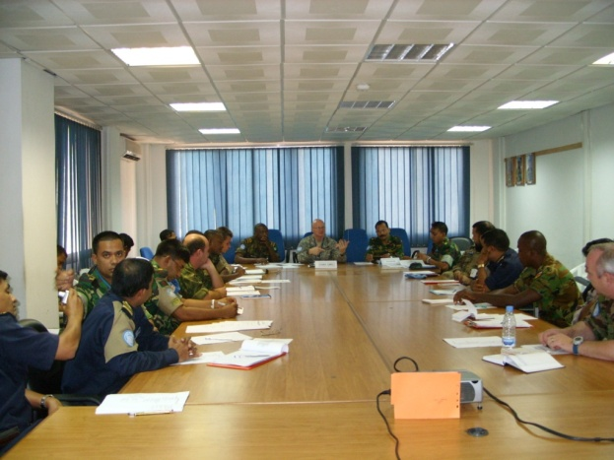
Major CIMIC Initiatives: Operational Level
UNMIL Force CIMIC Directive, 15 June 2009 (Version 2) – Base Directive plus Annexes:
      A – Terms of Reference
      B – Assessments
      C – Project Management
      D – CIMIC and Public Information
      E – CIMIC Education and Training
UNMIL CIMIC Course
CIMIC Training of and Capacity-Building Assistance to AFL and LNP
Support to Civil-Military Dialogue
Notes:
These are the major initiatives with respect to Pillar I – security. Support to civil authority activities are gradually expanding involvement of Liberian security structures (LNP, AFL, SSS, etc.,) in UNMIL Force security missions on behalf of the GoL (e.g., cash transport, VIP escort, border security, etc.) in order to facilitate transition of lead to these structures for these missions. In order to build public confidence in these institutions and promote GoL legitimacy, the Force assists the AFL on development and implementation of its own CIMIC capability, e.g., through inclusion of AFL officers in the UNMIL CIMIC course and encouragement in community based projects such as bridge laying by AFL engineers. The G5 is also working with Liberian civil society institutions to promote a healthy civil-military relationship in Liberia.
17

Slide 18
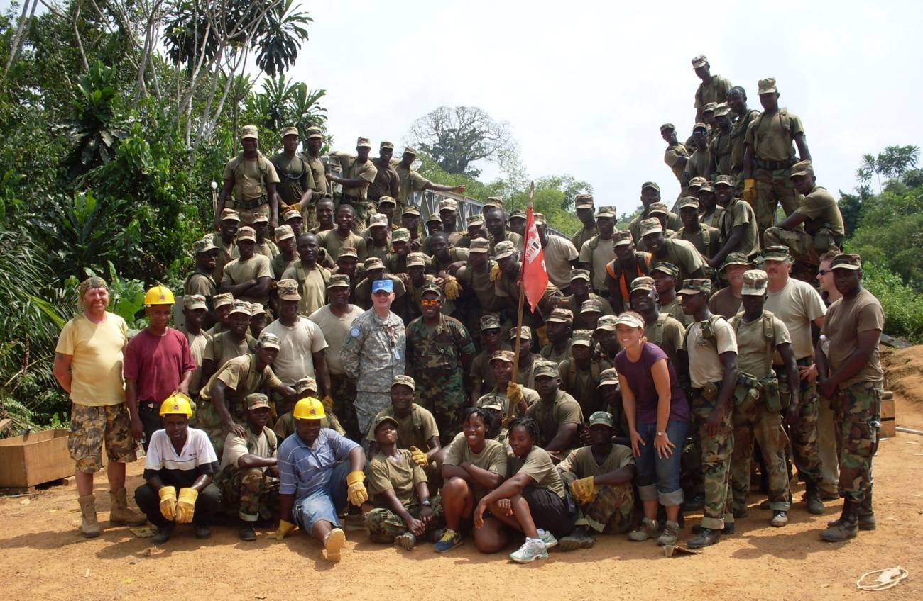
Major Initiatives – Pillar I
Force assistance to AFL training and capacity building as well as gradual transition of security missions to GoL lead
AFL and LNP CIMIC capacity-building: participation in UNMIL CIMIC courses and involvement in community-based projects
Assistance to development of “Center for Civil-Military Relations” and other civil society initiatives
Notes:
These are the major initiatives with respect to Pillar I – security. Support to civil authority activities are gradually expanding involvement of Liberian security structures (LNP, AFL, SSS, etc.,) in UNMIL Force security missions on behalf of the GoL (e.g., cash transport, VIP escort, border security, etc.) in order to facilitate transition of lead to these structures for these missions. In order to build public confidence in these institutions and promote GoL legitimacy, the Force assists the AFL on development and implementation of its own CIMIC capability, e.g., through inclusion of AFL officers in the UNMIL CIMIC course and encouragement in community based projects such as bridge laying by AFL engineers. The G5 is also working with Liberian civil society institutions to promote a healthy civil-military relationship in Liberia.

Slide 19
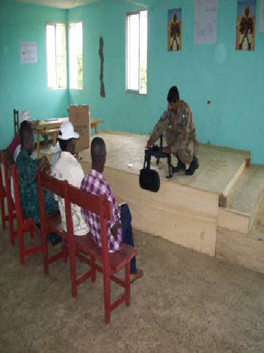
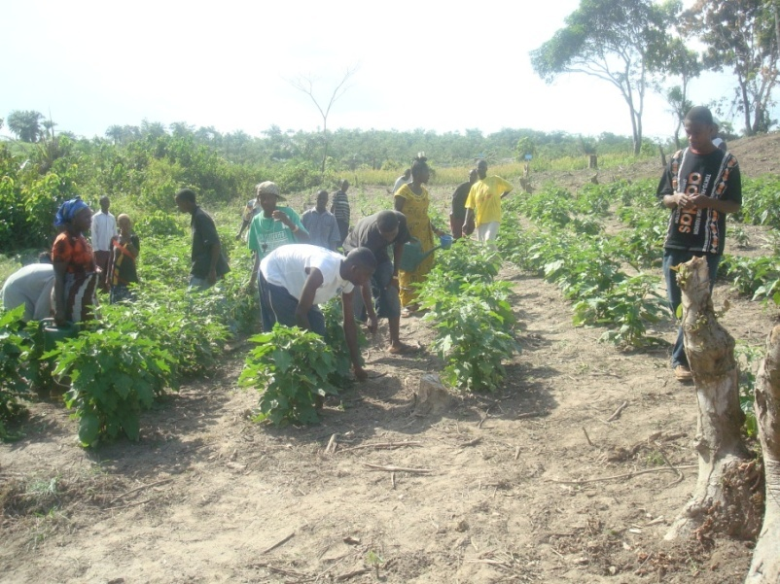
Major Initiatives – Pillar II
Vocational training, with greater linkages to small business and micro financing opportunities – over 4,000 trained during drawdown so far
Agricultural training farms – Bong, Lofa, and Nimba Counties involving more than 600 ex-combatants, et al.
“Ideal Village” by BANBATT 14 as a model for support to UNDP “Millenium Villages”
Notes:
These are the major initiatives with respect to Pillar II. In economic revitalization, efforts include coordinated joint vocational training in generator, vehicle, and building maintenance, construction skills, tailoring, agriculture, fishing, animal husbandry, project management, and information technology and management, and any other civilian-related skills resident with UNMIL Forces that lead to economic opportunity, public or private job placement, apprenticeship, small business development, and microfinancing. The three major agricultural farms that have helped hundreds of locals become subsistence farmers has been one of the Force’s flagship CIMIC initiatives. BANBATT 14’s “Ideal Village” demonstrates an excellent model of an integrated approach to development assistance, youth employment, and building self-reliance.

Slide 20
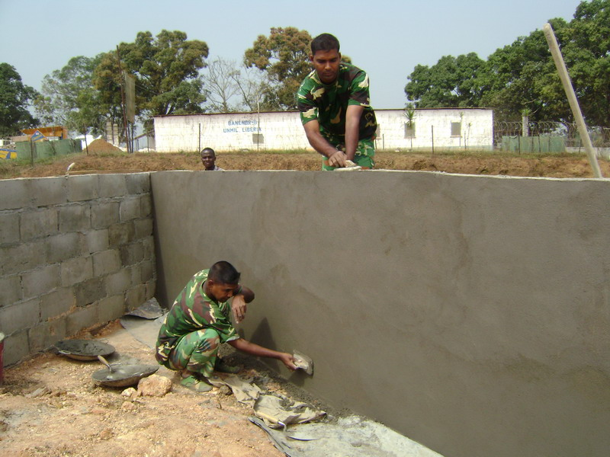
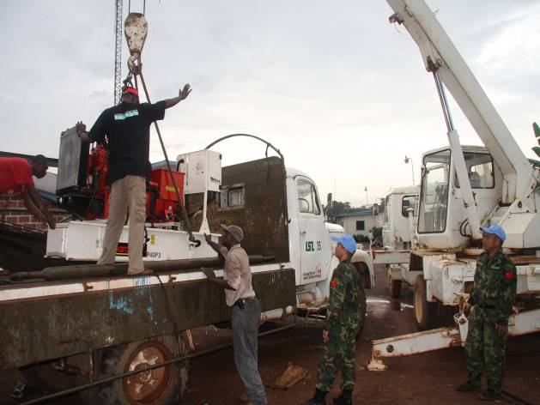
Major Initiatives – Pillar III
  MILOB Information-sharing with County governments to build information capacity, e.g., databases
  QIP projects to build RoL structures (police stations, courthouses, corrections facilities); five of 11 special RoL projects this year done by Force engineer assets (38 total)
Notes:
These are the major initiatives with respect to Pillar III – governance and rule-of-law. This includes information-sharing, not only from medical outreaches, vocational or technical training, and other CIMIC projects that may help substantiate the knowledge/data base capacity of the county/district governments on constituent and functional areas. It includes discreet sharing of UNMO and other military reports and data on the civil situation in order to building civil administrative information capacity, as well as assist with local assessment, early warning, and monitoring of development progress. Significant work is also being done this year to help build nearly a dozen police stations, courthouses, and corrections facilities in more remote areas to improve rule-of-law capacities as Quick Impact Projects.

Slide 21
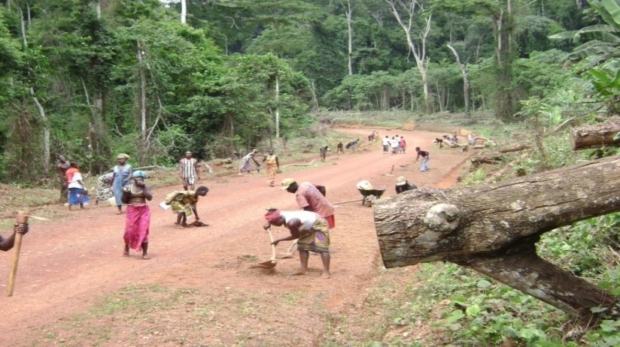
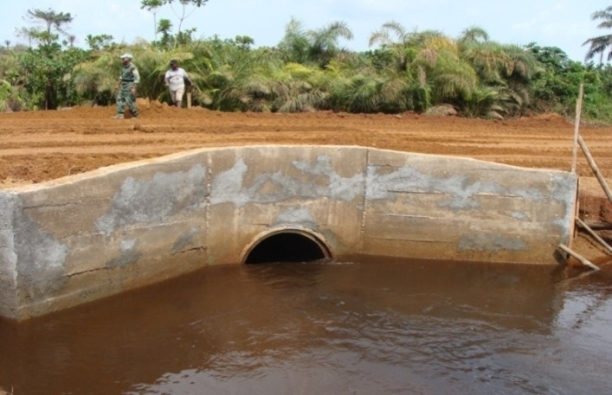
Major Initiatives – Pillar IV
Medical outreaches that feature “on-the-job” training of Liberian medical staff, e.g., PAK Level II (Tubmanburg-Harper), BANMED
Security/logistics support to nearly two million immunizations
Support to MoPW-synchronized road rehabilitation projects involving multiple partners – MoPW, USAID, RRR, World Bank, Buchanan Renewables, Force Engineers, AFL , e.g., Buchanan-Greenville MSR
Security best-practices with and logistical support to NGOs
Education sector: WAEC test distribution/security; schools donations; facilities improvements; and teaching assistance
Notes:
In infrastructure and basic social services, major project areas include: medical outreaches that feature “on-the-job” training of Liberian medical staff (e.g., PAK Level II Hospital in Tubmanburg and soon in Harper; support to Ministry of Health and UN agency led yellow fever and other immunizations of nearly two-million Liberians; support to Ministry of Public Works synchronized road rehabilitation projects involving multiple partners – MoPW, USAID, RRR, World Bank, Buchanan Renewables, Force Engineers, and AFL, such as the Buchanan-Greenville road and other major supply routes effectively opening the Southeast; execution of World Bank and UNDP agency-funded civil engineering projects for more than 600 km of major road maintenance, with security as well as commercial impacts; and support to NGOs in logistics as well as security best practices sharing, NGO collaboration and coordination, and information-sharing. UNMIL military have provided assistance to the education sectors, including security and logistics support for multiple distribution and collection of over 500,000 West African Examinations Council tests, contingent donations of school supplies (with some units adopting schools), engineer rehabilitation of more than two dozen schools, and providing tens of teachers to fill gaps.

Slide 22
UNMIL CIMIC – Way Ahead
Accelerate shift from direct action to indirect action – “civilianize” and “localize” CIMIC activities
Integration of CIMIC initiatives with those led by UN agencies under UNMIL development frameworks, e.g., youth empowerment
Channeling of CIMIC services through GoL entities, e.g., vocational training through youth organizations
Greater concentration on youth as most dangerous threat to long-term civil stability
Continue to work the Force out of jobs that should be done by the GoL, particularly internal security (in coordination with UNPOL)
Notes:
For 2009 and the time leading up to the general elections, the emerging strategy for CIMIC will most likely look to do these things. The Force has managed to to evolve its CIMIC operations to a more supportive, indirect, and capacity development assistance role, while synchronized with information operations. Having largely done this, we can now take steps leading up to the fulfilment of the exit strategy – first, by looking to make CIMIC more indirect with respect to the population through further integration with agency and GoL initiatives, placing them even more out in front; then in doing so, channeling CIMIC services such as vocational training through these entities. We also want to take a look at focusing more of our efforts to mitigate the risks posed by increasing numbers of displaced urban youths in particular, idle and unemployed, who are a vulnerable and potentially volatile group - ideal recruits for criminal and other illicit activity. G5 is looking to do this under the umbrella of the UNDP Joint Program for Employment and Empowerment of Youth, as well as a revised UN Development Assistance Framework, pending joint discussions with the Ministry of Youth, UNDP, and Mission Leadership. By making the military more of a “minority stakeholder” in the enterprise of building peace, thus working ourselves out of a job, we would facilitate a smoother completion of drawdown and minimize negative effects – operationally and strategically.

Slide 23
Thinking Globally, Acting Locally;
Thinking in Time, Acting in the Present
It’s not about us; it’s about them
If you don’t understand the culture, you don’t understand the problem
Your customer’s success is your success – that is your ticket home
Focus on unity of purpose (common end state) and shared risks
Knowledge is your economy; information is your currency of exchange
Ask not where they want to go today – ask where they want to be tomorrow
And, as always, manage expectations – yours and theirs
Notes:
Here are some pearls of wisdom on “CIMIC” gather over the year. CIMIC is thinking globally and acting locally – or in military terms, thinking strategically while acting tactically; it is also about thinking in time while acting in the present

