Slide 1
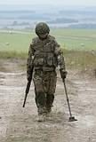
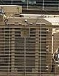
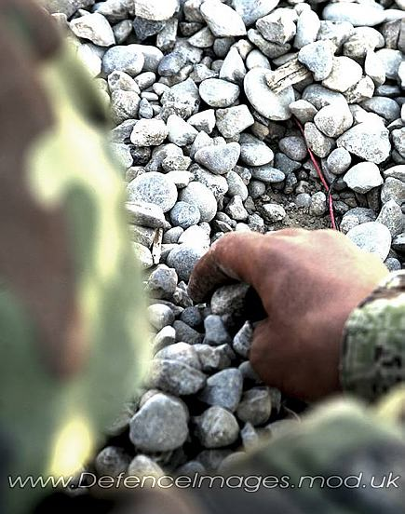
Anticipating the Insurgent Response
Fiona Browning
Land Battlespace Systems Department
Defence Science and Technology Laboratory
Notes:
DSTL/CP63304

Slide 2
Overview
Background
What is Red Teaming?
How does Dstl do it?
The approach
How does it help our customers?
Method management
Way forward

Slide 3
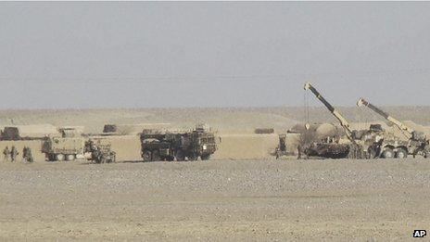
‘Afghanistan: 'Very large' Taliban bomb killed soldiers’
http://www.bbc.co.uk/news/uk-17288766

Slide 4
What is Red Teaming?
Red Teaming is the art of applying independent structured critical thinking and culturally sensitised alternative thinking from a variety of perspectives, to challenge assumptions and fully explore alternative outcomes, in order to reduce risks and increase opportunities.
Red Teaming Guide
http://www.mod.uk/NR/rdonlyres/B0558FA0-6AA7-4226-A24C-2B7F3CCA9A7B/0/RedTeamingGuiderevised12Feb10Webversion.pdf

Slide 5
What is Red Teaming?
Red Teaming is the art of applying independent structured critical thinking and culturally sensitised alternative thinking from a variety of perspectives, to challenge assumptions and fully explore alternative outcomes, in order to reduce risks and increase opportunities.
Red Teaming Guide
http://www.mod.uk/NR/rdonlyres/B0558FA0-6AA7-4226-A24C-2B7F3CCA9A7B/0/RedTeamingGuiderevised12Feb10Webversion.pdf

Slide 6
What is Red Teaming?
Red Teaming is the art of applying independent structured critical thinking and culturally sensitised alternative thinking from a variety of perspectives, to challenge assumptions and fully explore alternative outcomes, in order to reduce risks and increase opportunities.
Red Teaming Guide
http://www.mod.uk/NR/rdonlyres/B0558FA0-6AA7-4226-A24C-2B7F3CCA9A7B/0/RedTeamingGuiderevised12Feb10Webversion.pdf

Slide 7
What is Red Teaming?
Within the UK Defence environment adversaries are often referred to as Red and the UK and its allies are referred to as Blue.
Red Teaming can be used to investigate the robustness of Blue capabilities.
  Playing of Devil’s advocate.
    ‘What can go wrong, will go wrong’.
  Surrogate Red Teaming.
    Investigate more credible and likely to occur outcomes.

Slide 8
How does Dstl do it?
Dstl and the wider MOD use a variety of Red Teaming methods.
  All threat driven.
Surrogate Red Teaming has been applied by Land Battlespace Systems Department to investigate how the Red threat could change over time.
  A specific form of practical, human-in-the-loop experimentation.
  Pitting teams against one another in a competitive environment stimulates the generation of ideas – drawing on the desire to ‘win’.

Slide 9
The Surrogate approach
Weapons
Tactics
Scenarios
Red advisor passes attack plan to Blue team for assessment
Red team
Blue team
Detailed assessment
Limited feedback to Red team based on their ‘battle damage assessment’

Slide 10
The Surrogate approach
Red Advisor
Analyst
Red team players
Scientific Adviser (theatre)
‘Technical’ expert
Threat representative

Slide 11
The Surrogate approach
Customer
User
Blue team players
Technical expert
TTP representative

Slide 12
The Surrogate approach
Preparation
Facilitators
Dstl support
Scribes
Output

Slide 13
Exercise Timeline
Session 1
Session 2
Introductions and initial briefs
SWOT analysis of capability
Continued Red attacks with Blue feedback. Potentially including excursions
Red attacks and Blue feedback
Key topic discussions

Slide 14
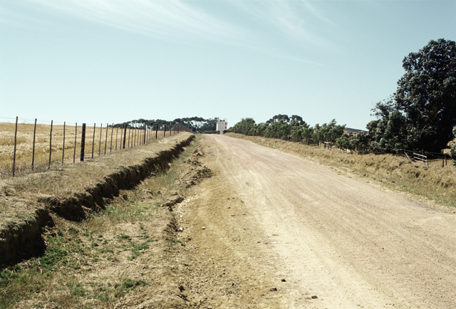
Example attack
Red observer
IED / Road side bomb
Direction of Blue travel

Slide 15
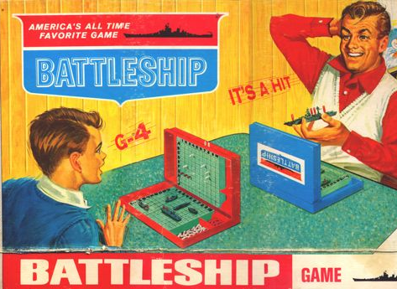
www.gamerfront.net

Slide 16
Nature of output
Generally a key insights paper is produced presenting the ‘quick-wins’ that had been identified up-front.
A summary is then compiled typically informing the customer on the following areas:
  Blue TTPs (as a result of Red action(s)).
  Exploration of potential options to maximise the longevity of the system.
  Identification of issues and implications, particularly with respect to training, associated with the wider distribution.
  Investigation into how the threat could evolve following the introduction to the front line.

Slide 17
Study Timeline
Exercise
Preparation
Output
Requirement Identified
Key insights paper
Summary paper

Slide 18
Study Duration
The first exercise took 8 months to complete.
  Method development.
  Preparation.
  The exercise itself.
  Documenting the output.
Exercises can now be completed in 6 weeks.
  Drawing on previous experience.
  Adapted the method.
  Increased the pool of people with Red Teaming skills.

Slide 19
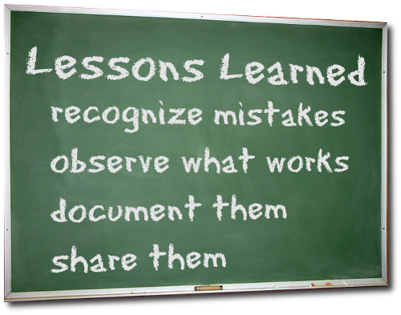
Knowledge base
Development in a number of areas has helped increase the time in which Red teaming exercises can be undertaken:
  Red teaming expertise.
  Scenarios.
  Threat guide.
  Lessons guide.
  Early considerations guide.
www.pmstudent.com

Slide 20
Early Considerations
An early considerations guide has been developed, exploiting previous exercises in order to:
  Reduce the timescales.
    In some cases, negate the need for a full exercise.
  Identify areas for consideration.
Exercise
Preparation
Output
Requirement
Key insights
Summary
Exercise
Preparation
Output
Requirement
Summary

Slide 21
Early Considerations
Information
Concepts and Doctrine
Training and Personnel
Equipment

Slide 22
What are the challenges?
Representation of the adversary.
Availability of players.
  Correct player choice is key to exercise success.
    Balance between technical expertise, operational experience and an ability to challenge perceptions.
Ensuring unfair knowledge is not gained throughout the exercise.
Preparing and conducting exercises at pace.
Ensuring caveats are understood.
  Red Teaming does not provide the answer.

Slide 23


How does it help our customers?
The output of such exercises has informed senior decision makers of potential credible Red responses should for example the UK decide to make a change to military capability within an Operational Environment.

Slide 24
How does it help our customers?
This has:
  informed Urgent Operational Requirement (UOR¹) development e.g. to help avoid unintended consequences.
  informed TTP’s.
  supported policy development/change decisions.
  proffered ways in which the wider threat may change over time given a series of Blue step changes.
¹Supplementing the MOD's long term planned equipment programme, UORs provide fast equipment solutions that operations demand

Slide 25
Way forward
Investigate use of a model to support Red Teaming exercises.
Expand use of Red Teaming.
  Applicable in a wide range of areas.
    E.g. core procurement programme.
    Not just applicable to theatre.

Slide 26
Summary
Surrogate Red Teaming has demonstrated real utility.
  Now mandated for consideration in the UOR process.
Method has evolved and is likely to continue to evolve.
Choice of players is key to success.
Red Teaming is NOT a prediction of the threat.

Slide 27

Final Thought…
“Minds are like parachutes,
they only function when they are open”
Lord Thomas Robert Dewar
www.t3.com/features/felix-baumgartner-space-jump

Slide 28
Questions?

