Slide 1

Illicit Trafficking in
Central America: Honduras
Cornwallis XVII, 2 April 2012
©
Notes:
Emphasis on Honduras

Slide 2
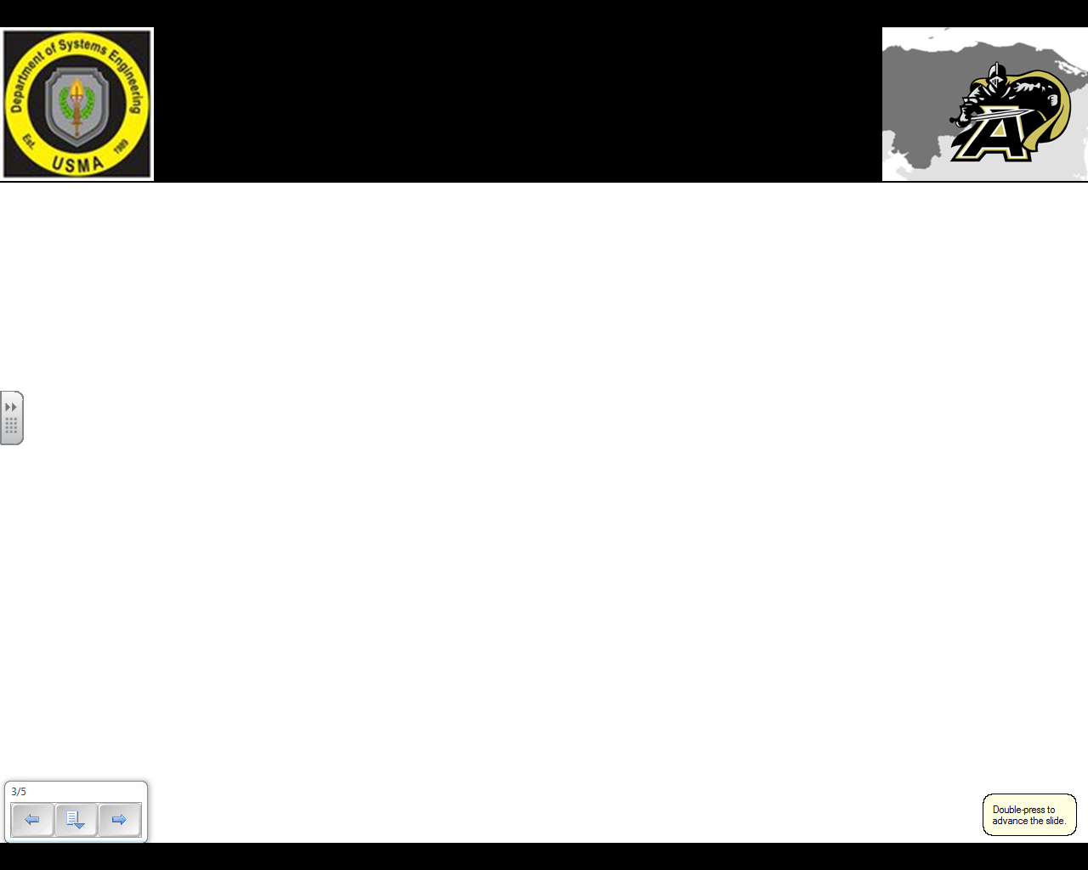
Purpose & Agenda
Purpose:
Provide on overview of work completed to date on Senior Capstone.
Receive feedback to incorporate in model development going forward.
Introductions
Problem Definition
  Background
  Previous Work
  Problem Statement
  Modeling Approaches
  Limitations/Assumptions
Research and Data Analysis
  SOUTHCOM Visit
  Key Resources
  Cocaine Database Analysis
  Summary Effects of Illicit Trafficking
Modeling
  Network Flow Model
    Nodal Analysis
    Formulation
    Utility
  System Dynamics
Summary and Way Forward

Slide 3
Introductions
Errin Helbling
  Systems Engineering Major
Zach Price
  Operations Research Major
Derek Sipperly
  Systems Engineering Major
  Academic Internship with USSOUTHCOM J8, Summer 2011
Brad Kelly
  Engineering Management Major

Slide 4



Background
Project initiated by Engineering Research and Development Center - Construction Engineering Research Lab (ERDC-CERL) through the Center for Nation Reconstruction and Capacity Development (CNRCD) at West Point in 2010.
Analysis intended to complement ongoing research at ERDC for the development of tools and techniques to rapidly prototype localized agent models for the analysis of infrastructure and essential service improvements on the local population.
Aimed at identifying key areas to insert influence in order to impede illicit trafficking activity within Honduras.
Notes:
Our client is ERDC and our job is to assist their current, ongoing research dealing with illicit trafficking in Honduras. We are looking to model the development of infrastructure and essential service improvements in order to identify key areas to input influence in hopes that it will slow illicit trafficking in Honduras. To create this model we first needed to develop a better understanding of the entire drug trafficking system which led to the work of last year’s cadet capstone group…

Slide 5
Previous Work
Develop a Holistic, Systems Understanding of the Illicit Trafficking Problem in Honduras
Notes:
What is a “Systemigram”?
Systemigram was developed by Dr. James Boardman and Dr. Brian Sauser, derived from “system” and “diagram”
Useful since it portrays the meaning in which the prose seeks to convey
A tool to assist systems engineers in covering a topic without sacrificing detail required to accomplish clarity
Comprised of nodes (nouns) and links (verbs)
Read from top left to bottom right
Model based off of mainstay thread
Systemigram: A systemigram is a portrayal of a number of different “scenes of interaction” within a system and the scenes’ relationships to one another in the system.
-Scenes Highlighted Last Year
1. Illicit Trafficking Problem
2. Current Enemy Operation
3. International Aid
4. Traffickers Tactics
5. Local Support
6. Economy
7. Education
-Systemigram Value: Helps outline causal loops between many different aspects within Honduras and international society (i.e. commerce, government, environment). Highlights the complexity of our problem.
-Systemigram Challenges: Quantifying relationships in empirical data and ensures that correlation between variables clearly means causation.

Slide 6
Problem Statement
Develop viable models that can be incorporated into ERDC tools and techniques, and offer insights into the allocation of resources to infrastructure and essential services to affect illicit trafficking (2011-2012)

Slide 7
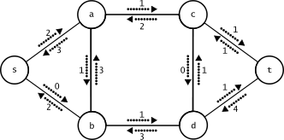
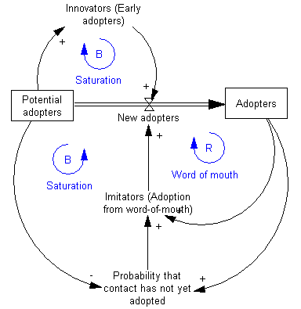
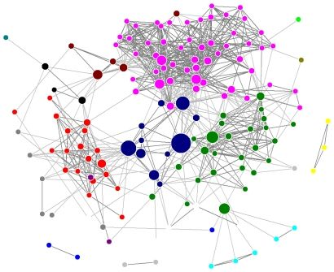
Current Modeling Approaches
  Network Flow
    Strengths: Can accurately reflect drug trafficking network, well-matched for military/anti-terrorism scenarios.
    Weaknesses: Limited data resources to quantify and “solve” the network problem. Network is ever-changing.
  System Dynamics
    Strengths: Grounded in causal relationships between many different aspects of society. Can be quantified in many different values. Extensive studies already in illicit trafficking and crime.
    Weaknesses: Relies heavily on empirical data support to develop behavioral relationship equations.
  Network Science
    Strengths: Identifies network’s “key players” and anticipates their actions through organizational structure analysis (communication, activity coordination, and decision making).
    Weaknesses: Requires abundance of data resources.

Slide 8
Constraints, Limitations, Assumptions
Constraints:
  Time, only two 40 lesson semesters.
Limitations:
  Readily available data sources and subject matter experts.
    Limited availability of specific data relating local populace to illicit trafficking.
    Language barrier with Honduran local newspapers and other primary source documents.
Assumptions:
  Data available will be adequate to develop a holistic, systems understanding of illicit trafficking throughout the region.
  General modeling approaches based on data available can be useful when applied to local conditions.
Notes:
Spell out tools?

Slide 9
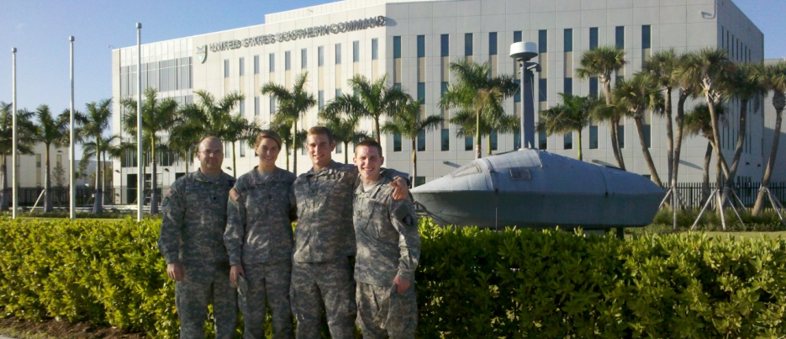
SOUTHCOM Visit
Purpose: Provided USSOUTHCOM an overview of a Department of Systems Engineering at West Point Cadet Capstone, while
gaining an improved understanding of illicit trafficking from USSOUTHCOM subject matter experts
receiving feedback on current approach
exploring collaboration opportunities going forward
Outcome: Valuable trip resulting in
understanding where our capstone fits into the problem and what exactly we are looking for
subject matter expertise in formulating nodes and arcs of our network flow model

Slide 10
Key Resources and Data Sources
Current Primary Resources
  Cocaine Movement Trends Update End of Year 2010 – Office of National Drug Control Policy
    Provided analysis of the total cocaine flow through Central America
  Cocaine Movement Trends Update Jan – Mar 2011 – Consolidated Counterdrug Database
    Provided data points for analysis in our Network Flow Analysis
  Woodrow Wilson International Center for Scholars, September 2011
    Provided general information and tactics, techniques, and procedures on illicit trafficking through Honduras and Central America
  United Nations Office on Drugs and Crime – Bi-Annual Seizure Reports
  World Bank Data
Notes:
We have looked at many more sources than you see here, however we have listed our integral research thus far. All these resources we listed have been used either as an effort to familiarize ourselves with the system, specifically transportation vectors, and the systemigram or the creation of our preliminary network. Our critical resources to date in regard to our network include the Consolidated Counterdrug Database, Woodrow Wilson International Center for Scholars and the UNODC. They all offer specific data, to include locations of interdictions and amount of drug seized, that we can use to identify nodes and shipment routes. Though more is needed, this hard data will also give us an opportunity to make assumptions as we go forward with the modeling process

Slide 11

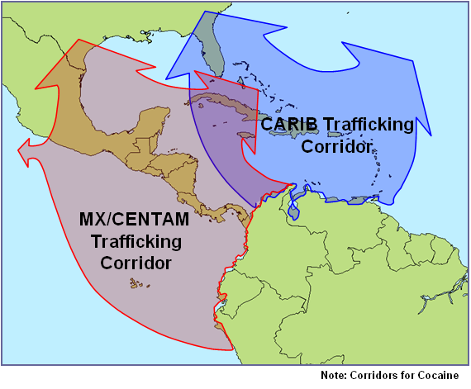
Cocaine Trafficking From South America to North America
“DTOs (Drug Trafficking Organizations) are businesses. Their objective is to limit costs and maximize profits. They do this by trying to minimize the number of participants, borders crossed, authorities they have to bribe.”
In 2009, an estimated 380 metric tons of cocaine was shipped from South America (source) to North America (sink).
DTOs ship cocaine as a commodity flowing through a network of nodes and arcs.
DTOs ship to minimize cost.
In the 1980s and 90s, Caribbean routes were preferred until improved airspace and maritime monitoring and intelligence sharing made arc costs prohibitive.
In the past decade, Central America has become the preferred transshipment for cocaine moving North.
Source: Wilson Article
Trafficking Corridors to North America
Source: USSOUTHCOM Presentation
Source: UNODC, World Drug Report 2011
Notes:
Honduras has emerged as a cocaine transshipment point between Colombia and the United States
Remote and poorly controlled areas, North Coast and Eastern Border, are natural safe havens for drug traffickers, providing them with isolated areas for trafficking operations
Geographic location provides an ideal transshipment point for South American drug lords
The basic analytic structure of a network flow model consists of nodes, arcs and arc capacities. Drug trafficking can be modeled as a network flow model based on previous research and analysis. Traffickers attempt to transport drugs from a source (Colombia) to a sink (U.S.), using various nodes within Honduras over certain routes to transport the drugs.
“DTOs are businesses. Their objective is to limit costs and maximize profits. They do this by trying to minimize the number of participants, borders crossed, authorities they have to bribe. This explains why they have established forms of transport through Central America.” –Dudley 38.
So, you can see that an increase or improvement in the PMESII-PT variables can cause an increase in cost for the drug traffickers.
Max-flow problems are a special case of minimum-cost network flow problems.
Many situations can be modeled by a network in which the arcs have a capacity limiting the amount of a resource/product shipped through the arc. In these cases, you want to transport the max. amount of flow from a start point (source) to an end point (sink). These are max flow problems. As problem solvers, we would like to analyze the effect of stopping the flow of drugs through Honduras, so we might look at a max-flow/min-cut problem, says that the max amount of flow from the source to the sink = minimum capacity, which when removed from the network, causes the flow from source to sink to be infeasible.
Minimax problems look at the problem in a similar way, they are a form of Linear Programming duality in which you want to minimize the max amount of flow of a product. While both are potentially useful, max flow/min cut gives us a better model as we look at interdicting at the local level.
Trafficking flows to main consumer markets It is estimated that almost 380 mt or 45% of the total cocaine exports from the Andean region leave for North America, a region with a population of some 460 million people. The bulk of cocaine shipments are still by sea across the Pacific to Mexico and on to the United States. In addition, Central American countries have gained prominence in recent years as trans-shipment locations. The Caribbean, in contrast, has lost significance as a trans-shipment hub over the last decade. More recent data suggest that the downward trend did not continue in 2009 and some early indications for 2010 suggest that the importance of the Caribbean may have started to rise again. Seizures made in South American countries outside the Andean region, in Central America and the Caribbean in relation to shipments towards North America are estimated at slightly less than 100 mt (purity-adjusted). A further 100 mt of purity-adjusted cocaine seizures are made in North America. Thus, out of 380 mt exported to North America, only some 180 are available for consumption, of which the bulk (88%) is consumed in the United States.

Slide 12
Consolidated Cocaine
Database Findings
# total seizures continues to climb but land seizures are low.
General upward trend of seizures drives further question.
  Is drug trafficking as a whole increasing as a business?
  Are methods of interdiction improving?
 | Maritime | land | Air
2005 | 98 | 26 | 14
2006 | 62 | 6 | 11
2007 | 49 | 8 | 37
2008 | 144 | 4 | 51
2009 | 281 | 8 | 84
2010 | 335 | 8 | 97
2011 | 142 | 1 | 55
Totals | 1111 | 61 | 349
Data from cocaine database (above) is measured from 2005 through Quarter 1 of 2011.
Source: CCDB 2005 - 1st QTR 2011

Slide 13
Consolidated Cocaine
Database Findings
Slope of two plots are very similar.
Do traffickers simply prefer to traffic drugs via maritime because more can be transported at once or is that all we target?
Land interdictions remain low while maritime and air trends rise.
 | Maritime (kg) | Land (kg) | Air (kg)
2005 | 122290 | 5216.273 | 12119.56
2006 | 89074 | 118 | 20240
2007 | 60625 | 1058 | 40263.06
2008 | 193905 | 1526.62 | 56655.3
2009 | 332967.3 | 6462 | 75991
2010 | 394627.5 | 4241.9 | 118098.5
2011 | 258413.5 | 72 | 51289.88
Totals | 1451902 | 18694.79 | 374657.3
Data of size of seizure (kg) by type or transportation and year from cocaine database (above) is measured from 2005 through Quarter 1 of 2011.
Source: CCDB 2005 - 1st QTR 2011

Slide 14
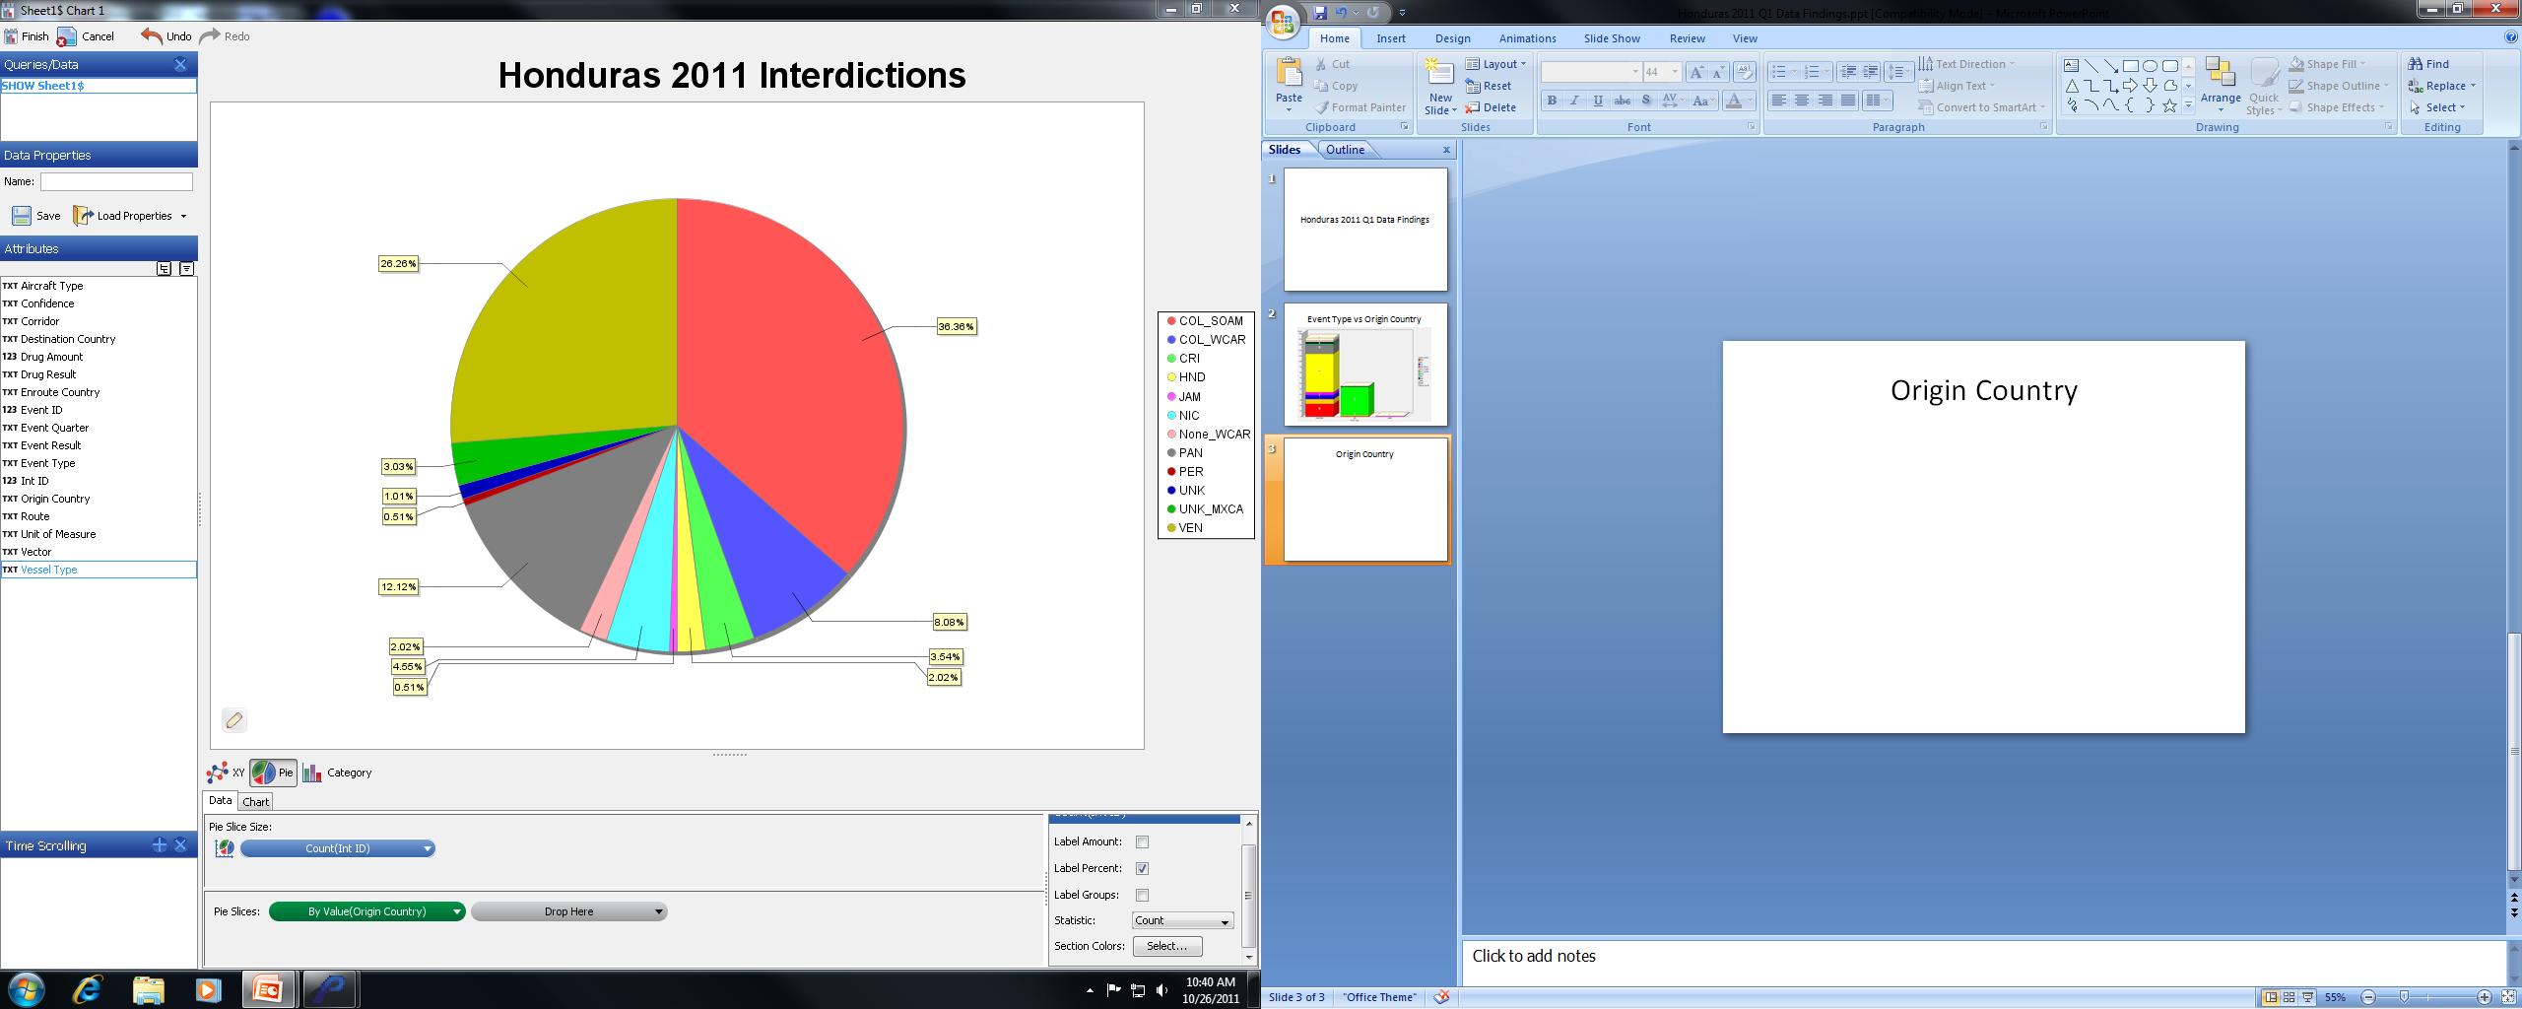
Interdictions by
Origin Country
Pie chart represents percentages of interdictions based on origin country.
Most cocaine destined for Honduras comes from Colombia and Venezuela.
Source: CCDB 2005 - 1st QTR 2011

Slide 15
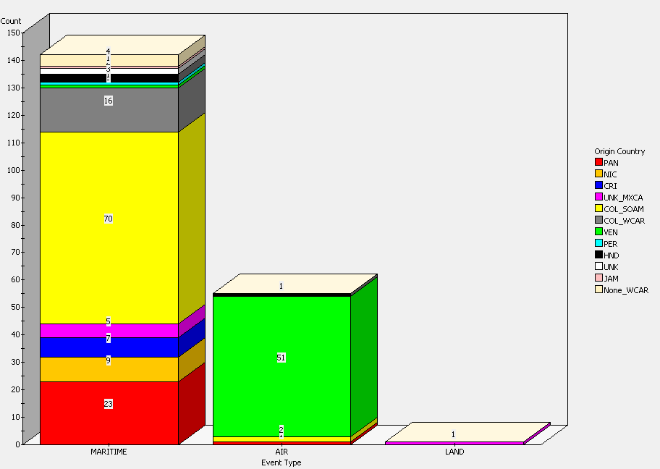
Event Type by Origin Country
Interdiction type based on frequency and origin country in transit to Honduras.
Denotes importance of maritime interdiction, especially in Atlantic coast corridors.
Shows that Honduras is more of a transshipment destination rather than a supply or demand destination.
Source: CCDB 2005 - 1st QTR 2011

Slide 16
Drug Amount vs. Origin Country (kg)
This graph represents the total drug amounts (kg) interdicted by origin country.
Can help us make key assumptions as we formulate the network flow model as to specific drug amounts coming from source nodes to/through Honduras.
Exponential decay: Shows countries’ importance in developing source nodes – Columbia, Venezuela, and Panama are responsible for the majority of cocaine in-flow to Honduras.
Source: CCDB 2005 - 1st QTR 2011

Slide 17
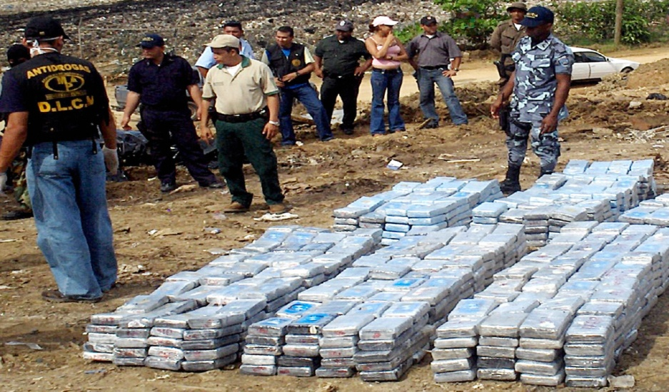
The Effect of Trafficking
Through Honduras
Increase in Mexican drug wars pushed drug trafficking into Central America
Ousting of President Zelaya (June 2009)
Honduras homicide rate doubled in past decade
59% Hondurans below poverty line
Assassinations of government officials and news reporters
Gangs control large territories of land
Latin America→ highest levels of youth violence in world
(Murders per 100,000 people)
“[Drug Trafficking] is the main single factor behind the rising levels of violence in the region” World Bank 2011
Notes:
Homicide Rate – indicates stability
While we have listed here all of the indicators that the world bank possessed data for, only the political and military indicators showed some worthwhile correlation to instability (homicide rates) and cocaine flow. The other indicators had data that did not correlate with instability and cocaine flow – we are still looking into other data resources more economic, social, infrastructural, and informational indicators to understand more fully the nature of the society when dealing with the drug trafficking issue.
IN REFERENCE TO INCREASING COCAINE projected AND HOMICIDE RATES
Military expenditure: increasing, but slowly
Electricity Production: increasing, but slowly
Health Expenditure: Increased sharply until 2009, took a small dip (coup?)
GDP per Capita: remains relatively unchanged
Children out of School: sporadic data, but lower rates since 2009
Poverty Headcount (% of Pop.): steadily decreasing
Life Expectancy: steadily increasing
School enrollment, primary (% net): sporadic data, spike in 2009-2010, decrease in 2011
Internet Users: sharp increase
FDI, net (US$): sporadic data, but sharp increase from 2009 to 2010

Slide 18
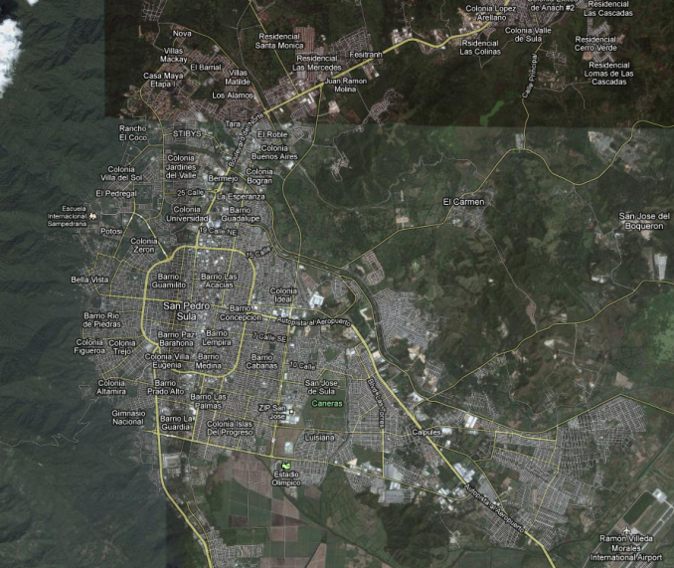
Node Analysis:
San Pedro Sula
Cocaine Corridors (Geographical Sites)
Inflow: From the coast, Tela (maritime into Tela); and from the Southeast, Yoro (air tracks into Yoro)
Outflow: Overland, west towards Guatemala
Political: “Governance”—many areas controlled by gang activity
Military: “Security”; “Rule of Law”; 1000 police officers; impunity rate extremely high (unsolved serious crimes); 60% of murders linked to drugs
Economic: Manufacturing, Industrial center of Honduras; transportation hub; light industry and commercial production in coffee, bananas, beef, sugar cane, tobacco, forestry; 2/3rd of countries GDP
Social: 2nd largest city; 900k people, 1.2m in metro area; many higher education opportunities; most bilingual schools in CENTAM
Infrastructure: major transportation hub; international airport; private university, rail lines (Tela, Puerto Cortes); largest bus station in CENTAM; city in quadrants, abundant public transportation
Information: highest murder rate in the world
Notes:
Source: wikipedia; cnn article

Slide 19
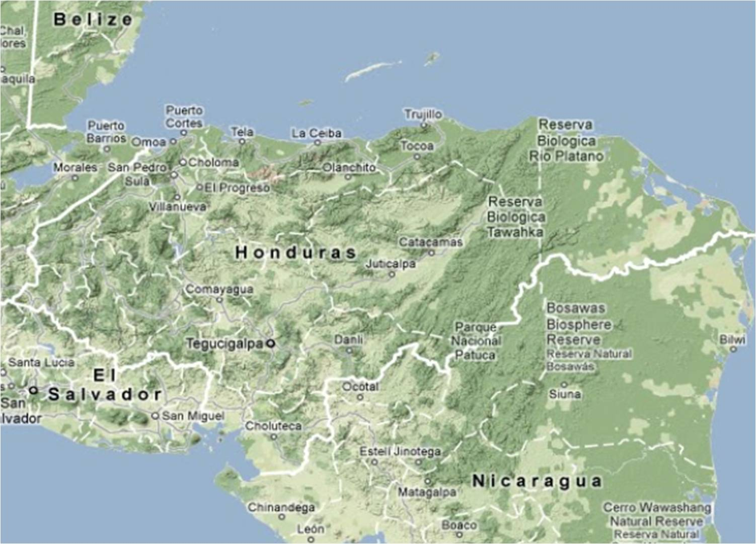
Trafficking Through Honduras
U.S.
Trujillo
Tela
San Pedro
Sula
Puerto
Lempira
Yoro
Catacamas
Santa Rosa De Copan
Tegucigalpa
Choluteca
S.A. (Col.)

Slide 20
Formulating the Network
U.S.
Sink
NA
Trujillo
Node 3
C_{8NA}
Tela
C₇₈
Node 7
C_{SA3}
C_{9NA}
C₃₇
San Pedro
Sula
Node 8
C₂₃
Puerto
Lempira
Node 2
C₃₆
Yoro
Node 6
Catcamas
Node 4
C₂₄
Santa Rosa De Copan
C₆₈
Node 9
C₅₉
C₄₅
Tegucigalpa
Node 5
C_{SA2}
C_{1NA}
C₁₅
Each arc has a cost, “C_{ij}”
Choluteca
Node 1
S.A. (Col.)
Source
SA
C_{SA1}

Slide 21
Formulating the Network
Sink
NA
Sink
NA
Node 3
C_{8NA}
Node 7
C₇₈
C_{SA3}
C_{9NA}
C₃₇
Node 8
C₂₃
Node 2
C₃₆
Node 6
Node 4
C₂₄
Node 9
C₆₈
C₅₉
C₄₅
Node 5
C_{SA2}
C_{1NA}
C₁₅
Each arc has a cost, “C_{ij}”
Node 1
Source
SA
C_{SA1}

Slide 22
Illicit Trafficking
Min Cost Network Flow
Node 8
C₇₈
Node 7
C₃₇
Node 3
C₆₈
C₃₆
C_{SA3}
C_{8NA}
Node 6
C₂₃
Sink
NA
Node 2
C_{SA2}
Source
SA
C_{9NA}
C₂₄
Node 4
Node 9
C_{SA1}
C₅₋₉
C₄₅
Node 5
C₁₅
Node 1
C_{1NA}

Slide 23
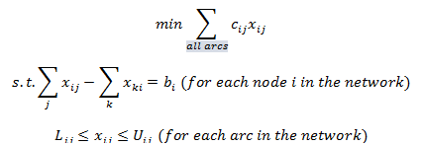
Min Cost Network Flow
Formulation and Assumptions
x_{ij} = number of units of flow sent from node i to node j through arc (i,j)
b_{i} = net supply (outflow – inflow) at node i
c_{ij} = cost of transporting 1 unit of flow from node i to node j via arc (i,j)
L_{ij} = lower bound on flow through arc (i,j). If no lower bound, L_{ij} = 0
U_{ij} = upper bound on flow through arc (i,j). If no upper bound, let U_{ij} = infinity
The first constraint means that the net flow out of node i must equal b_{i}. This is the flow balance equation. The second constraint ensures that the flow through each arc satisfies the arc capacity restrictions.
Notes:
There’s the model, now here is how we formulate the model.
Drug trafficking can be modeled as a network flow model based on both previous research and analysis as well as case studies. Traffickers attempt to transport drugs from a source (i.e. Colombia) to a sink (i.e. United States), using various nodes within Honduras over certain routes, primarily along the coasts, to transport the drugs. “DTOs are businesses. Their objective is to limit costs and maximize profits. They do this by trying to minimize the number of participants, borders crossed, authorities they have to bribe. This explains why they have established forms of transport through Central America.” Dudley, 38.

Slide 24
Cost/Capacity
Indicators
Now that we have established our network's arcs and nodes…
Indicators of how a population lives depending on cocaine flow amount need to be identified
Analyze these indicators in order to model cost/capacity as a function of variables related to whole of government actions.
  Ex: If we increase school enrollment in one node, what are the effects to the network in terms of cocaine traffic and homicide rates?
Political
FDI
Military
Military Expenditure
Economic
Poverty Headcount
GDP per capita
Social
Life Expectancy
School Enrollment
Children out of School
Health Expenditure
Infrastructure
Electricity Produced (kWh)
Information
Internet Users
Notes:
Homicide Rate – indicates stability
While we have listed here all of the indicators that the world bank possessed data for, only the political and military indicators showed some worthwhile correlation to instability (homicide rates) and cocaine flow. The other indicators had data that did not correlate with instability and cocaine flow – we are still looking into other data resources more economic, social, infrastructural, and informational indicators to understand more fully the nature of the society when dealing with the drug trafficking issue.
IN REFERENCE TO INCREASING COCAINE projected AND HOMICIDE RATES
Military expenditure: increasing, but slowly
Electricity Production: increasing, but slowly
Health Expenditure: Increased sharply until 2009, took a small dip (coup?)
GDP per Capita: remains relatively unchanged
Children out of School: sporadic data, but lower rates since 2009
Poverty Headcount (% of Pop.): steadily decreasing
Life Expectancy: steadily increasing
School enrollment, primary (% net): sporadic data, spike in 2009-2010, decrease in 2011
Internet Users: sharp increase
FDI, net (US$): sporadic data, but sharp increase from 2009 to 2010

Slide 25
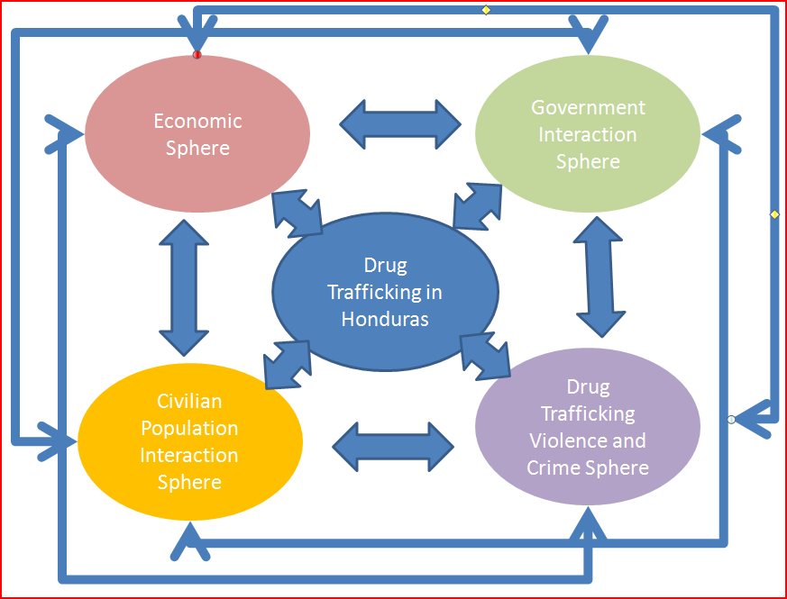
Way Forward:
System Dynamics
Study Structure
1. Problem Articulation
2. Dynamic Hypothesis
3. Formulation
4. Testing
5. Policy Formulation & Evaluation
Possible Spheres of Interaction:
Primary: Drug Trafficking Sphere
Government Policy Domain
Economic Influences Sphere
Drug Market Violence and Crime Sphere
Civilian Population Interaction Sphere
25

Slide 26
Summary and
Way Ahead
Summary:
Developed thorough problem understanding
Incorporated research/stakeholder input
Performed data analysis of available resources
Developing a final network flow modeling approach
Way Ahead:
Developing System Dynamics technique, targeting specific areas of influence and interdiction opportunities and incorporating effort into Network Flow approach.
Final Project Presentation May 2
Notes:
Endstate:
What ifs:

Slide 27
Questions
?
27

