Slide 1

Quantitative Profiling of Trafficking Networks; “Rumsfeldian” Spaghetti and the Combination of Science and Art
Jonathan Dalley CEng MIET
Sensor Systems Group
Dstl Sensors & Countermeasures
Room 201-C, Building 005
Dstl Porton Down
Salisbury
Wiltshire SP4 0JQ
United Kingdom
 Telephone : +44 (0) 1980 65 8754
 Email : jdalley@dstl.gov.uk

Slide 2
“There are known knowns; there are things we know we know.
We also know there are known unknowns; that is to say we know there are some things we do not know.
But there are also unknown unknowns; there are things we do not know we don't know”
US Secretary of Defence Donald Rumsfeld 12/02/2002

Slide 3
Scope
Discuss Networks and Analysis of;
  Open
  Closed
  Partially Open
Worked example
Model Maturation
Conclusions

Slide 4
Introduction
Art vs Science, Intelligence vs Analytics
  Intelligence
    Objective/qualitative analysis of information gathered by observation, interview and intercept.
  Analytics
    Subjective/quantitative analysis based on the application of statistical models and analysis against measured data.
Notes:
This is my interpretation of the difference between Intelligence and Analytics based on multiple sources.
From an analytics perspective, Intelligence is usually used as contextual information to definitive measurement and statistical analysis to inform analysis.
My question is though:
What can an OA/ORSA bring to the table when there is no/limited definitive measurement?
How can he/she use this contextual information to inform an analytical process?
More fundamental question:
How to conduct analysis without definitive measurement?
As such, I am presenting a methodology to provide indicative analysis and advice where definitive information is not available.

Slide 5
Network Science
The National Research Council defines Network Science as "the study of network representations of physical, biological, and social phenomena leading to predictive models of these phenomena.“
For the purposes of this presentation I have defined networks as being either;
  Open
  Closed
  Partially Open

Slide 6
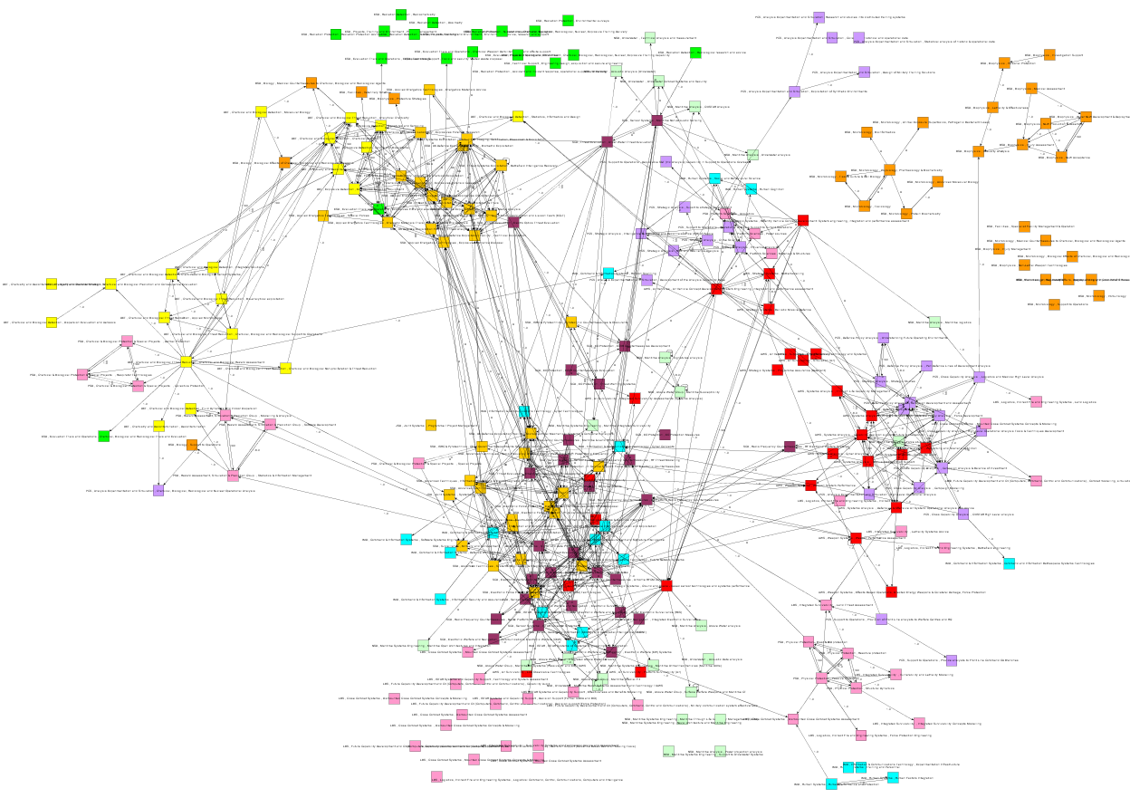
Open Networks (known known)
Characterised by access available to measure all aspects of the network
Measurables define the network
Examples:
  Passenger flight networks
  Postal network
  Road network
  Production line
Notes:
The examples are not necessarily limited to infrastructure networks, in fact this presentation aims to look at the quantification of the flow of goods within these networks.
Systems engineers and business process analysts have built careers from modelling open systems and networks for the purpose of optimising the flow and throughput (e.g. commercially six-sigma). As such this is a known and well understood science.
Image shows Network of Department Capability Interaction within Dstl

Slide 7
Closed Networks (unknown unknown)
Characterised by an inability to observe cause, effect or function.
Existence comes out of an recognition that there are networks acting that we are not aware of.
Logically impossible to quantify.
Examples: N/A

Slide 8
Partially Open Networks (known unknown)
Characterised by observed network effect without quantifiable knowledge of the network interactions.
Quantified by observation of the effect/output of the network. Often the only directly measurable aspect.
Examples:
  Illicit trafficking of Drugs/Humans/Lethal Aid/Immigration
Notes:
Where open networks enable the analyst to measure network interactions, the aim of this technique is to use intelligence analysis and other means to provide a surrogate or proxy measure from which to base an assumption to build a network model, combining the art of intelligence with the science of analytics.
Will be covered in greater detail in a following worked example.

Slide 9
Terminology
System
  A set of interacting or interdependent components forming an integrated whole
Sub-System
  Sub-component of a system
Super-System
  A system of systems
Macro-System
  A system of super-systems
Notes:
Using systems definitions as a guide to defining network interactions.
These are relevant as they assist in the definition of a hierarchical structure for the network and assist in visualisation of scalability.
I.e. A system is as large as you define its boundaries to be.

Slide 10

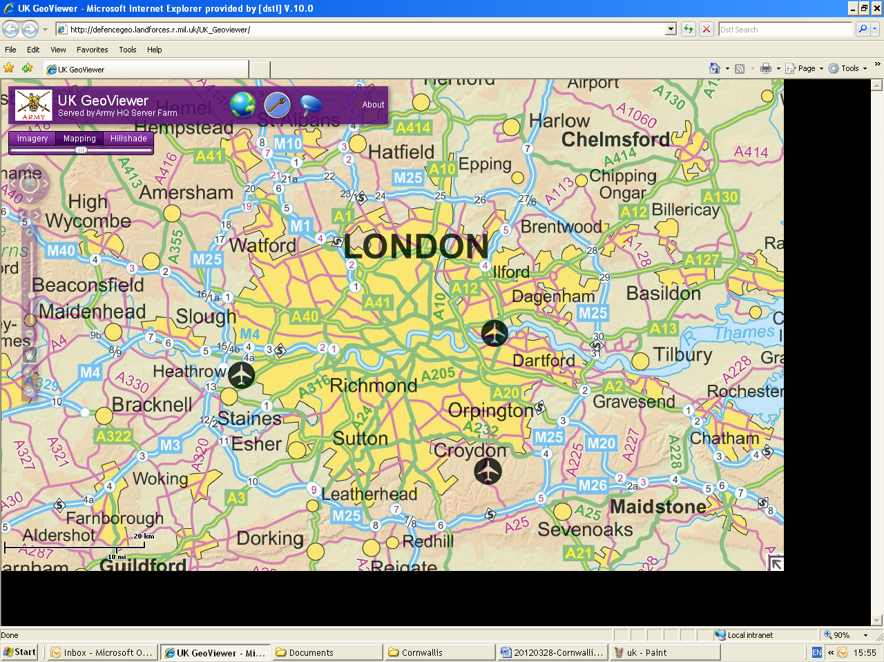
Worked Example, Exercise Scenario
Cigarettes have been made illegal in London
There is continued demand for cigarettes
  Public supplied through ad-hoc illegal road-side salesmen
  Assessed to be run by territorial gangs
Facilitation/supply assessed to be collaborative but may include extensive supplier network
Notes:
For the purposes of the workshop I have generated a fictional worked example to assist in the demonstration of the potential benefits of the proposed approach.
At no stage do I profess to be an expert in the trafficking of goods.
I am a Systems Engineer.

Slide 11
Observation of Cigarette Salesmen Activity
Notes:
By monitoring and recording operational activity and successes by security forces (Police) a geo-referenced record of cigarette related offences has been made.
It is understood that all activity cannot be observed.
This is the only direct measurable used in this technique.
It is assumed that a uniform proportion of activity is observed across the system.

Slide 12
Identification of Gang Laydown
Barnet
Woodford Green
Wembley
City
Richmond
Bromley
Croydon
Notes:
In this example, police intelligence sources have generated a postulated understanding of the gang lay-down (i.e. is given, however could be generated/combined with analytical means as well, e.g. clustering analysis).
Using a geo-analysis tool such as ESRI ArcGIS, this information can be digitally applied to the geographic location.

Slide 13
Assumption Generation
Assume uniform rate of arrest / police counter cigarette activity
How many stores have been interdicted?
Where gang boundaries overlap a 50:50 distribution of activity is assumed (initially)
Notes:
This method is heavily assumption based.
Generate assumption
Test assumption
re-write/re-test assumption as necessary/required
You have to be comfortable working with unknowns.
As discussed before, at this stage, a uniform level of police activity/performance/success rate is assumed.
From the observed figures (e.g. arrests/confiscations), a quantitative understanding of the physical amount of interdicted stores can be calculated over the analysed period of time.
Initially, boundary overlap is assumed to have an even distribution between the protagonists, however this assumption can be matured iteratively.

Slide 14
Quantities of Cigarettes by Gang
Randomly Generated Figures (Example)
Notes:
By understanding the amount of sales in a given gang district and applying the previously identified assumptions we are able to gain an understanding of the relative activity of individual gangs (sub-systems). (This can be fed back into the iterative approach to overlap if desired)
This level of understanding though, will only inform the tackling of the symptom, not the cause. In this case, cigarette sales, not supply.
What can we (as OAs and ORSAs) do and what information can we therefore use to generate a level of understanding of the network as a whole?
Can this be used to inform the picture of the wider Super-System and the Macro-System?
What part can OR/OA play in this wider analysis?

Slide 15
Identification of Gang Interactions
Notes:
By treating each gang area as a sub-system or “sub-network element”, we can look at and identify potential interactions between them (need-lines).

Slide 16
External Influence/Supply
Notes:
By treating the London Cigarette gang network as a network within a “Super-network”, we can gain an understanding of / assume the external influences.
What is the level of connectivity?

Slide 17
Definition of Points of Entry
Notes:
When these two elements are combined an assumed understanding of inputs to individual sub-system elements can be identified.
“Click”
“Click”
We will look at the Bromley element in more detail.

Slide 18
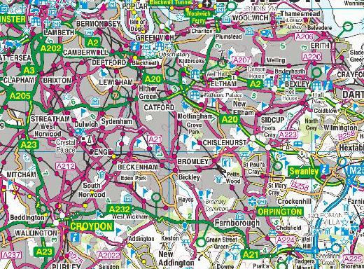
Definition of Gang Interactions
15%
10%
60%
15%
Notes:
Through structured interview with an intelligence expert on “Bromley”, a postulated understanding of the relative level of input into their sub-system element can be generated.
“Click”
This is not an observed measurable, it is a hypothesis formed by an intelligence subject matter expert.
This activity can then be repeated for each element to generate relative requirements for each element as an input.
The cross border input requirement for one element will be the output required from another etc

Slide 19
Quantify Boundary Interactions
Notes:
From the aggregation of these intelligence driven relative requirements, applied to the observed and recorded levels of activity, sub-system boundary interactions can be quantified in terms of input/output across each boundary.
Wembley (for instance) requires to draw all of its cigarette requirement from other sub-systems (City, Barnet & Richmond)
Wembley may however also provide for Barnet, therefore drawing extra (above its own usage requirements) from City and Richmond to facilitate.

Slide 20
Quantify Points of Entry
(Tactical/Operational Bdry)
Notes:
This will drive the quantifying of the external inputs or points of entry.
If one of the inputs were disrupted, the effect in the system could be estimated.
A second way of looking at this is to do with net import/export
Who are the net importers?
Who are the facilitating elements/net exporters? Who do they facilitate? Where do they draw their stocks from?
If Network element Import = Export then they are a pure facilitator. Depending on how close to “Zero” they are gives how facilitative the element is. This could be easily shown by Colour coding.

Slide 21
Quantify Gang Feed and Nodes
(Tactical Connectivity)
Notes:
Looking at Wembley, how does the facilitation flow to supply them.
Whilst summative chains exist, what is their volume at a given point (can be calculated).
The most effective targeting of the Wembley network may therefore (for instance) involve action in Croydon.
Following this stage, if you were then to aggregate the facilitation chains of each element to identify network chains/links with high flow rates.
Flow in both direction in this case is positive as is indicative of level of activity geographic area. From this summation, a critical path with specific nodes and links can be identified to focus “police effort” (in this case) to provide maximum network effect (within defined jurisdiction) with limited resource.

Slide 22
So What?
A lack of activity is indicative of something
Non-Operational feed network elements could be indicative of various results:
  Rival gangs
  Separate system
  Different role (e.g. not sales orientated)
  Inactivity in Bromley indicative of:
    Northern supply focus?
    Facilitative focus?
Highest level of flow within the network
Largest point of entry into the network

Slide 23
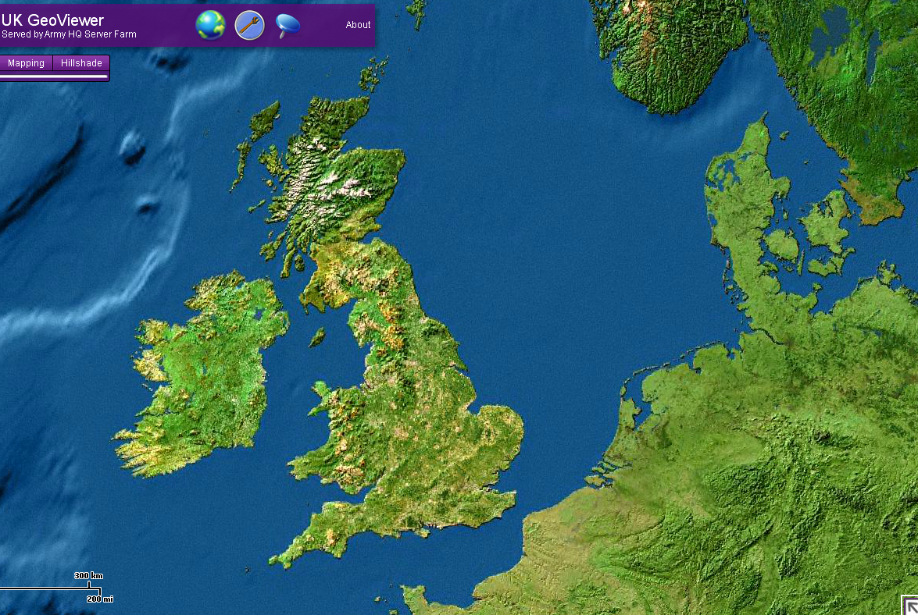
Quantify Operational & Strategic Connectivity
© Crown Copyright Dstl 2012
Notes:
If we can treat gangs in a city in that way, then by scaling the area back to a national level, it should be possible to conduct similar analysis between population centres or districts/provinces.
From this, the next logical step is then to generate an international/transnational understanding.
Ultimately, the question as to scope is limited by your definition of the network and what the jurisdictive position of the decision maker is.
I.e. what is within the decision maker’s power to influence, both in terms of command and legally?
Should this therefore potentially be handed up to the next level?

Slide 24
Maturing the Model
The example shown is a fairly simple model
The in the previous example, the model can be further matured through the maturation of assumptions:
  Population Density (proxy for criminality density)
  Security force density (may influence arrest/activity rate)
    By population
    By geographic area
  Etc.
Notes:
A unique set of assumptions may be required for each scenario that you may look at.
The generated example was purely for demonstration purposes.

Slide 25
Constraints
Limited by
  Intelligence Understanding
  Robustness of assumption
  Common data capture
  Knowledge of whether you are correct
Notes:
It will be difficult to use this method in an area where there is little or no knowledge of the wider intelligence picture.
This lack of intelligence understanding may impact on the robustness of the assumptions that are generated.
A common baseline data capture methodology/hierarchy/taxonomy is required, especially as you begin to scale back to a wider area of operations where this may be less controllable.
It is difficult to know whether you have been correct with your assumptions/model generation as the result can only be observed if action is taken. The issue however is that a human network is likely to be intelligent and is therefore likely to change following this application of an external effect (a “wicked” problem).

Slide 26
Conclusions
This approach has been developed from a tactical perspective.
The tactical network will be inherently “Wicked”
  Any imposed constraint/change will imply change in the network
It has not been tested at the operational/strategic level where it may be more stable to imposed change.
Benefit may be observed in diverse subject networks.
This work has been developed in isolation.
  External feedback and common experiences are appreciated.

Slide 27
Questions

