Slide 1
‘Operational’ Operational Analysis After Afghanistan
Graham Brownbill Group Principal Analyst, Support to Operations , UK Dstl
Presentation includes views of the author, these are not necessarily the same as those of UK Govt or Dstl
OFFICIAL

Slide 2
BLUF (Bottom Line Up Front)
For 12 years a single operational priority has given Operational Analysis an advantage and challenge. This has given us a greater profile and opportunity to prove ourselves to senior commanders.
This is now ending, we are losing this priority and the exposure that it provides. However, despite the austerity driven wishful thinking in our capitals the world is an increasingly unstable place.
Dstl is preparing for future operations by ensuring that it has the embedded capabilities required.
OFFICIAL

Slide 3
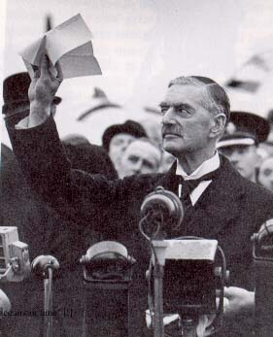
Peace in our time
Arab Spring turned to Winter.
Resurgent Russian Bear.
Cash rich China.
Chemical weapon red line crossed with impunity.
Loss of credibility and neutrality.
Lack of understanding of military matters amongst NATO governments.
Austerity.
OFFICIAL

Slide 4
Pressures on capability
Defence unlike hospitals and schools does not have a baseline.
It is little understood (and even less respected) and will not be without a catastrophic failure.
Reviews inevitably justify cuts.
Studies that support cuts are produced to imply academic rigour.
However, these reviews and supporting studies are often one sided.
OFFICIAL

Slide 5
Impact on OA
Reduced OA budgets and manpower caps.
Threat of being replaced by non-professionals
Greater pressure to bend studies to recommend cuts.
Enhanced importance of honesty.
Increased need (but fewer opportunities) for analysts to fully understand their military analyst profession.
At worst nations and NATO may decide that OA particularly ‘operational OA need not be retained or can be contractorised.
Risk of starting again too late for the next challenge.

Slide 6
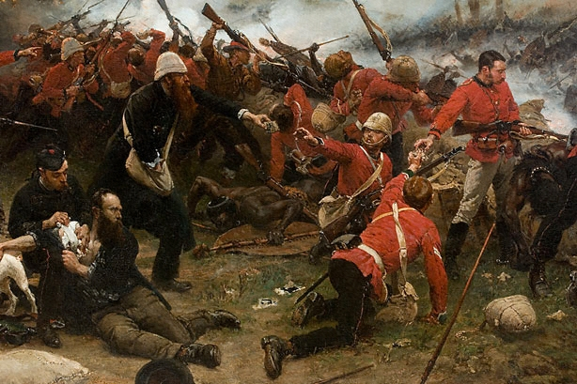
Operational OA?
Those elements of OA directly contributing or preparing to contribute to operational decision making.
Needed in large numbers in war time.
A smaller standing capability in peacetime ready for immediate support.
Enhanced by the mobilisation of all analytical capability.
Not a separate population of analysts but regular cross fertilisation as part of a balanced career.

Slide 7
High impact Decision Support
Decisions:
(Strategic) Decision to go to war, Strategic direction, scale of effort and objectives (embedded OA).
(Operational) Decisions how to go to war, campaign plan to achieve success, avoid failure and measure progress. (embedded OA).
(Tactical) Decisions to deliver elements of success. Mission plan, Mission Assessment and Mission Monitoring. (Deployed OA).
(Tactical) Effective employment of capability adapted to meet front line requirements (Scientific Advisor (SCIAD)).

Slide 8
Enablers
Assigned analysts to the HQs in peacetime.
OA formalised in Procedures and manning charts.
Supported by:
  Reachback.
  Graduated readiness of trained augmentees and full time people.
  Training.
  Policy and process to allow safe and effective deployment.
  Access and support by senior management and the wider analytical community.

Slide 9
UK progress so far
OFFICIAL

Slide 10


Not Only Afghanistan!
Kosovo
, KFOR:
Scientific and Analytical
Support to Operations and Crises
HQ ARRC OAB deployed for
Afghanistan
, ISAF:
7
-
months. WETs, AWC ('99)
HQ ARRC OAB deploys for 1
-
year ('05
Afghanistan
, ISAF:
-
'07)
OA teams in HQ ISAF & UK
Gulf
, Op GRANBY:
Royal Marines ('02)
Afghanistan
, ISAF:
OA deploys with 1 (UK)
Afghanistan
,
HQ ARRC OAB deploys for 1
Cabinet Office
: Fuel
Op HERRICK:
UK and NATO
-
Div ('90
-
'91)
HQ. 300+ Dstl staff over 7
year into HQ IJC ('11)
crisis
('00)
-
years, predominately OA and
SCIAD ('05
defra
: OA support Foot &
-
'12)
Mouth crisis
Bahrain
, Op TELIC /
Mali
('01)
Op KIPION:
OA deploys to
Op Newcombe:
UK MCC Bahrain. ~40 Dstl staff
(’13)
over 6
-
years ('06
-
'12)
1990
1995
2000
2005
2010
2015
Iraq
, Op TELIC:
OA team in
Bosnia
, SFOR
:
HQ MND(SE). 200+ Dstl staff
Turkey/Italy
,
Fly
-
away OA teams. ('96
-
'99)
over 7
-
years, multitude of roles
Op ELLAMY:
AWC team
('03
-
'09)
deploys air analyst to NATO
Kuwait/Qatar
:
Dstl
HQ ('11)
deploys scientists ('03)
Bosnia
, IFOR:
HQ ARRC
Oman
, Ex Saif Sareea II:
Cabinet Office:
OAB deployed for 1
Firefighters Dispute
('07)
-
year.
OA teams in JFHQ and LCCHQ
NATO's 1st Op deployment.
('01)
('95
-
'96)
OFFICIAL
© Crown copyright 2013 Dstl

Slide 11
High impact Decision Support
(Strategic- Military Strategic Plans (MSP)), preparation for future crisis. decision how to react to a particular crisis, scale of effort and strategic national objectives.
(Operational) Preparation for future operations. Planning to deliver strategic objectives, assessment of campaign progress, the deployment, sustainment and recovery of force.
(Tactical – formations) Maintaining capability for future ops, in theatre command and control of assigned forces mission planning and assessment, effective use of capability, Air campaign planning & targeting, Maritime Battle Staff..
Enablers: Reachback, Risk Management, Policy, Graduated Readiness.
OFFICIAL

Slide 12
Analytical Support to Crisis and Contingency
MOD Military Strategic Planning (MSP) supports Ministers, CDS and senior officers in developing the MOD response to contingency and Crisis.
MOD Operations Directorate develops the strategy developed by MSP and provides strategic direction for current operations.
Dstl has now set up a team to support MSP, providing embedded analysts in the planning team and extensive reachback.
OFFICIAL

Slide 13
Joint Expeditionary Force (JEF) and VANGUARD
MOD criticised for the fraction of the forces that can be deployed.
JEF is MODs answer, directing what forces should be provided at readiness.
VANGUARD is the army’s contribution allocating every formation a readiness and including what that formation should bring and how it will be tested (ACTIVE EDGE).
OA and SCIAD included in the ORBAT for Air Assault Task Force, Lead Commando task force, Lead Armoured Task force (as part of the Bde HQs) and VANGUARD Division.
The challenge is to make it happen.

Slide 14
Existing capabilities with re-emphasis on readiness and contingency planning
PJHQ
  Joint Force HQ
HQ ARRC
Joint Force Air Component Command
Formation Support
Maritime
OFFICIAL
© Crown copyright 2013 Dstl

Slide 15
Scientific Support in Crisis & War
Primary project for maintaining readiness.
Maintains the capability to support future ops and safe and effective deployment of Dstl personnel to operational theatres and hostile locations.
  Policy and process.
  Risk Management.
  Standing Reachback capability.
  Enhancement of SCIAD capability.
  Graduated Readiness of permanent staff and augmentees
  Mandatory Training
  Technical and on the job training and experience
  Limited studies capability.
OFFICIAL

Slide 16
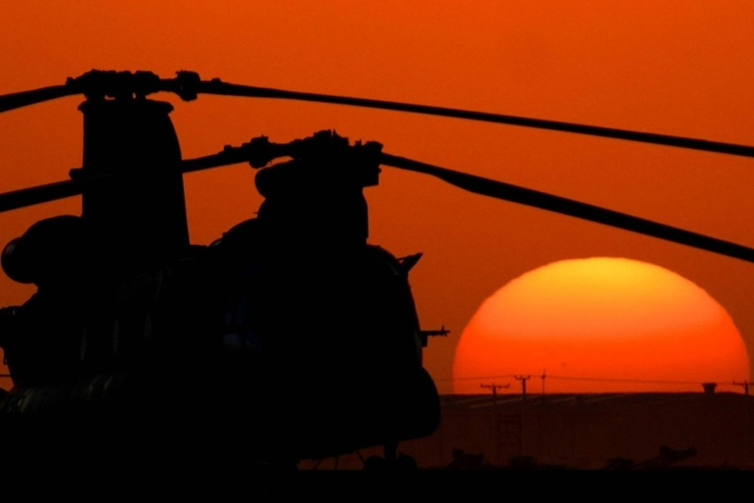
Conclusion
We are now losing the advantage and challenge of a single operational priority.
However, despite the austerity driven wishful thinking in our capitals the world is an increasingly unstable place.
To keep OA relevant we must maintain the highest standards and ensure that we focus on the decisions that really matter.
Dstl is preparing for future operations as a priority.
OFFICIAL

Slide 17
Notes:
This slide may be shown at the end of the presentation.

