Slide 1
UK OFFICIAL
(releasable to the public)

Slide 2
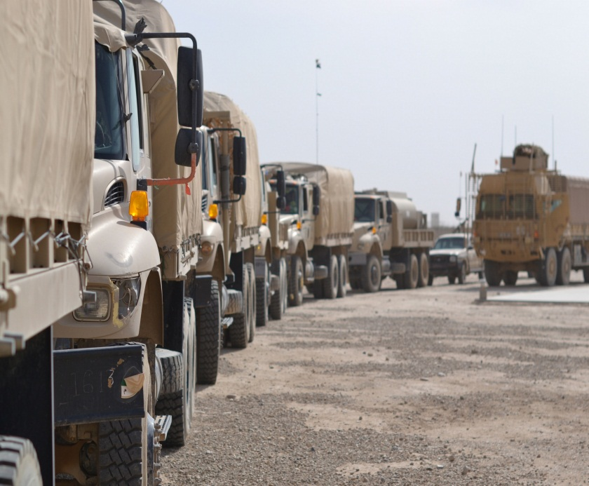
Analysis to inform the cost-effective redeployment of materiel from Afghanistan
Cornwallis XIX: Analysis of Commercial and Market Force Roles in Conflict Management and Mitigation
30 July 2014, Royal Holloway, University of London,
Publication reference: DSTL/CP82520
René Nevola
Principal Analyst
Human Systems Group, Information Management
Dstl Porton Down
WILTSHIRE SP4 0JQ, UK
( + 44(0)1980 65 8233
mil. (9)6801 8233
≡E+ vrnevola@dstl.gov.uk
UK OFFICIAL
(releasable to the public)

Slide 3
Security classification
The content of the following slides remains at UK OFFICIAL (UNCLASSIFIED) or below:
However,
Questions concerning the content of the following slides may demand a response that requires a higher level of classification. Under such circumstances a response will be provided which will remain at UK OFFICIAL (UNCLASSIFIED) for the purpose of this presentation (apologies in advance).
UK OFFICIAL
(releasable to the public)
30 July 2014
© Crown copyright 2014 Dstl

Slide 4
Presentation plan
About the presenter
SCIAD/OA role in Afghanistan
Setting the scene (OP HERRICK 18/19)
Understanding the concerns and the requirement
Analysis undertaken (delivering the plan)
Informing evidence-based options/solutions
Impact (Measure of Effect)
… Questions
45 minutes
15 minutes
UK OFFICIAL
(releasable to the public)
30 July 2014
© Crown copyright 2014 Dstl

Slide 5
About the presenter
René Nevola (vrnevola@dstl.gov.uk)
Principal Analyst (OA) / Scientist (human sciences) at UK MOD’s Defence Science and Technology Laboratory (Dstl);
Ex-Army with 24 years MOD research experience;
6 operational deployments as head of Operational Analysis (OA) and scientific advisor (Iraq and Afghanistan);
UK National Leader to the cross-Government international research collaboration and chairman of a NATO research group;
Capability and Technical Advisor to MOD research programmes;
Visiting lecturer to University MSc course.
MMedSci (Master of Medical Science) and member of American College of Sports Medicine and Operational Research Society.
UK OFFICIAL
(releasable to the public)
30 July 2014
© Crown copyright 2014 Dstl

Slide 6

SCIAD/OA role in Afghanistan
SCIentific ADvisor / Operational Analyst;
Deployed civil servants (scientists / analysts);
Providing robust technical/analytical advice to inform Commanders’ evidence-based (strategic and tactical) decisions;
Based at HQ Task Force Helmand and HQ Joint Force Support (Afghanistan);
Deployed by PJHQ J5 SCIAD DACOS to provide Support to Operations (S2O);
Reachback capability to a pan-government department network of expertise (co-ordinated by Dstl).
UK OFFICIAL
(releasable to the public)
30 July 2014
© Crown copyright 2014 Dstl

Slide 7
Setting the scene (OP HERRICK 18/19)
Maintenance of security in Afghanistan was at an end-stage of transition from ISAF to Afghan National Security Forces (ANSF);
ISAF Forces were leaving Afghanistan and redeploying their respective national assets to home bases (within similar time-scales, using similar strategies and requiring similar resources);
The size of the redeployment challenge for UK Armed Forces was described by the MOD press office as “the biggest logistical challenge since World War II”
In total, it is estimated that between 01 Oct-12, when redeployment started, and the end of operations, approximately 5,000 Twenty-foot Equivalent Units (TEUs) worth of materiel (including 400 tonnes of ammunition) and 3400 vehicles and major equipment (including 50 aircraft) will have been redeployed (Source: http://www.army.mod.uk/news/26323.aspx)
UK OFFICIAL
(releasable to the public)
30 July 2014
© Crown copyright 2014 Dstl

Slide 8
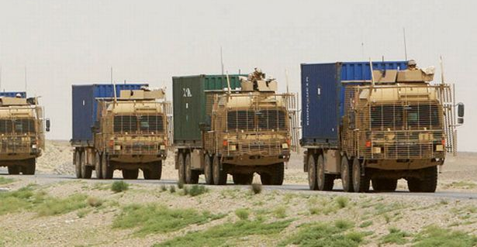
Setting the scene (OP HERRICK 18/19)
© Crown copyright 2014. Image courtesy of defence images database
UK OFFICIAL
(releasable to the public)
30 July 2014
© Crown copyright 2014 Dstl

Slide 9
Setting the scene (OP HERRICK 18/19)
Operations in Afghanistan 2013
To meet the Chief of Joint Operations’ (CJO) redeployment targets (to time, cost and quality) the Commander sought to:
  Identify the size of the redeployment challenge;
  Reassess the requirement for re-supply to better match supply to demand and avoid preventable wastage (which risked delaying redeployment);
  Process the redeployment of redundant assets as early as possible to avoid over-loading capacity at a later stage;
  Identify ways of improving faster more efficient processing and transport (e.g. ensuring chartered lines of communication operated at near-capacity) of assets for redeployment without reducing standards;
  Reduce the size of the challenge by avoiding redeployment of non-ACTO assets that were: [a] of lesser value than the cost of transit; [b] unfit for re-use by UK Forces; and [c] could be sold/disposed locally.
*
( * ACTO: Attractive to Criminal and Terrorist Organisations)
UK OFFICIAL
(releasable to the public)
30 July 2014
© Crown copyright 2014 Dstl

Slide 10
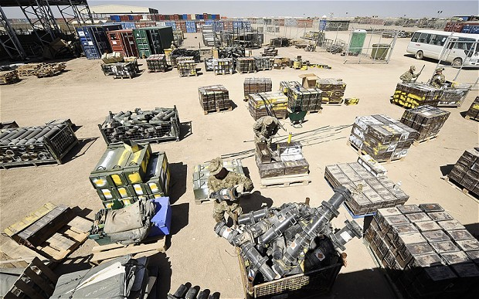
Setting the scene (OP HERRICK 18/19)
Operations in Afghanistan 2013
© Crown copyright 2014. Image courtesy of defence images database
UK OFFICIAL
(releasable to the public)
30 July 2014
© Crown copyright 2014 Dstl

Slide 11
Understanding the concern
Customer’s (DCOMD JFSp[A]16)* (dated 2013) expressed concern
  Reported delays to the movement of contractors’ trucks in/out of Camp Bastion were adding risk to the timely (and cost effective) redeployment of UK assets from Afghanistan;
  The process for entry to Camp Bastion (via the Main Entry Point [MEP]) was imposing considerable constraint upon the sale of UK disposals (that were assigned as scrap) to local businesses. Failure to sell such redundant assets (scrap) in-theatre would incur added expense for their in-theatre destruction or delay the timely redeployment of more valuable assets by occupying space upon expensive/limited ‘lines of communication’ to the UK.
* DCOMD JFSp(A) : Deputy Commander Joint Force Support (Afghanistan)
UK OFFICIAL
(releasable to the public)
30 July 2014
© Crown copyright 2014 Dstl

Slide 12
Understanding the requirement
  Requirements that were to be addressed by the analysis described in this presentation were to inform evidence-based options for:
  Reducing the delays to contractor movements in/out of Camp Bastion
  (i.e. efficiently process scrap for re-sale);
  The efficient, timely, and cost-effective sale of disposed UK assets at Camp Bastion
  (i.e. optimise commercial disposal whilst maintaining security/force protection).
  To provide options for the above requirements whilst assuring full compliance with the highest standards (as priority) for effective force protection of Camp Bastion and ISAF (International Security Assistance Force) dependents resident within the base.
1. Traffic management : scheduling
2. Customer access to UK commercial contractor
UK OFFICIAL
(releasable to the public)
30 July 2014
© Crown copyright 2014 Dstl

Slide 13

Concern
Understanding the concern & requirement
Pre-entry processing (Y)
Pre-entry ‘SOAK’ (X)
V
V
Protected area outside-the-wire
Added factors to consider:
Scheduled opening hours
unscheduled closure time
Combat Logs Patrol (CLP) entry
manning constraints
Processing rates
Processing capacity
Competing demands with coalition partners’ plans
Contractor EXIT was only available between ‘entry-waves’.
Gravel Soak Lot (GSL)
MEP (Z)
Base
V
V
Inside-the-wire: Protected
Time to enter Base via MEP = X+Y+Z
UK OFFICIAL
(releasable to the public)
30 July 2014
© Crown copyright 2014 Dstl

Slide 14
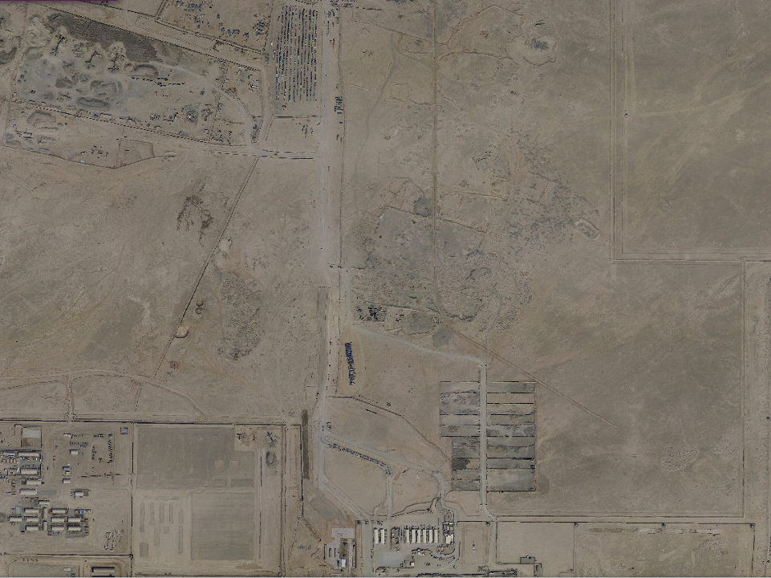

Concern
Unplanned delay:
Accumulation of traffic / vehicles awaiting entry to the processing areas
1. Traffic management (scheduling)
‘SOAK’ processing areas for entry to Camp Bastion
2. Customer access to UK commercial contractor (sales)
Gravel SOAK Lot (GSL)
UK OFFICIAL
(releasable to the public)
Main Entry Point (MEP)
Image courtesy of
Earth
Notes:
Drivers were reporting multiple days in SOAK (i.e. waiting to enter the base)
Emergence of non-ISAF parking area charging drivers and using a fee-based queuing system which accounted for delayed movement (of up to 18 days in extremis) to the official MEP SOAK area
Excessive time for customers to collect purchases from the UK disposal-sales contractor known as AGILITY was hampering business.
Lengthy periods waiting to deliver to the MEP were unlikely to be within the ISAF managed SOAK, and prior to the analysis such delays could not be consistently explained;
There was a need to carefully coordinate the arrival of vehicles at the MEP to remain within a sustainable rate of processing through the MEP, thereby removing the need to ‘wait’ prolonged periods in a non-ISAF parking area.

Slide 15
Analysis C2 (command and control)
Defining the task
  Meeting with customer (DCOMD JFSp[A]16) and stakeholders (OPG[R] , USMC: US Marine Corps, TCMC: Theatre Contractor Management Cell)
Governance and co-ordination (i.e. command and control)
  SPG , USMC-UK meetings (share analyses with deployed ORSA and coordinate ops scheduling)
Planning the analysis
  Agreed with PJHQ J5 SCIAD DACOS
Delivering the plan
… details follow in the following slides.
*
*
*
SPG: Strategic Planning Group; OPG[R]: Operational Planning Group (Redeployment)
UK OFFICIAL
(releasable to the public)
30 July 2014
© Crown copyright 2014 Dstl

Slide 16
Planning the analysis
Strategy for meeting the 2 aspects of the requirement
1. Traffic management (scheduling)
  Review the process for entry and exit to/from Camp Bastion;
  Determine the actual flow of MEP traffic with the existing resources;
  Estimate the theoretical maximum achievable flow of traffic through the MEP based upon; (a) existing; and (b) supplemented resources;
  Suggest evidence-based options for improving the efficiency for processing of vehicles through the MEP (fully compliant with ops/security procedures);
  Inform options for scheduling military traffic using the MEP;
  Co-ordinate and schedule (with stakeholders/contractor) commercial traffic;
  Assure full compliance with the mandated process for secure traffic management.
UK OFFICIAL
(releasable to the public)
30 July 2014
© Crown copyright 2014 Dstl

Slide 17
Planning the analysis
Strategy for meeting the 2 aspects of the requirement
2. Customer access to UK commercial contractor
  Compare the demand upon the MEP with the capacity (resource-dependent)
  Analyse traffic patterns (to/from the MEP) and identify reasons for delays which cannot be explained by constraints at the MEP
  Consider options to mitigate delays and estimate the benefit of each;
  Understand the ‘sales’ process and estimate the demand upon the MEP
  Stakeholders down-select of evidence-based options
  Measure of effect / impact.
UK OFFICIAL
(releasable to the public)
30 July 2014
© Crown copyright 2014 Dstl

Slide 18
Delivering the plan
Analysis undertaken
Review the processes for moving in/out of the base
  Fragmented orders (FRAGOs), Concept of Operations (CONOPS), Standard Operating Procedures (SoPs), BRITFOR SOIs etc.
  Meeting with stakeholders (redeployment and Main Entry Point [MEP])
Determine ACTUAL process adopted
  Direct observation (visits) including time-motion studies and analysis
  Analysis of data records held by MEP stakeholders (US Marine Corps, RAF Regt Force Protection staff, Theatre Contractor Management Cell [TCMC])
Model the processes
  Simul8 model (developed in collaboration with Dstl (Mr David Cooley), independently verified, and validated in-theatre with actual data and observations).
UK OFFICIAL
(releasable to the public)
30 July 2014
© Crown copyright 2014 Dstl

Slide 19
Delivering the plan
Analysis undertaken : Modelling and analysis
Estimating the influence of options to change the process(es)
  Simul8 model (stochastic model) of the MEP and its SOAK processes, with user-input options (permitted within 1st to 99th percentile range of each variable’s capacity)
  Development of an MSExcel workbook containing macros to process the Simul8 data files and graphically display results (including total flow of traffic, queue times/locations etc.).
  Estimated confidence interval for theoretical (modelled) options (simulations)
  Statistical analysis of ‘actual recorded data’ v. estimated confidence interval of specific options (ɑ=0.05, paired t-test for the normally distributed data).
UK OFFICIAL
(releasable to the public)
30 July 2014
© Crown copyright 2014 Dstl

Slide 20
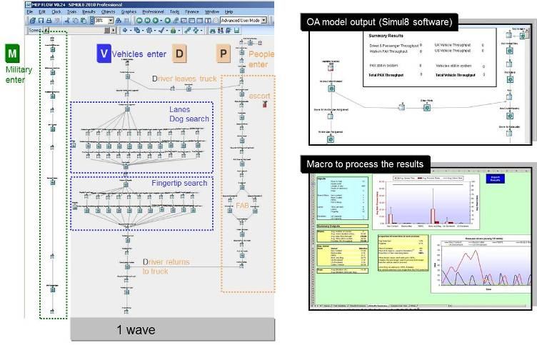

Delivering the plan
Analysis undertaken : Modelling and analysis
A stochastic, discrete event simulation model (using Simul8 software) was developed by Dstl in response in collaboration with the Operational Analyst (OA) in-theatre. The model included resources and empirically-derived ‘work-times’ provided by in-theatre SMEs and recorded by OA during direct observations conducted at the MEP.
Time to complete: ‘X’ minutes
UK OFFICIAL
(releasable to the public)
30 July 2014
© Crown copyright 2014 Dstl

Slide 21
Delivering the plan
Informing evidence-based decisions: Modelling and analysis
  Use of the Simul8 model (which had been verified by Dstl and approved for use by PJHQ and D. Scrutiny) enabled evidence-based options to be addressed for BOTH of the 2 key aspects of the requirement:
1. Traffic management : Scheduling
2. Customer access to UK commercial contractor
UK OFFICIAL
(releasable to the public)
30 July 2014
© Crown copyright 2014 Dstl

Slide 22
Delivering the plan: Queues/delays?
Analysis undertaken : Modelling and analysis
Emergence of unofficial pre-SOAK parking area
Rate of MEP processing remained constant
Driver-reported delays to entry were not attributable to time in the official SOAK process
Time vehicle spent in process (days)
B > A
T-Test p=0.03
Statistically significant
Vehicle time spent in ‘SOAK [?]’ (Source: driver)
A
B
B = A
T-Test p=0.24
Vehicle time spent in ‘SOAK [√]’ (Source: ISAF)
B = A
T-Test p=0.16
A
B
Vehicle time at the MEP (source: ISAF)
Period in 2013 (A = 6 wks; B =6 wks)
UK OFFICIAL
(releasable to the public)
30 July 2014
© Crown copyright 2014 Dstl
Notes:
The analysis showed that:
Time to process vehicles at the MEP itself had not changed between periods;
Neither had the time that vehicles had spent in the official soak area changed between periods;
However, driver-reported periods waiting to enter the base had increased significantly (B>A). Some drivers (very few) had negotiated contracts that paid according to their total time on-task , which may have added to the anecdotal reports of extended periods of waiting time (as it was arguably in the interest of such drivers to maximise their ‘time on task’). Most contracts were paid by the number of deliveries made and the reverse was true of such drivers (who sought the quickest time to be processed at the MEP in order to make their next paid delivery).
The existence of an unofficial ‘parking area’ was evident and likely accounted for the majority of reported delays. Such analysis provided evidence with which to seek support from local authorities to police.

Slide 23
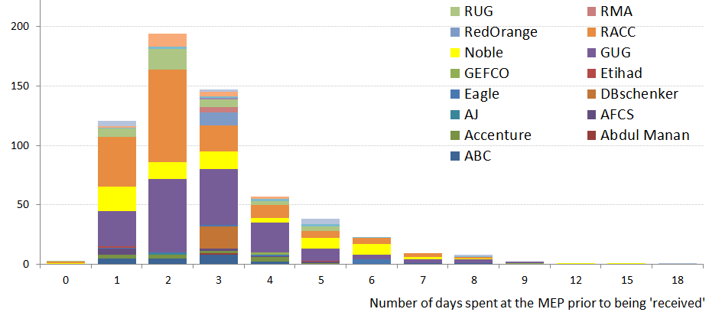



Delivering the plan: MEP utilisation
Analysis undertaken : Records of contractor deliveries
73.6% of all contracted entries at the MEP
There was no statistical bias evident between contractors regarding time in ‘SOAK’
Frequency
(number of entries recorded on the
TCMC access programme spread sheet)
Contractors making the fewest deliveries in-period tended to report longer process times.
LESSON: Educate and inform (process).
note:
The coloured bars represent contractors
UK OFFICIAL
(releasable to the public)
30 July 2014
© Crown copyright 2014 Dstl
Notes:
The analysis showed that:
Most drivers achieved their deliveries within the planned processing times;
No bias was evident to suggest prioritizing the processing of any one contractor above another;
Those drivers reporting the longest processing times had made the least frequent deliveries and were likely less familiar with the process (making errors such as forgetting documents needed by security, queuing in the wrong places etc.);

Slide 24
Delivering the plan: MEP utilisation
Without use of the GSL for sales, spare capacity (to support increased ‘sales’) could only be achieved with additional resources or when reserved capacity was not required
Where: Capacity = Maximum processing rate
Processing rate for entry to Camp Bastion (Vehicles·day⁻¹)
MEP capacity C
(for additional resource option 2)
Agreement with ORSA analysis
MEP capacity B
(for additional resource option 1)
Reserved (military use)
MEP capacity A
(for existing resources)
Reserved
(military use)
Actual
(incl. customer access)
Actual
GSL sales
Spare capacity (MEP)
Until GSL was used for sales, customers had to enter the base to collect/view their purchases.
Improved Customer access
UK OFFICIAL
(releasable to the public)
30 July 2014
© Crown copyright 2014 Dstl
Notes:
Use of the GSL removed part of the demand from the MEP itself and thereby enhanced resilience (by establishing ‘spare capacity’) within the existing resources that supported the management and security of the entry/exit process;
The analysis concurred with that of the ORSAs in-theatre. Results and the model were shared with coalition partners as part of a collaborative agreement supporting each other.

Slide 25
Delivering the plan: GSL utilisation
GSL: Gravel SOAK Lot
Processing rate (Vehicles·day⁻¹)
MEP loading
Where: Capacity = Maximum processing rate
Exploitable capacity (GSL)
GSL sales expected
GSL capacity
(existing resources)
Commercial use of GSL optimised the sale of disposals (reducing the strain on redeployment), and enabled cost-effective resilience at the MEP (without use of additional resources).
GSL sales
Actual
Analysis continues to inform the evidence-based scheduling of traffic at the MEP to remain within capacity (and possible expansion of the GSL).
UK OFFICIAL
(releasable to the public)
30 July 2014
© Crown copyright 2014 Dstl
Notes:
Initially planned use of the GSL was well-within its capacity, but would require either expansion within the existing real-estate (or loading the excess demand to the MEP) at possible peak rates of sales;
Analysis was able to inform all options (cost-benefit appraisal etc.)

Slide 26
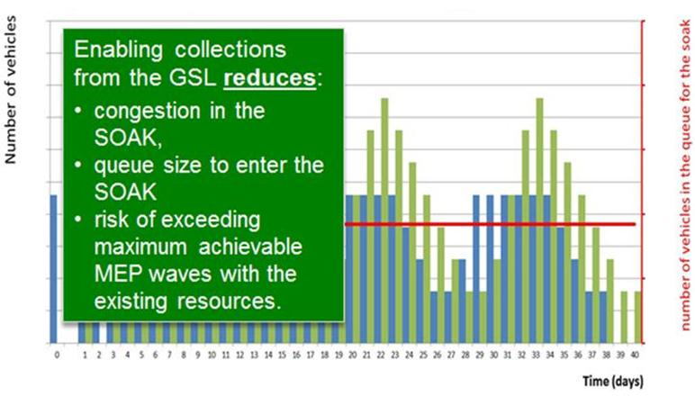
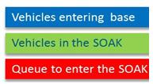
Delivering the plan : Informing the management of MEP traffic/resilience and commercial access to sold stock
Queue ‘risking’ unofficial parking delays and un-moderated costs/fees
Effective management of all traffic scheduled to arrive at the MEP reduced queues and vehicles ‘At risk’ of being directed to unofficial parking (incurring un-moderated delays and unofficial costs/fees)
UK OFFICIAL
(releasable to the public)
30 July 2014
© Crown copyright 2014 Dstl
Notes:
Analysis to inform the effective management of traffic by carefully scheduling deliveries and commercial collections was shown to reduce the risk of queues forming awaiting entry to the SOAK areas. Such queues risked being venturing into unofficial parking areas which likely accounted for lengthy delays and added expense.

Slide 27
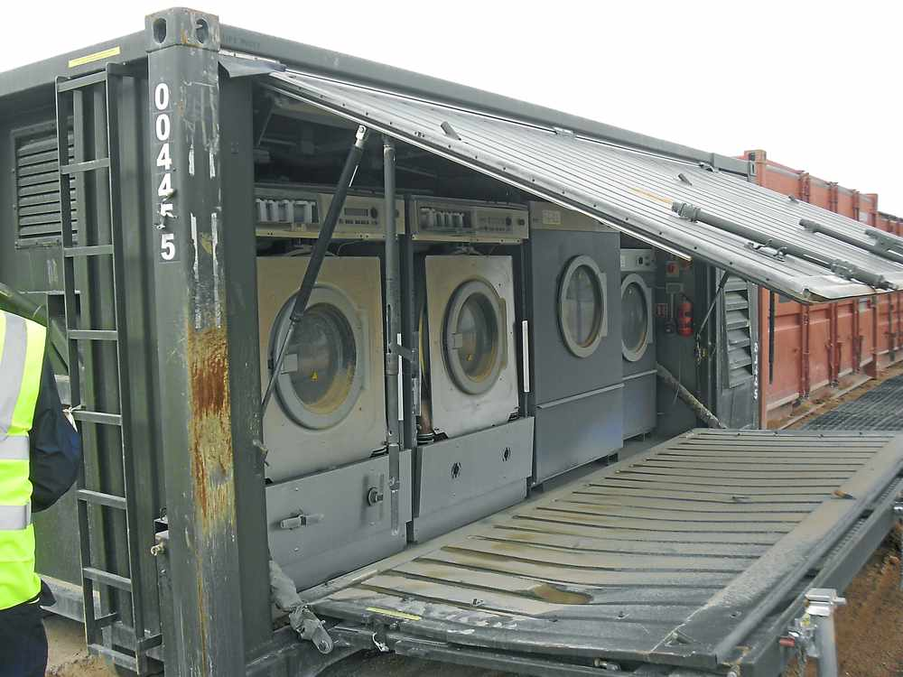
Delivering the plan
Selling items for disposal at the Gravel Soak Lot
© Crown copyright 2014
UK OFFICIAL
(releasable to the public)
30 July 2014
© Crown copyright 2014 Dstl

Slide 28
Informing evidence-based solutions
Drivers who were less familiar with the entry process accounted for most of the longer times (delays) to enter Camp Bastion;
A Simul8 model was verified (by D. Scrutiny and Dstl) and validated on the basis of comparisons between actual and modelled traffic-flow and queue sizes at Camp Bastion;
Modelling the times that drivers had reported to be in ‘SOAK’ was found to be unsustainable (further evidence of an unofficial parking area being responsible for the reported delays to traffic movements);
There was no bias evident in contractor processing within the official MEP processing areas;
The Gravel Soak Lot (GSL) was under-utilised and had exploitable capacity;
Use of the GSL to provide commercial customers with secure access to their purchases without entering the MEP, immediately increased sales from 15 collections·wk⁻¹ to 40 collections·wk⁻¹. As at Jun-14 this rate increased to 420 collections·wk⁻¹.
Analysis delivered evidence-based options concerning the management of resources to achieve enduring resilience throughout the peak traffic periods during redeployment of ISAF forces (thereby de-conflicting plans to use the same resources).
UK OFFICIAL
(releasable to the public)
30 July 2014
© Crown copyright 2014 Dstl

Slide 29
Informing evidence-based solutions
Support to Operations
Safety and security of deployed coalition forces at Camp Bastion was further assured by the timely update to the Force Protection processes directly informed (and administered) by proactive analysis (including modelling) of the flow of traffic through the base's Main Entry Point (MEP). Furthermore, the analysis identified and quantified the benefits of reducing the traffic via the MEP by exploiting an adjacent, secure area (known as the Gravel Soak Lot [GSL]) where materiel assigned for disposal could efficiently be sold to local Afghan businesses. Such action supported the Campaign Mission (e.g. enhancing economic stability) and supported MOD’s redeployment strategy by reducing additional strain on military logistics' lines of communication. Strategic use of the GSL for this purpose generated an income from items which would otherwise have incurred a cost to dispose.
UK OFFICIAL
(releasable to the public)
30 July 2014
© Crown copyright 2014 Dstl

Slide 30

Impact (Measure of Effect)
"The use of the GSL is a genuine game changer. At the moment we are moving 40 containers a week; we would like to see this increase to 100 or 120 at the earliest opportunity. We have pre-sold between 2000 and 3000 already. At 100 per week we can dispose of approximately 5000 through the GSL between now and the end of Nov-14. The flow of 100 containers through the GSL reduces truck movements through the MEP by 50 which is equivalent to over 65% of a day's volume. If this can be sustained and increased to 120 containers that is almost one day per week reduction in MEP through flow. As the outside vehicles never enter Bastion there is a commensurate reduction in security issues. It is imperative that the GSL opportunity is exploited aggressively to the full at the earliest opportunity and the current success sustained.“
Agility project manager (Bastion Disposal Project)
Reported to be 420 containers each week
Mission Exploitation Symposium (Jun-14)
UK OFFICIAL
(releasable to the public)
30 July 2014
© Crown copyright 2014 Dstl

Slide 31

Questions …
Thank you.
UK OFFICIAL
(releasable to the public)
30 July 2014
© Crown copyright 2014 Dstl

Slide 32
Abstract: Analysis informs redeployment of materiel from Afghanistan
The safety and security of deployed coalition forces at Camp Bastion is paramount. Processes are in place to control aspects such as the flow of vehicles and these are regularly reviewed based on changes to the threat. Our analysts monitored the flow of vehicles during a time of heightened threats, which informed force protection processes. The modelling and analysis of the flow of traffic identified and quantified the benefits of making use of an alternative route. During a time of heightened vehicle-borne threats, our experts informed an update to the Force Protection processes by applying modelling and analysis of the flow of traffic through the base’s Main Entry Point (MEP). The analysis identified and quantified the benefits of reducing traffic via the MEP by making use of an alternative route, where materiel assigned for disposal could efficiently be sold to local Afghan businesses. This activity supported the Campaign Mission by enhancing economic stability, supported MOD’s redeployment strategy and generated an income for the UK from items that would otherwise have incurred a cost for disposal. The use of the alternative route reduced truck movements through the MEP by more than 65% of a day’s volume and as vehicles never entered Bastion, there was a commensurate reduction in security issues.
UK OFFICIAL
(releasable to the public)
30 July 2014
© Crown copyright 2014 Dstl

Slide 33
UK OFFICIAL
(releasable to the public)
30 July 2014
© Crown copyright 2014 Dstl
Notes:
This slide may be shown at the end of the presentation.

