Slide 1
An Introduction to the Cornwallis Group
Tony Hopkin
Managing Chair the Cornwallis Group

Slide 2
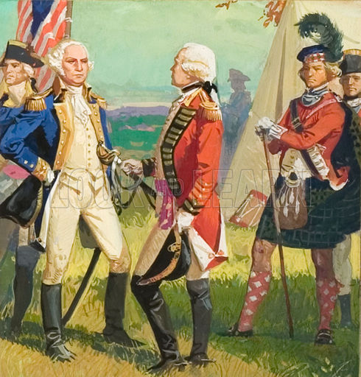
History
A small concerned gathering of analysts at ISMOR
New threats to world peace
OA addressing current or old threats
Inadequate opportunity to look at new approaches to new problems
Large workshops limit comprehensive exchange
Out of ISMOR, in 1996, The Cornwallis Group was born
The Cornwallis Group takes its name from Cornwallis Park, Nova Scotia, home to the Pearson Peacekeeping Centre; venue for the Group meetings until 2003. Cornwallis Park, in turn, is named for Colonel Edward Cornwallis, Governor of Nova Scotia in the mid-18th century; Edward was uncle to Charles Cornwallis, the general who surrendered the British Army to George Washington, at Yorktown in 1781.
Notes:
History
At the end of the 20th century, a small gathering of analysts expressed concern with the ability of operations analysis and related fields to respond to the world’s needs with the restructuring of the world into a multi-polar one. The change that occurred with the collapse of the Soviet Union at the end of the bi-polar era raised new questions for military, economic, political, and social sectors. New or revised threats to world peace and stability became of increasing importance.
A consensus emerged that there was a call for a significant change to the analytic processes, tools, and thinking about complex problems related to obtaining and maintaining peace and stability in the world. A prevalent view was that at a minimum the traditional opportunities for introducing new approaches and defining the new array of problems potentially susceptible to analytic processes were inadequate. Overcrowded workshops severely limited opportunities to develop a comprehensive exchange of knowledge, and a need arose to address these challenges.
The group decided on a format that would allow for extended time for a limited number of researchers, analysts, and users of analysis to present their views and introduce new problems and approaches to solutions. Thus was born, in 1996, what became known as the Cornwallis Group.
The Cornwallis Group takes its name from Cornwallis Park, Nova Scotia, home to the Pearson Peacekeeping Centre; venue for the Group meetings until 2003. Cornwallis Park, in turn, is named for Colonel Edward Cornwallis, Governor of Nova Scotia in the mid-18th century; Edward was uncle to Charles Cornwallis, the general who surrendered the British Army to George Washington, at Yorktown in 1781.

Slide 3
Mission
A vehicle for excellence in analysis for the purposes of international peace and stability
A bridge between national military agencies, other governmental departments, international and non-governmental organizations that often work together on the ground, but seldom meet in a reflective environment to discuss issues of common concern
The group intends to reach out to those organizations, which do not usually participate in military conferences, to engage with them in establishing a common understanding of the wider constraints under which we are attempting to deal with new operational challenges
Notes:
Mission
The Cornwallis Group sees itself as a vehicle for excellence in analysis. Through discussion, outreach, and publication, it also sees itself as a bridge between national military agencies, other governmental departments, international and non-governmental organizations that often work together on the ground, but seldom meet in a reflective environment to discuss issues of common concern. The group intends to reach out to those organizations, which do not usually participate in military conferences, to engage with them in establishing a common understanding of the wider constraints under which we are attempting to deal with new operational challenges.

Slide 4
Principles
A platform for new ideas, problems, and techniques to contribute to international peace and stability
Conduct symposia and workshops, and publications
Alternate US/CAN and EU
Open to all who would like to participate
All nations are welcomed
Three day residential workshop
Minimum of one hour of floor time
Opportunities for presentations outside the themes
Notes:
Statement of Principles
Established as a forum for the exchange of analytic techniques and processes The Cornwallis Group is not limited to models, dealing with or related to improving the conditions for international peace and stability. The group is open to all who would like to participate in its deliberations. Participants from any and all nations are welcomed into the group.
The primary activity of the group is to conduct symposia and workshops, and publications, dealing with problems and issues related to improving the conditions for, and contributing to, the establishment and maintenance of, international peace and stability.
Following the feature is the key of the founding of the group. Symposia is always designed to permit each accepted speaker a minimum of one hour of floor time, to include adequate time for discussion and questions from the audience.
While there may be themes established for symposia of the group, there will always be opportunities for presentations that cover issues outside the themes. This principle will contribute to the richness of discussions.
The group maintains a minimal administrative structure, and provides a platform and opportunities for the comprehensive exposure of new ideas, problems, and techniques to contribute to international peace and stability.

Slide 5
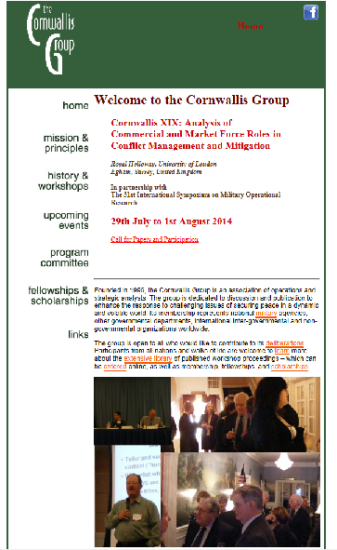
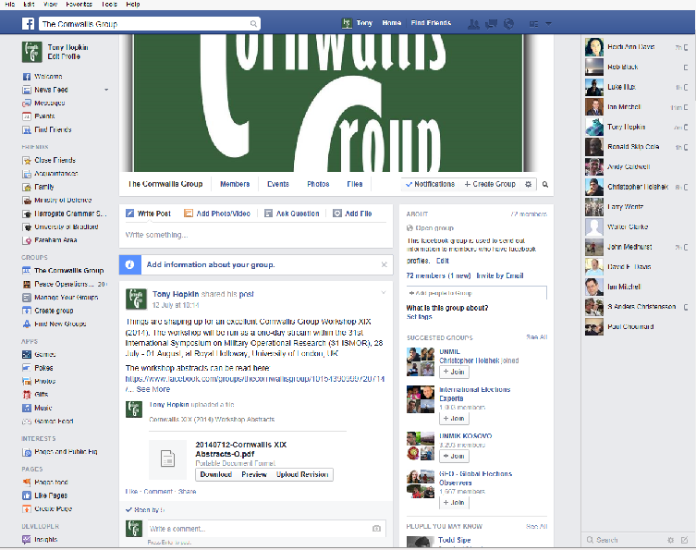
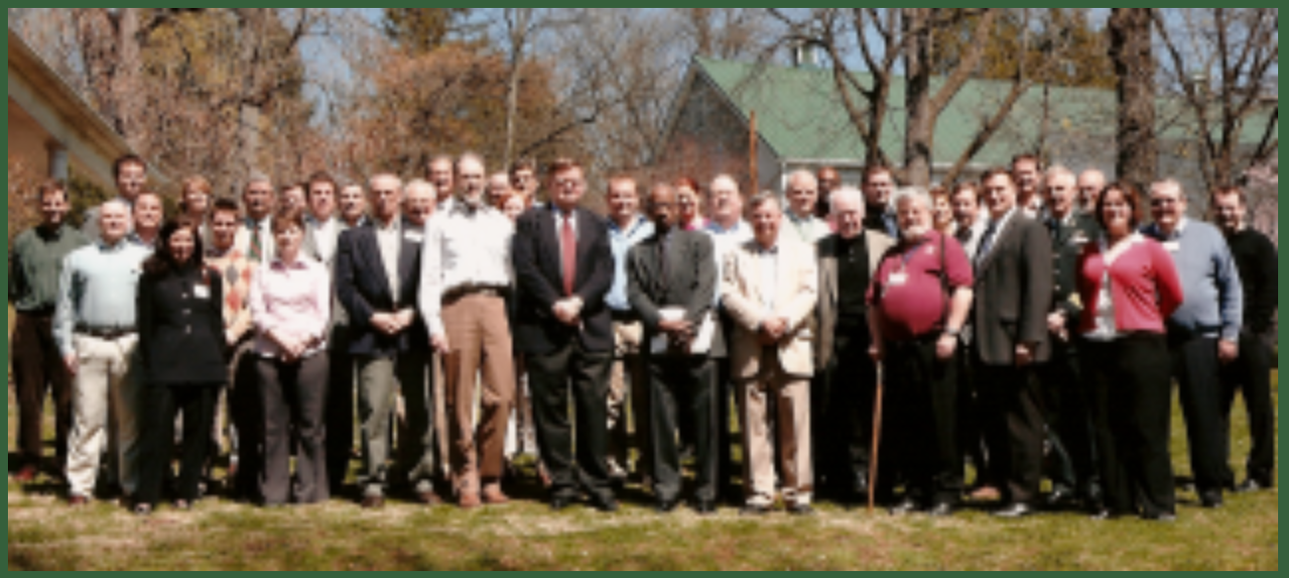
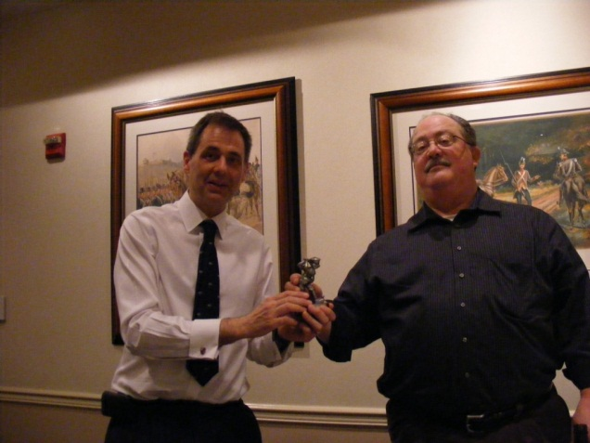
More than a workshop – a community
www.thecornwallisgroup.org/
The Cornwallis Group
The Cornwallis Group Golf Trophy
www.facebook.com/groups/thecornwallisgroup/

Slide 6
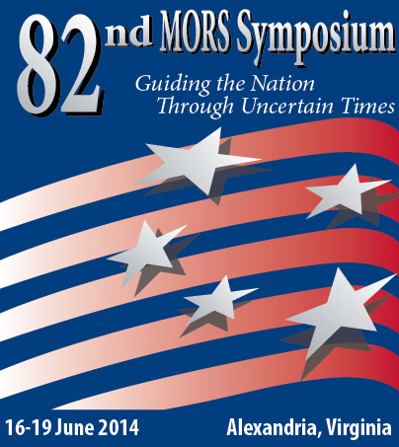
Uniquely Cornwallis Group
ISMOR, MORS and The Cornwallis Group met at the 82nd MORS Symposium. The following were identified as positive and unique to the Cornwallis Group
Forward learning and academic
Feedback by referees papers (peer review)
Exploring analytical challenges beyond direct operational operations
More orientated to peace, stability, security
The reach to OGD, CSO, NGO
1-hour papers, deeper discussion

Slide 7
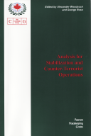
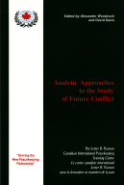
Topics covered
Analysis for Evaluation and Assessment
Analysis of Trafficking and Transnational Threats
Analysis for Future Conflict
Analysis for The Future of Afghanistan
Analysis of Societal Conflict and Counter-Insurgency
Analysis in Support of Policy
Analysis for Multi-Agency Support
Analysis for Civil-Military Transitions
Analysis for New and Emerging Societal Conflicts
Analysis for Stabilization and Counter-Terrorist Operations
Analysis for Governance and Stability
Analysis for Compliance and Peace Building
Analysis for Assessment, Evaluation and Crisis Management
Analysis for Crisis Response and Societal Reconstruction
Analysis of Civil-Military Interactions
Analysis for Peace Operations
Analysis for and of the Resolution of Conflict
Analytic Approaches to the Study of Future Conflict

Slide 8
Cornwallis XIX: Analysis of Commercial & Market Force Roles in Conflict Management & Mitigation
Private companies and Civil Society Organizations (CSOs) are increasingly considered a partner in the prevention, settlement and transformation of violent conflicts.
Their future as part of the mix within operational theatres seems assured for the immediate and medium term.
How has analysis has been used to produce a ‘Blended Solution’ plan of action to improve the effectiveness of the response?
The Group has accepted presentations that cover issues outside the theme. This principle will contribute to the richness of discussions.

Slide 9
Enjoy the workshop!

