Slide 1
Value Engineering in a Service-Oriented Organization
29 July 2014
Presented at ISMOR, Egham, Surrey, UK
By Dr. Bill McDaniel, Johns Hopkins University/Applied Physics Lab

Slide 2
Outline
What is Value Engineering (VE)
VE Methodology
Service and performance-based contracts
Incentives for contractors
Summary and conclusion

Slide 3
Value Engineering
Value Engineering (VE) is a process improvement methodology applied in the US Department of Defense (DoD)
The goal of a VE effort is to increase the value of systems, equipment, facilities, services, or supplies
  Performance
  Durability
  Reliability
Cost reduction is the most common metric used
  VE projects do not achieve savings by reducing scope
  Successful VE projects deliver the same or better product or service at a lower cost
VE has a defined methodology, but is open to the application of other tools, such as Lean 6-sigma methods
  Safety
  Quality
  Effectiveness
Despite a history that traces back to World War II, Value Engineering has rarely been successfully applied to service-oriented or performance-based contracts

Slide 4
Defining Value Engineering
Value Engineering
IS …
  A process improvement methodology
  A DoD-mandated program
  Usually applied to construction or materiel acquisition
  One of a number of DoD initiatives intended to reduce costs
IS NOT …
  Just a flow chart technique
  Optional for DoD components
  Usually applied to service or software acquisition
  The only way to achieve cost savings
Because of increased budget pressure, the US DoD is re-emphasizing Value Engineering as a means of cost reduction

Slide 5
The Two VE Tracks
Value Engineering Change Proposal
Value Engineering Proposal
Government Initiated
Government keeps all of the $$ savings
Needs a VE Champion
May require a contract mod
Contractor Initiated
Government and contractor share $$ savings at a negotiated % split
  (voluntary clause has a higher % split for the contractor than mandatory clause)
Needs a VE Champion
May require a contract mod
Notes:
Sources:
Value Engineering Guidebook (June 2011) p 4.
Slide 97, 112 in the VECP_Training_2013.pptx
FAR Part 48

Slide 6
Value Engineering Proposal (VEP)
VE Methodology
Socialize & Market Idea
Start
Generate Ideas
Initiate VEP
Select Solution
Prepare Business Case
Evaluate VEP (PM/PMO)
Accept?
Yes
Implement Program Changes
Document Savings
Notify VE Program Coordinator
Refine Solution and/or Business Case
Changes
Required
Reject
End

Slide 7
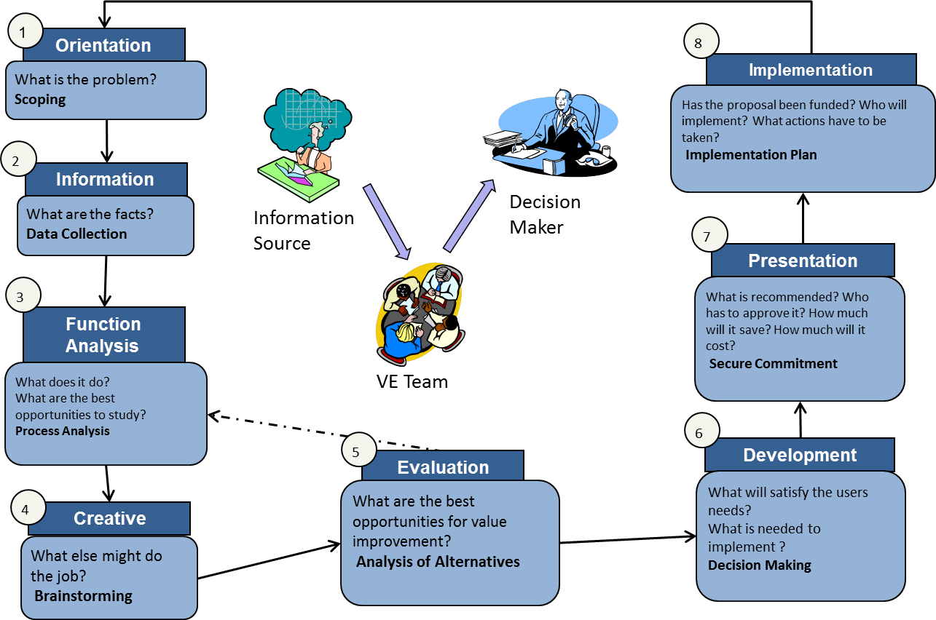
Value Engineering Methodology

Slide 8
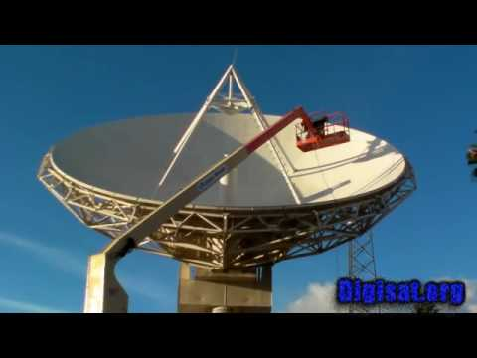
Example: Reuse Satellite Ground Stations
Orientation
  New satellite ground stations required unexpected infrastructure changes
Information
  Perimeter fencing and sewer lines had to be moved at significant cost
Function Analysis
  New ground stations needed to be on-site and capable of receiving new RF signal, but followed a standard architecture
Creative
  Existing ground stations on-site could be repurposed
Evaluation
  Existing ground stations had appropriate architecture and could be retrofitted for new RF
Development
  Savings claimed for difference between refurbishment cost and original build estimate
    Could have claimed cost avoidance for additional infrastructure costs
Presentation
  Decision was made to refurbish existing ground stations
Implementation

Slide 9
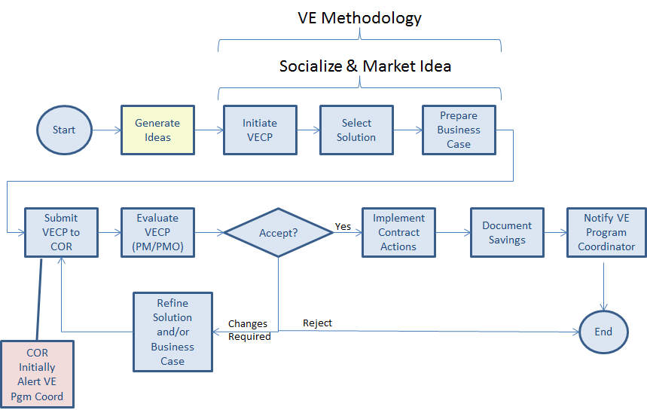
Value Engineering Change Proposal (VECP)

Slide 10
Service and Performance-Based Contracts
VE has rarely been successfully applied for services or service-based contracts
  In particular, performance-based contracts have not been addressed
However, the DoD is moving toward these types of contracts for acquisitions
At the same time, there is increasing pressure to lower costs
We have attempted to address this gap by implementing a VE program at a large, predominately service-based DoD information technology agency
The critical issue to address is finding incentives for contractors to participate in VE
The examples in this talk are based on US law and policy
They are intended to show the process improvement challenges that may occur and some ways to overcome them

Slide 11
Sharing Considerations
Whether the VE clause is the incentive or mandatory clause can alter basic considerations.
Mandatory
Government pays for:
  Idea generation (Request for proposal & Statement of work)
  Concept paper ($10-15K)
  Tech Interchange
  meetings pre-VECP
  Proposal prep costs
  ($30-$100K)
  Dev & Impl costs (Up front)
Contractor Incentive:
  25% of net savings (Firm fixed price)
  15% of net savings (Cost reimbursement)
Voluntary
Contractor pays for:
  Idea generation
  Concept paper
  Pre-VECP development
  Proposal prep costs
  ($30-$100K)
  Govt reimburses Dev costs
  and funds Impl $
Contractor Incentive:
  50% to 75% of net savings (Firm fixed price)
  25% to 50% of net savings (Cost reimbursement)

Slide 12

Types of Savings
Instant Contract Savings: net cost reductions on the contract under which the VECP is submitted and accepted.
Concurrent Contract Savings: net reduction in the prices of other contracts that are definitized and ongoing at the time the VECP is accepted.
Future Contract Savings: the product of the future unit cost reduction multiplied by the number of future contract units in the sharing base.
  On instant contracts, future contract savings include savings on increases in quantities after VECP acceptance that are due to contract modifications, exercise of options, additional orders, and funding of subsequent year requirements on a multiyear contract.
VECP
Implemented
Instant Savings
Future Savings
Current Contract with Vendor
Follow-on Contract with Vendor
Concurrent Savings
Current Contract with a different Vendor

Slide 13
VECP in Performance-Based Contracts
Performance-based contracts do not preclude VE
  When changes do not pay for themselves (or pay back enough) under the current contract, VECPs are still needed because they lock in savings on future contracts
  Even a negotiated sole source contract with option years does not lock in the savings for the contractor
  The government may require cost and pricing data before exercising an option
Use VECPs to increase profit, resolve problems, share in future savings, and to be more competitive

Slide 14
Innovative Uses of Contracts
(Incentives with Option Years)
Ex: Performance based contracts with option years may need to be cost and price certified before executing the option years.
Therefore any significant efficiencies that are not captured in a VECP will skew the cost/price data to be lower and not identify the savings.
Only a VECP will protect the company savings in the form of future savings for the option years and capture the data for VE yearly reports.
Dependent on VECP
VECP
Implemented
Instant Savings
Future Savings
Current Contract with Vendor
Follow-on Contract with Vendor
Notes:
Source:
Value Engineering Guidebook (Jun 2011) p. 137.
Analysis

Slide 15
Potential Technical VECP Triggers
In technology service contracts, advances in technology occur more frequently than in traditional non-technical product centered programs.
  Programing languages change/advance
  Operating Systems change
  Hardware technology refreshes
  Standards governing any of these may change
Redundant capabilities may be retired
  As software matures and new capabilities are added, there will be redundant capabilities available to users
Software may become obsolete
  Software designed for activities or missions that are no longer performed may be eliminated
VECP
Implemented
  Both situations require engaged management of the IT environment to recognize and act on these opportunities
Instant Savings
Current Contract with Vendor
Concurrent Savings
Dependent on VECP
Current Contract with a different Vendor

Slide 16
Conclusion
Value Engineering is a useful methodology for reducing costs
VE methodology has little precedent in a service acquisition organization
Incentives for contractors must be in place, well-understood, and supported by processes
Questions?

Slide 17
Backup

Slide 18
Potential Governance VECP Triggers
Compliance with:
  Laws, Regulations, and Policies
  Strategic Guidance
  Relevant Authoritative Architectures
  Technical Direction
Periodic Management Reviews of the Program
A change in the compliance requirements may drive a review that includes a VE effort
Notes:
Source:
DoD IEA v2.0 Volume II Description Document Final (06 Aug 2012) pp. G-3 – G-4.
VECP_Training_2013 slide 125.
Value Engineering Handbook (Sep 2006) p 35.

Slide 19
Potential Governance VECP Triggers cont.
For example, the Technical Direction includes the DoD IT Standards Registry (DISR). The DISR maintains a database of all technical standards that are defined as either Emerging, Mandated, or Retired.
When a technical standard within the DISR is redefined, all affected portfolios should review the standard for applicability and potential inclusion for VE savings:
  New Emerging Standards
  Emerging Standards changing to Mandated Standards
  Emerging/Mandated Standards changing to Retired Standards
Notes:
Source:
Analysis

Slide 20
Potential Technical VECP Triggers
Diminishing Manufacturing Sources and Material Shortages (DMSMS) have large potential for VE return on investments.
In technology service contracts, advances and changes in technology occur more frequently than in traditional non-technical product centered programs.
  Programing languages change/advance
  Operating Systems change
  Hardware technology refreshes
Cross portfolio VE efforts should be conducted when major technology changes occur
  (Windows 7, 64 bit systems, cloud based services, mobile services, etc.)
Notes:
Source:
Value Engineering Handbook (Sep 2006) p. 7.

Slide 21
Innovative Uses of Contracts
(Incentives with Share lines)
On cost under runs, the share line is normally only applicable to the current contract.
If a VECP is submitted during the under run period, future savings can be realized for the contractor, since the VECP innovation is locked in.
Otherwise the government will negotiate future contracts at the under run rate and the company will not receive the potentially eligible VECP future savings.
Dependent on VECP
VECP
Implemented
Instant Savings
Future Savings
Current Contract with Vendor
Follow-on Contract with Vendor
Notes:
Source:
VECP_Training_2013.pptx slides 114-115.
Value Engineering Guidebook (Jun 2011) p. 137.
FAR Subpart 16.401(a)

Slide 22
Literature Review
A review of twelve years worth of abstracts for white papers collected by the Society of American Value Engineers yielded no mentions of “performance-based” and only incidental mentions of “service”
  http://www.value-eng.org/
The Institute for Defense Analysis release “Value Engineering and Service Contracts” in 2009 to encourage VE use, but gave no concrete examples
  http://www.acq.osd.mil/se/docs/Value-Engg-Service-Contracts-IDA-Rpt-3733.pdf
  Mandelbaum, J., Merson, I., Reed, D., Vickers, J., Roark, L., Value Engineering and Service Contracts, Institute for Defense Analysis, June 2009
Carnegie Mellon conducted a study in 2004 that yielded 19 examples of process improvement in large-scale IT efforts
  Most focused on error-reduction
  Many just highlighted overall benefits of CMMI, a related process improvement concept
  None specifically used VE methodology
  Capell, P., Benefits of Improvement Efforts, Carnegie Mellon Software Engineering Institute, September, 2004.

Slide 23
Value Engineering History
Concept originated during WWII as a systematic approach to handling material shortages by Larry Miles – General Electric
1957, Navy’s Bureau of Ship Building established first formal VE activity
1959, Added to the ASPR (forerunner of today’s FAR)
1963, DoD established program
  In-house
  Incentive program for contractors
1988, OMB Circular A-131 issued
1993, OMB Circular A-131 mandated use of VE by all agencies
1996, National Defense Authorization Act of FY 1996 (P.L. 104-106, Sec. 4306), “Each Executive Agency shall establish and maintain cost-effective value engineering procedures and processes.”
2011, PL 111-350 reworded Title 41 on public contracts

Slide 24
Handbook of VE
Program Intent
VE Overview
Projects Requiring VE
VE Planning
Annual Portfolio VE Plan
Conducting VE Studies
Metrics, Reporting and Program Support
Quality Control / Quality Assurance
VE Training
Awards Program
Points of Contact
Acronyms, Definitions, Tools and Techniques

Slide 25
Roles and Responsibilities
Program/Project Manager or System Owner
    Define the overall goals and objectives for VE for their program/project/system
    Identify and execute annual VE activities
    Provide subject matter expertise and resources required to support VE activities
Value Engineering Program Coordinator
    Agency VE Program Coordinator (VEPC) and VE subject matter expert (SME)
    Oversees execution of Agency VE program in accordance with DoD guidance.
    Facilitates development of portfolio/directorate VE plans
    Validates and synchronizes portfolio/directorate VE plans; develops annual Agency VE Plan
    Monitors progress of VE Plan execution and develops annual VE metrics report for DoD.
    Develops and provides VE training
    Reviews VE activity with VEMs at a minimum annually and prior to Quarterly Portfolio Reprots; records current Agency VE activity
    Provides technical assistance to VE study groups and conducts Quality Assurance review of their products
    Assists VEMs with developing VE award nomination packages, validates nomination packages, coordinates award activities with MPS, and submits agency Director-approved packages to VE Management Advisory Group

Slide 26
Roles and Responsibilities
Value Engineering Manager
    Designated VE point of contact and VE SME within the assigned portfolio or directorate.
    Develops local VE processes to execute the program in accordance with the VE program.
    Develops and monitors execution of annual VE plans
    Monitors performance of VE study groups; keep VEPC informed on progress.
    Validates VE activities reported in Quarterly Portfolio Reports
    Provides VE updates to the VEPC to track current VE activities
    Participates in VE study groups, where appropriate
    Participates in VE study group decision briefs
    Builds VE award nomination packages, where appropriate
Value Engineering Study Team Lead
    Manages the study group and acts as the project manager for a specific VE study.
    Identifies subject matter expertise required to support the VE study.
    Works with stakeholders, to include the VEM, to align study activities with program/project, portfolio and Agency goals and objectives.
    Obtains any required technical assistance from the VEM or the VEPC
    Prepares the VE Decision Briefing and the VE study findings
Value Engineering Study Facilitator
    Works with the VE Study Team Lead to plan and conduct the study and meetings.
    Ensures meetings stay on track and that appropriate methods are used to conduct the study.

Slide 27
Annual VE Planning and Reporting
Programs/Projects/Systems define VE objectives for year
Portfolio/Directorate VEMs validate and synchronize portfolio/directorate goals and objectives
    VEPC validates and synchronizes portfolio/directorate VE plans and develops Agency VE Plan
Progress is tracked through Quarterly Portfolio Reports and Agency data repository
VEPC compiles and delivers the Annual VE Report to DoD
VEPC works with Portfolio VEMs to submit relevant VE projects for recognition by Agency and DoD

Slide 28
Training Modules
General
  One-hour online orientation brief for Agency-wide training
  Leadership-level overview briefing on VE
VEP
  Two-day VE methodology orientation with PEO MA
    Engage PMs on a specific and portfolio relevant topic.
  Identified and consolidated external VE training module links
    Defense Acquisition University (DAU) VE training modules.
VECP
  Contracting Officer Representatives (CORs) training
    Focuses on the contract implications of voluntary contractor-initiated VECPs.
  Contractor VECP training module
    Increase contractor awareness and voluntary VE participation.

