Slide 1

Evaluation of Assessment Methodology to Support
Combined Joint Task Force-Horn Of Africa
Cadets Greg Elgort, Eric Jones, Eric Kim, Taylor Mosera and Dr. John Farr
United States Military Academy
West Point, New York 10996-1776

Slide 2
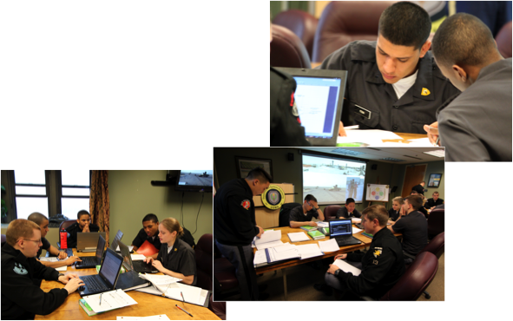
Agenda
Problem Definition
Overview of Current Assessment
Methodology
Proposed Assessment
Methodology
Kenya Study
Summary
Notes:
Photo taken from AFRICOM website

Slide 3
Problem Statement
Combined Joint Task Force - Horn of Africa (CJTF-HOA) is the only official permanent DoD presence on the continent of Africa and is responsible through AFRICOM for the assessment of US Government military activities. Through civilian affairs teams, open sources, other government agencies, etc., they are responsible for assessing how government projects contribute to security, improved governance, and economic development. They also contribute to the situational awareness as a key member of the US government team. The purpose of this research is to review and make recommendations of the current assessment methodology.

Slide 4
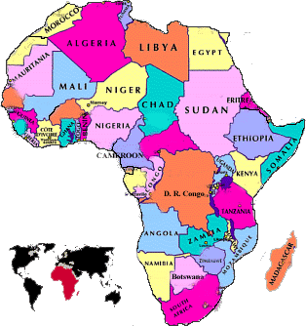
People
Country Background
Was colonized by the English
Gained independence in 1963
Only started allowing multiparty elections in 1992
Population: 41,070,934
6.3% has HIV/ AIDS (11th in world)
85.1% are literate
45% Protestant w/ 33% Roman Catholic
10% Muslim
10% Indigenous Beliefs
2% Other
Large amounts of corruption
  Government fails to control
Average income= $1,600 (197th in the world)
Unemployment Rate: 40%
50% below poverty line
Large amount of money from tourism
UK is #1 export partner
12% of imports from China, 6% from US
Kenya is of key strategic interest to the US

Slide 5
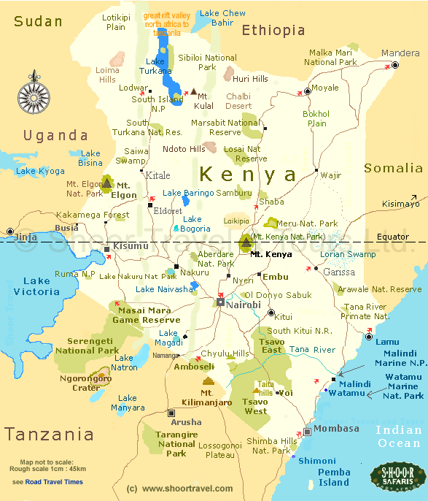
Background
Shares borders with many countries with emerging terrorists organizations
Buffer country between many unstable and stable governments
Emerging terrorist network
Predominately non Muslim
Corrupt but democratic government

Slide 6
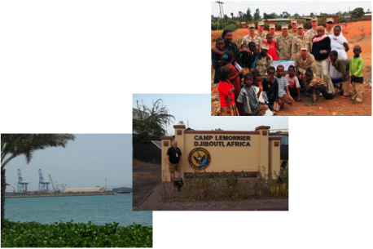
Agenda
Problem Definition
Overview of Current Assessment
Methodology
Proposed Assessment
Methodology
Kenya Study
Summary
Notes:
Photo taken from AFRICOM website

Slide 7
Assessment Methodology
MOEs and MOPs
  Quantitative/Qualitative
    MOEs (Measures of Effectiveness)
      Behavior, capability, or operational environment
    MOPs (Measures of Performance)
      Task performance
Assessment Process and Related Measures
  Relevant
  Measurable
  Responsive
  Resourced

Slide 8
Assessment Methodology
LtCol Mike Brown, JAWS AY07-08
Figure 1 – HOA Phase Zero Effects and Assessments

Slide 9
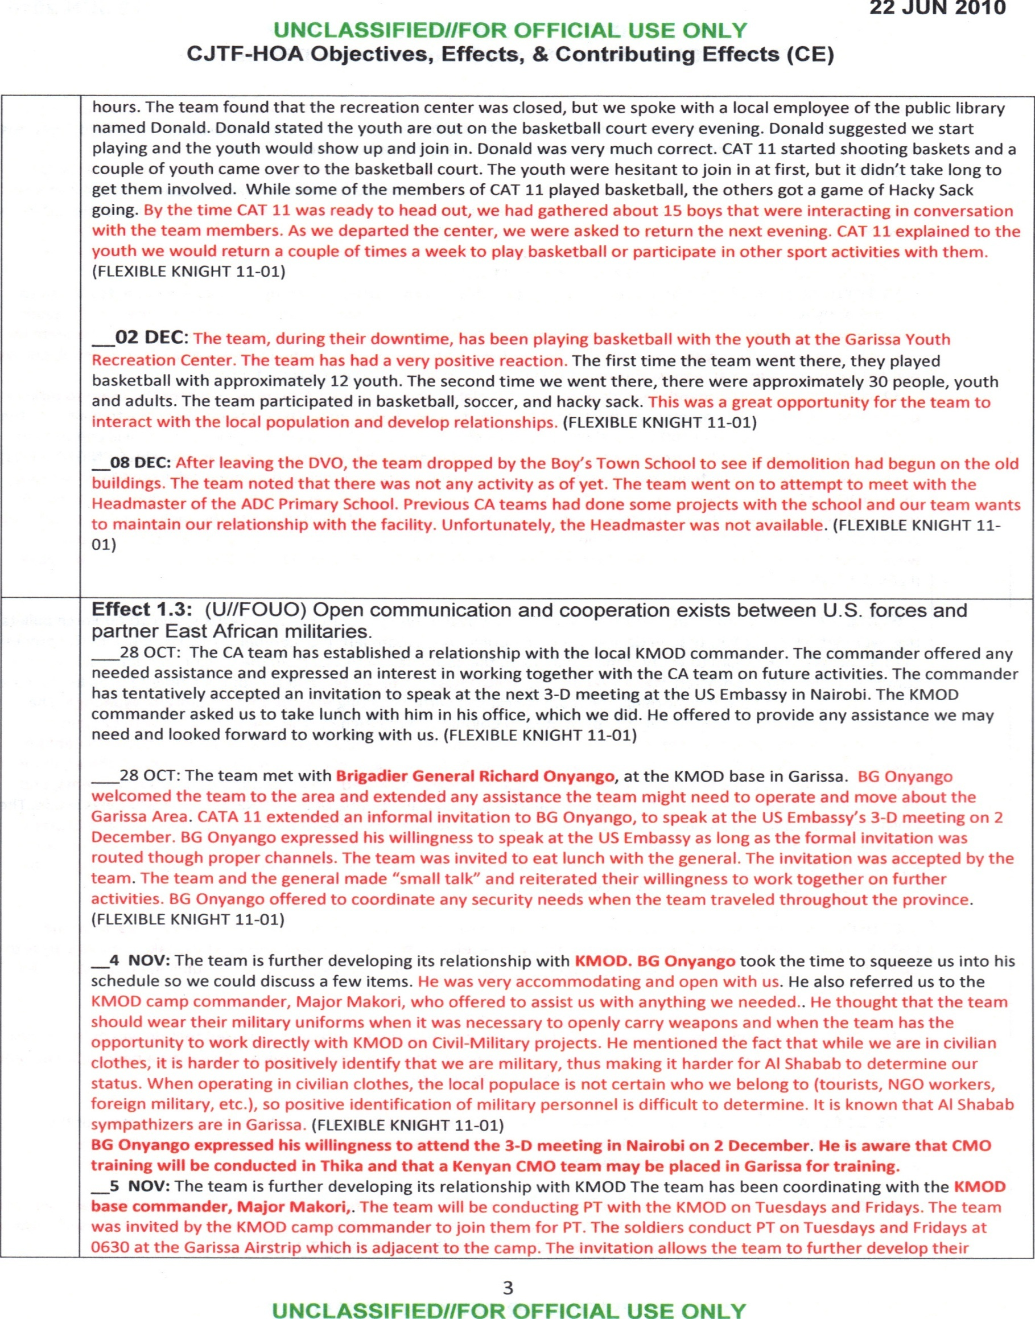
CJTF-HOA Objectives, Effects, and Contributing Effects
Assessment Methodology

Slide 10
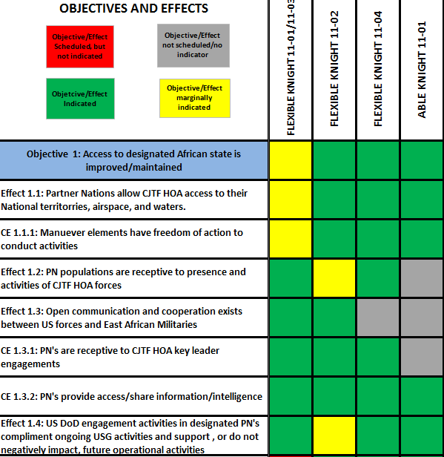
Color Code Objectives and Effects
Assessment Methodology

Slide 11
Assessment Methodology
Organization
  Objectives – Effects – Missions
  Quantitative Objective Measures
Un-weighted results of assessment are presented in Objective Results, Effect Results, and Written Description of Mission Summary
E | Significant Evidence
e | Some Evidence
C | High Confidence
c | Low Confidence
 | Significant Effect
 | Some Effect
 | Negative Effect
 | Insufficient Data

Slide 12
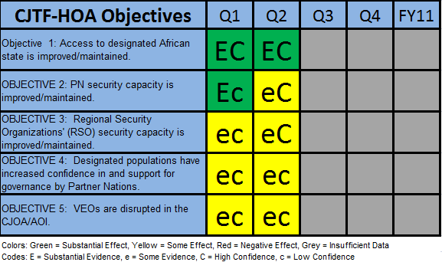
Summary CJTF-HOA Objectives
Assessment Methodology

Slide 13
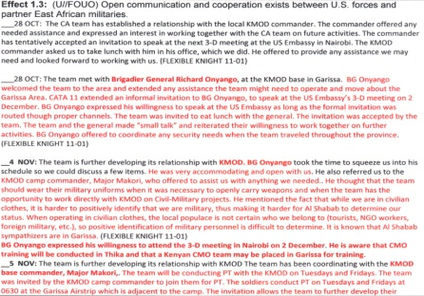
Assessment Methodology
CJTF – HOA Objectives, Effects and Contributing Effects Document
Color Code Objectives and Effects
(Kenya FY11Q1 & Q2 Encl Files)
Satisfy MOEs
Summary CJTF-HOA Objectives (E/C & Color Code Chart)
Notes:
Progress on the various effects were written into the CTFJ – HOA Objs, Effects and Contributing Effects Documents.
Progress of what was going on determined if they satisfied MOEs. These MOEs were then summarized in the Kenya FY11Q1 Encl 1 Doc.
Each effect was then color coded in respect to the amount of success the four different missions had.
The overall objective color code depended on the amount of each color there were.
Questions
Why is OBJ 2 in FY11Q2 changed to yellow when the OBJs and Effects sheet pretty much stayed the same and the status of OBJ 2 was still considered green?
Was there a quantitative way to come up with the overall color for the OBJs as well as the evidence?
Much of the effects all still have insufficient information according to the excel sheet, but document still has info and leader engagement information. Why was the assessment not made? Not much info? I.E. effect 2.1

Slide 14
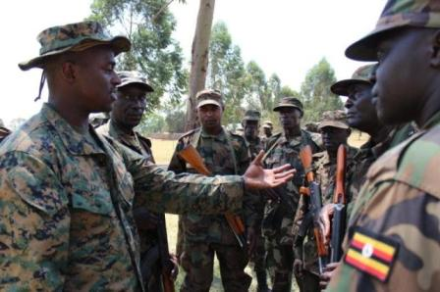
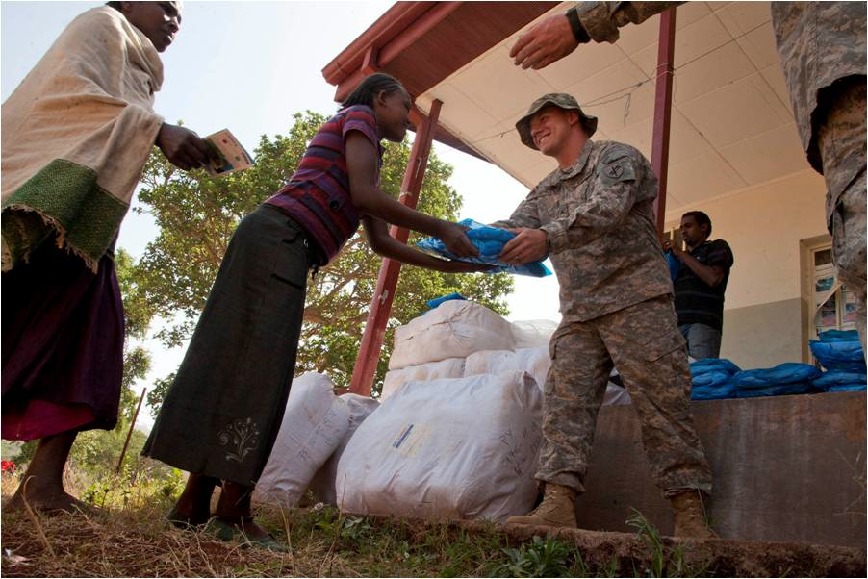
Agenda
Problem Definition
Overview of Current Assessment
Methodology
Proposed Assessment
Methodology
Kenya Study
Summary
Notes:
Photo taken from AFRICOM website

Slide 15
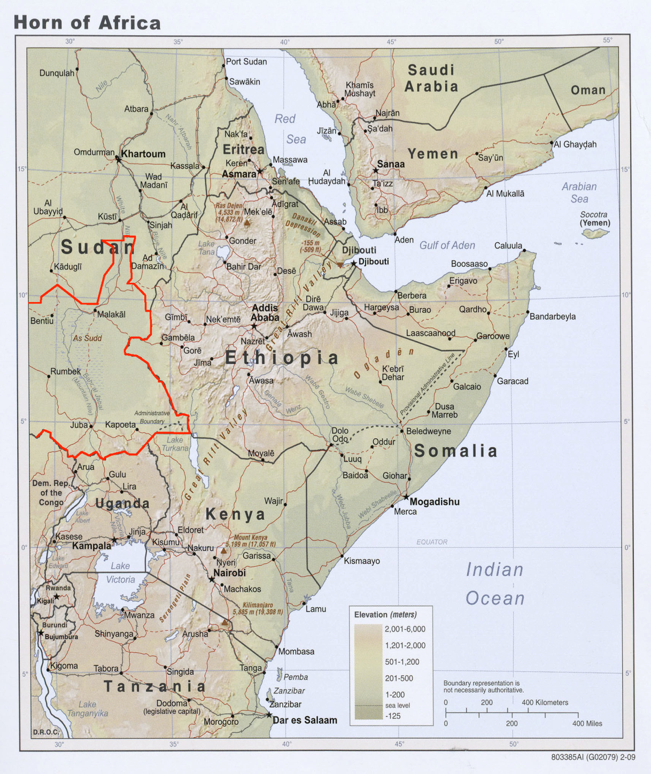
Solution Methodology
Will conduct analysis based upon regions.
How do we categorize a region?
What are the most important indicators of instability?
Eritrea
South
Sudan
Ethiopia
Somaliland
East
Kenya
Somalia
Uganda
West
Kenya
Tanzania

Slide 16
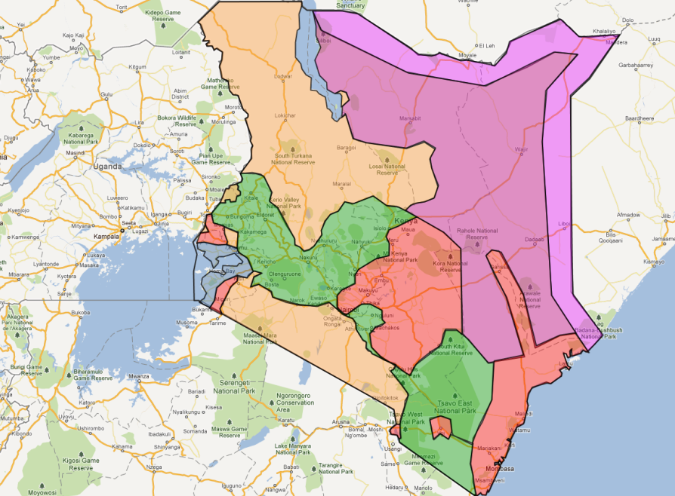
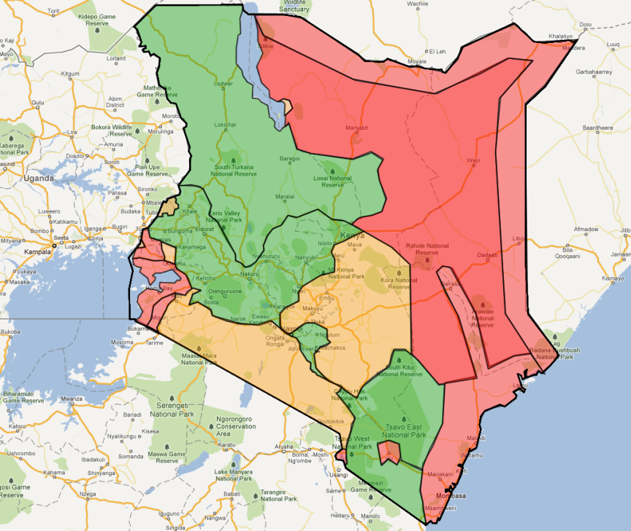
Solution Methodology
Ethnic Groups Map Recreation
Green – Area of extremely complex tribal and Ethnic mixtures
Red – Bantu
Orange – Nilo-Hamitic
Blue – Nilotic
Purple – Hamitic
Marginal Stability Example
Green – Positive Marginal Stability Index
Yellow – No Change in Stability
Red – Negative Marginal Stability Index

Slide 17
Proposed Assessment Methodology
Multiple Objective Decision Analysis (MODA)
Mathematical techniques we use to evaluate alternatives with sound operations research techniques
Provides a quantitative method for trading off conflicting objectives
Value Focused Thinking
An alternative-focused thinking in that a clear understanding of values drives the creation of alternatives
Values are principles used for the evaluation of actual or potential consequences of action and inactions, of proposed alternatives, and of decisions
Notes:
Photo taken from AFRICOM website

Slide 18
Proposed Assessment Methodology
A family of indices – economic development, stability, fragility
- Use open source or existing data
- Regional or national focus?
- Displayed using a color coded map or other visual means
Data
Methods
Processes
Tools
Measures and Metrics
Knowledge
Open Source
Existing
Weighted Scoring
Indices
Strategy
Actions
Policy
Notes:
Photo taken from AFRICOM website

Slide 19
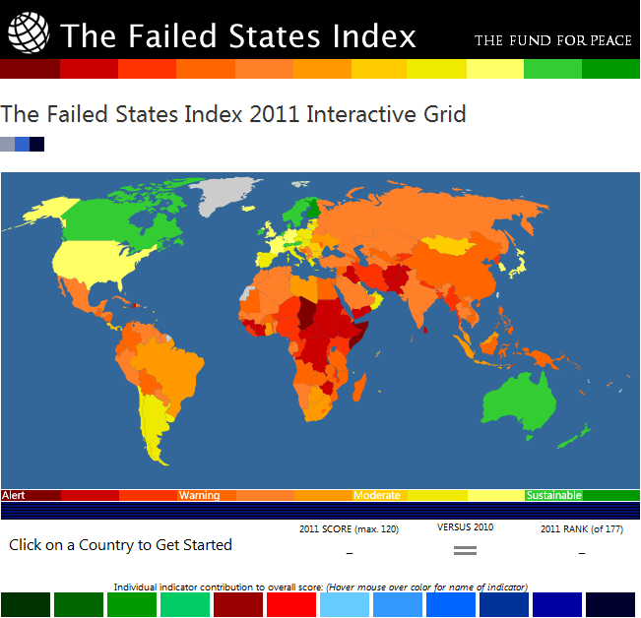

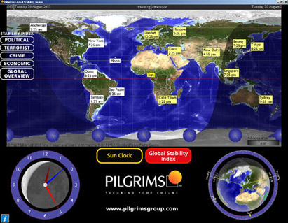
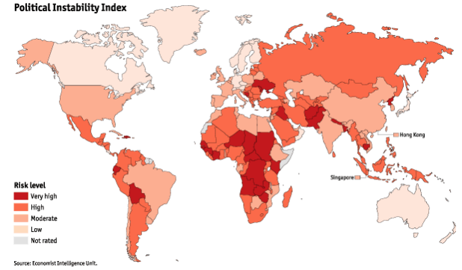
Existing Methodologies
Notes:
-All four measure the stability or lack there of by assigning a score to different value measures.
-Each have their or respected way of assigning scores and they all do not use the same value measures.
-All methodologies including ours agree: Kenya is instable but they are moving in the direction of stability

Slide 20
Systems of Systems Relationships
Systemigrams can be used to describe interdependencies to help structure problem

Slide 21
Value Model
The Value Model
  A mathematical model that takes statistics for each of the indicators developed as inputs and computes a value which when added to the other indicators values provide a total score indicating the likely progression of a conflict or greater instability in this case.
Qualitative Value Model
  The complete description of the stakeholder qualitative values, including the fundamental objective, functions (if used), objectives, and value measures.
Quantitative Value Model
  The value functions, weights, and mathematical equation used to evaluate candidate solutions.

Slide 22
Qualitative Value Hierarchy

Slide 23
Qualitative Value Hierarchy

Slide 24
Qualitative Value Hierarchy

Slide 25
Qualitative Value Hierarchy

Slide 26
Qualitative Value Hierarchy

Slide 27
Weighted Scoring For Indices
 |  | Importance of the Value Measure to the Decision Makers and Stakeholders
 |  | High | Medium | Low
Variation in Measure Ranges | High | Minimize Number of Terrorists Attacks Percent Unemployed | Size of Military Infant Mortality Rate Inflation Rate | Government IT Organization Labor Participation Rate
 | Medium | Percentage of Population below Poverty Line Corruption Index | Government Anti-terrorist Organization Citizens Killed or Captured by the Government Tourism Revenue Amount of Drugs Imported/Exported | Number of Attempted Acts of Piracy Investment Climate Ranking
 | Low | Life Expectancy Defense Budget Spending | Average Annual Income Education Spending HIV/AIDs Deaths per Year | Literacy Rate
V(a_{i}) =

Slide 28
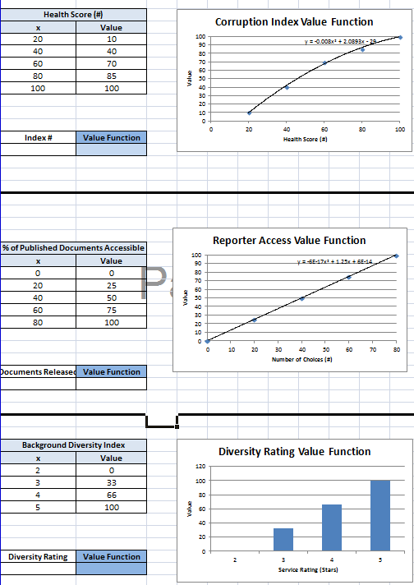
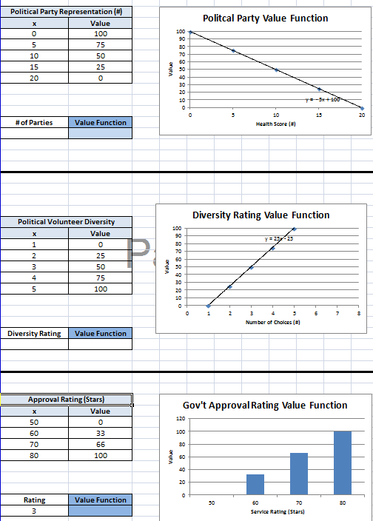
Value Functions

Slide 29
Weighted Stability Score
-Total value over 4 year period
-Kenya is becoming more stable since 2008

Slide 30
FFP Score Trended
Note the same shape as our stability model

Slide 31
Kenya Stability Profiler
Notes:
4 Quadrants
functions
2 value measures per function
The further from the center the more unstable
Ideal would be a small circle around the origin
4 years worth of data ‘07-’10

Slide 32
Stop Light Chart
Function | Sub-Function | Value Measure | 2007 | 2008 | 2009 | 2010
Governance and Politics | Military and Govt Corruption | Minimize Corruption Index (#)
 | Country Health Status | Minimize Infant Mortality Rate (Deaths/1000 Births) |  | NI | NI
 | Political Unrest | Minimize Citizens Killed or Captured by the Govt (#)
 | Parallel Beliefs, Goals, and Morals | Maximize Education Spending (% of Govt Budget) | NI | NI | NI
Economy | Strong Economy | Minimize Percent Unemployed (%)
 |  | Maximize Average Annual Income
 |  | Optimize Inflation Rate (%)
 |  | Maximize Investment Climate Ranking (#)
 | Private Sector Development | Maximize Tourism Revenue ($ Mil)
Social Well Being | Poverty | Minimize % of Population Below Poverty Line (%) |  | NI | NI
 | Conflict Between Ethnic Groups | Maximize Labor Participation Rate (%) |  |  |  | NI
 | Pandemic Influenza and Decease | Minimize HIV/AIDs Infection (Deaths/Year) |  |  |  | NI
 | Life Expectancy | Maximize Life Expectancy (Yrs) |  |  |  | NI
 | Education | Maximize Literacy Rate (%) |  |  |  | NI
-Level of change from year to year of value measures
-Level of change measured by the value’s score
-Red is least amount of change and Green is the most

Slide 33
Stop Light Chart
Function | Sub-Function |  |  |  | Value Measure | 2007 |  | 2008 |  | 2009 | 2010
Security | Terrorism |  |  |  | Minimize Terrorism Attacks (# of Attacks/Year) | NI |  | NI |  | NI | NI
 | Size of Military |  |  |  | Maximize Size of Military (% Military per Labor Force)
 | Defense Budget |  |  |  | Maximize Government Defense Expenditures (% of GDP)
 | Internet Monitoring |  |  |  | Existence of Cyberspace Monitoring Activity (Y/N)
 | Federal Force Protection Agency |  |  |  | Existence of Govt Anti-Terrorism/Force Protection Agency (Y/N)
 | Piracy |  |  |  | Minimize Attempted Acts of Piracy (# of Attempted Acts/Year)
 | Drug Trafficking |  |  |  | Minimize #vof Drugs Crossing the Border (1000 Kg Khat/Yr)
 |  |  |  | Description: |  | Frequency by Year:
 |  |  |  | = Value between 66 - 100 |  | 8 | 7 |  | 5 |  | 8
 |  |  |  | = Value between 33 - 66 |  | 6 | 6 |  | 8 |  | 7
 |  |  |  | = Value between 0 - 33 |  | 7 | 8 |  | 8 |  | 6
 |  |  | NI | = No Information Found

Slide 34
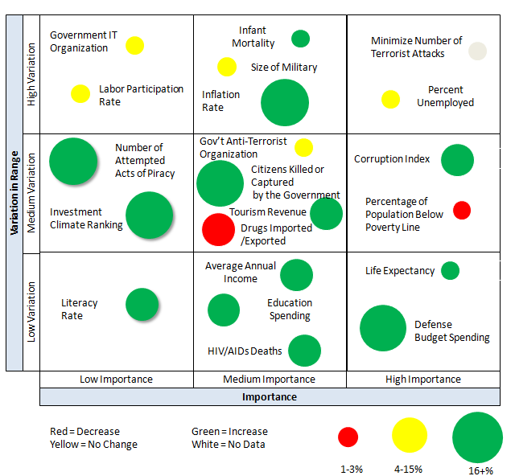
Bubble Chart

Slide 35
Agenda
Problem Definition
Overview of Current Assessment Methodology
Proposed Assessment Methodology
  Short Term Improvements
  Long Term Ideas
Summary
Notes:
Photo taken from AFRICOM website

Slide 36
Summary
We have reviewed the current assessment process per request of CJTF-HOA
Presented to CJTF-HOA who has asked for a demonstration by FEB 2012
Long term plans will lay the groundwork for further research on what is needed to asses all regions of interest in Africa
Input data must be easily obtainable to be useful
Validation data study needed
Need to incorporate civil affairs data collection abilities
Notes:
Photo taken from AFRICOM website

Slide 37
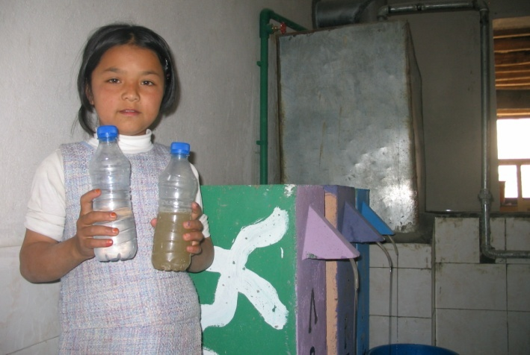
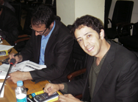
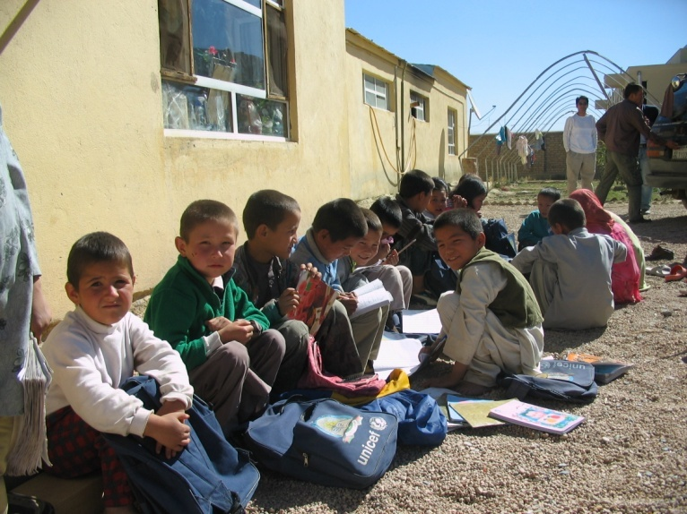
Questions?
Notes:
37

